Slide 1
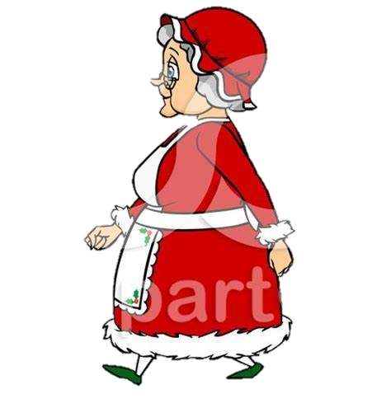
Mrs Claus the Christmas Hero
By Lily, Emma and Poppy

Slide 2
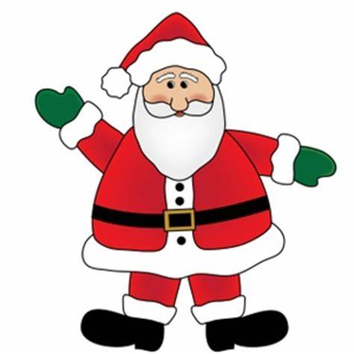
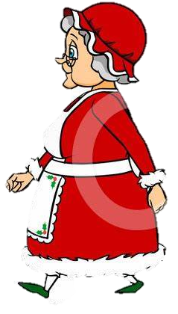
One snowy Christmas Eve, Mrs Claus was getting ready for bed but she forgot that Santa was sick.

Slide 3
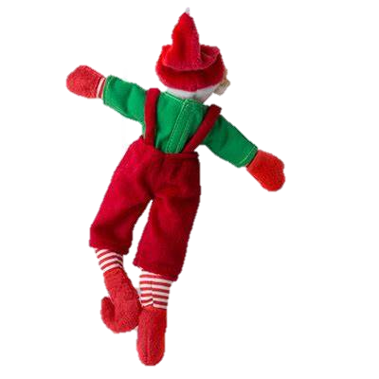
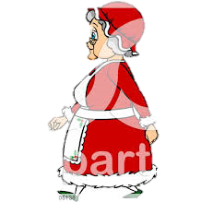
She was very nervous because she didn’t know if Santa could deliver the presents.

Slide 4
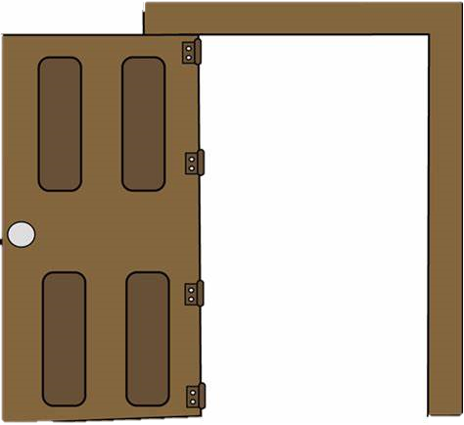
So she stopped getting ready for bed and put on Santa’s hat and rushed to the sleigh.

Slide 5
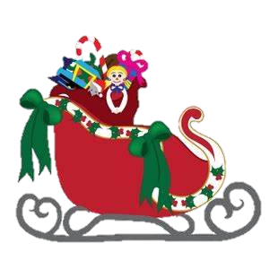
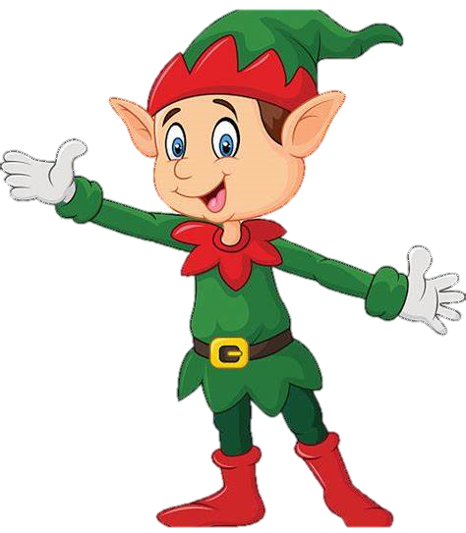
But Mrs Claus didn’t know how to get the sleigh to move so she asked an Elf.

Slide 6
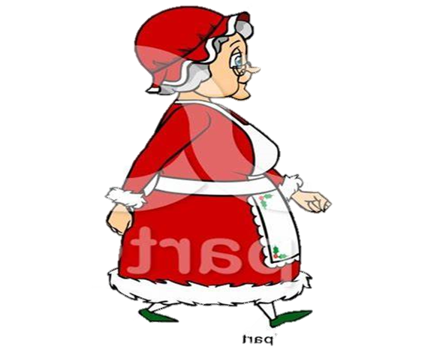
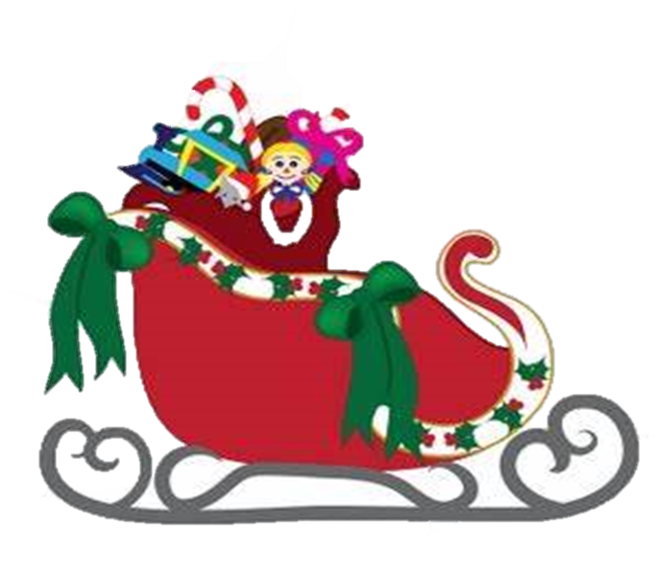
The Elf gave her the magic word and off she went flying in the sky.

Slide 7
The reindeer weren’t used to Mrs Claus flying the sleigh so they didn’t listen to her and guided her into a hole.

Slide 8
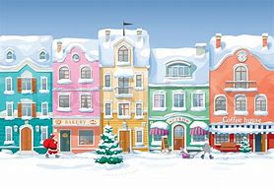
She eventually got out of the hole by using the magic word and continued to deliver the presents.

Slide 9
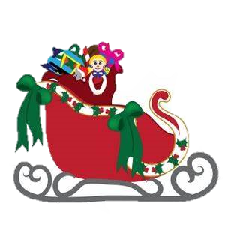
In Tobermore, she got stuck in the chimney of one of the houses.

Slide 10
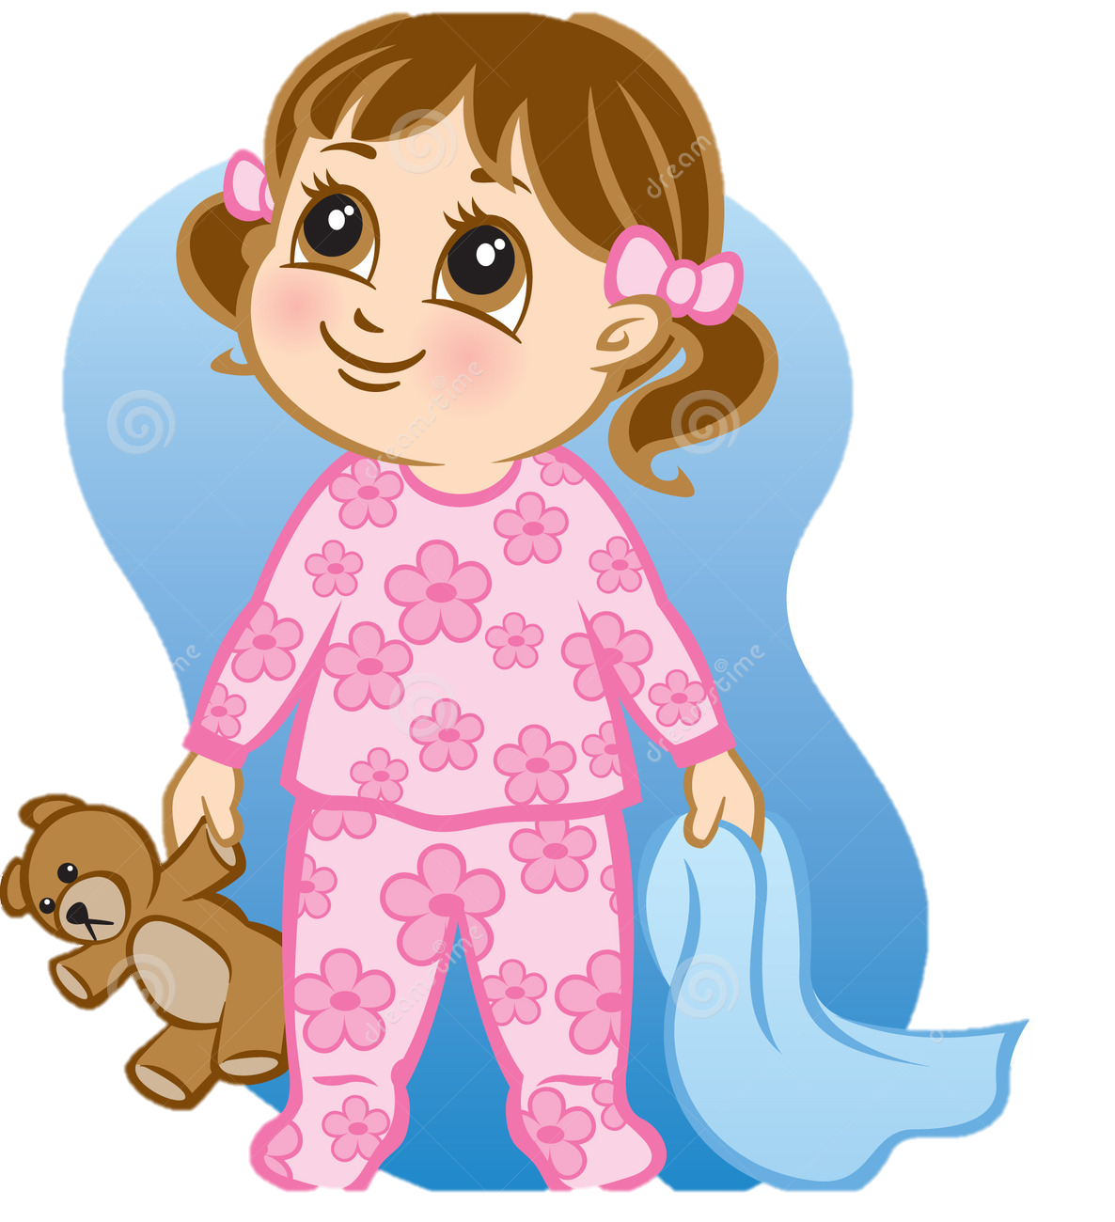
She shouted for help and the children in the house ran outside to see what the noise was.

Slide 11
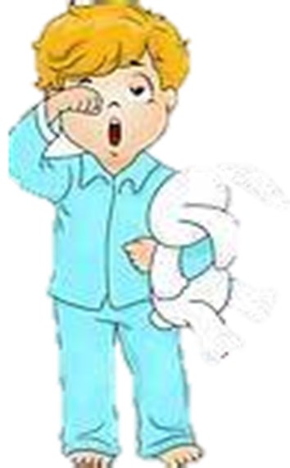
They got a ladder and pulled Mrs Claus out.

Slide 12
The children asked Mrs Claus why are you delivering the presents and not Santa?
Why are you delivering the presents and not Santa?

Slide 13
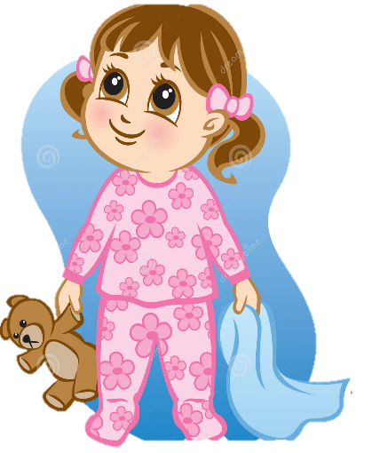
She told them that she was delivering the presents because Santa was sick.

Slide 14
The children told her that she was a Christmas hero.
You are a Christmas hero!

Slide 15
Mrs Claus went back to the North Pole and told Santa about her wonderful Christmas journey.

