Slide 1
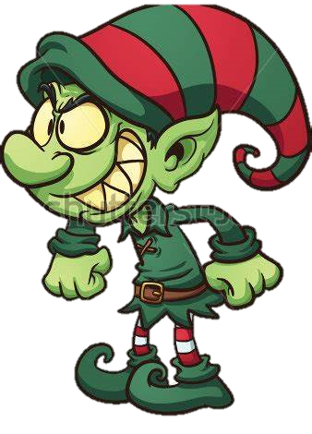
Noah the Evil Elf
By Noah P.7 Charlie P.6 and Alex P.5

Slide 2
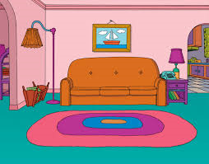
One Snowy Christmas Eve, Charlie and Alex were going to bed. They were so excited and they could not wait until morning.

Slide 3
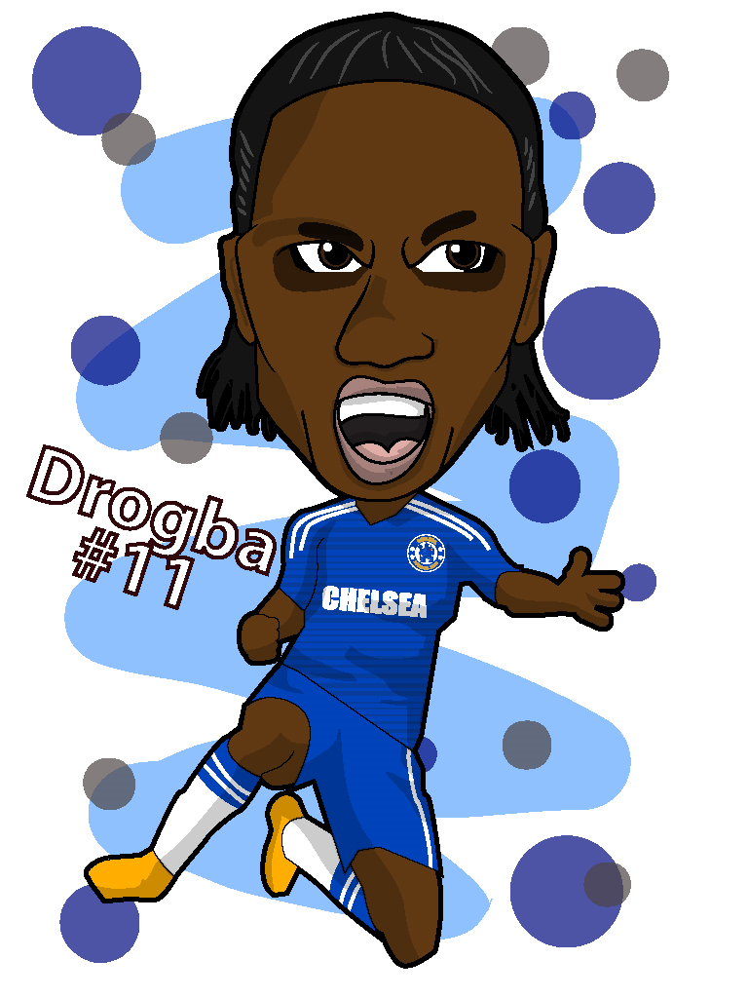
Charlie and Alex woke up but when they went downstairs there were no presents! They were very confused.

Slide 4
They saw a note which said, “Sorry you have no presents, but I have taken them all!” This note was signed by Noah The Evil Elf.

Slide 5
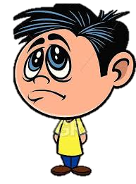
Charlie and Alex were so cross and started to get upset.

Slide 6
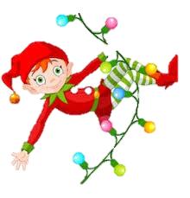
All of a sudden there was a magical spark and a nice elf appeared.

Slide 7
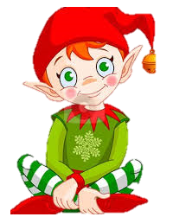
He said, “I heard you lost all of your presents. Do you want to come with me to the North Pole and get them back?”

Slide 8
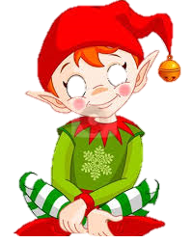
The boys agreed and they all disappeared.

Slide 9
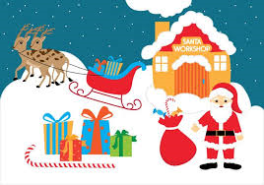
They got to the North Pole and told Santa their problem.

Slide 10
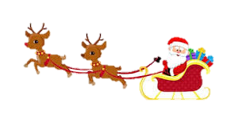
Santa said he would help and they went looking for Noah the Evil Elf.

Slide 11
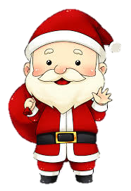
Eventually they found Noah with all the presents in the sleigh.

Slide 12
Santa told Noah to give the presents back and that taking presents from others wasn’t the true meaning of Christmas.
Why are you taking presents from little children you older than them.

Slide 13
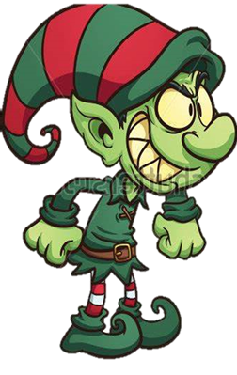
Noah gave them back and ran away as he was very embarrased.

Slide 14
Santa gave all the presents back to the children and saved Christmas. Both Charlie and Alex thanked Santa.
Thanks Santa

