Slide 1
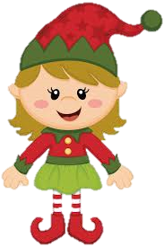
The Elves’ Magic Star!
Enjoy!
By Bobby Courtney & Shania

Slide 2
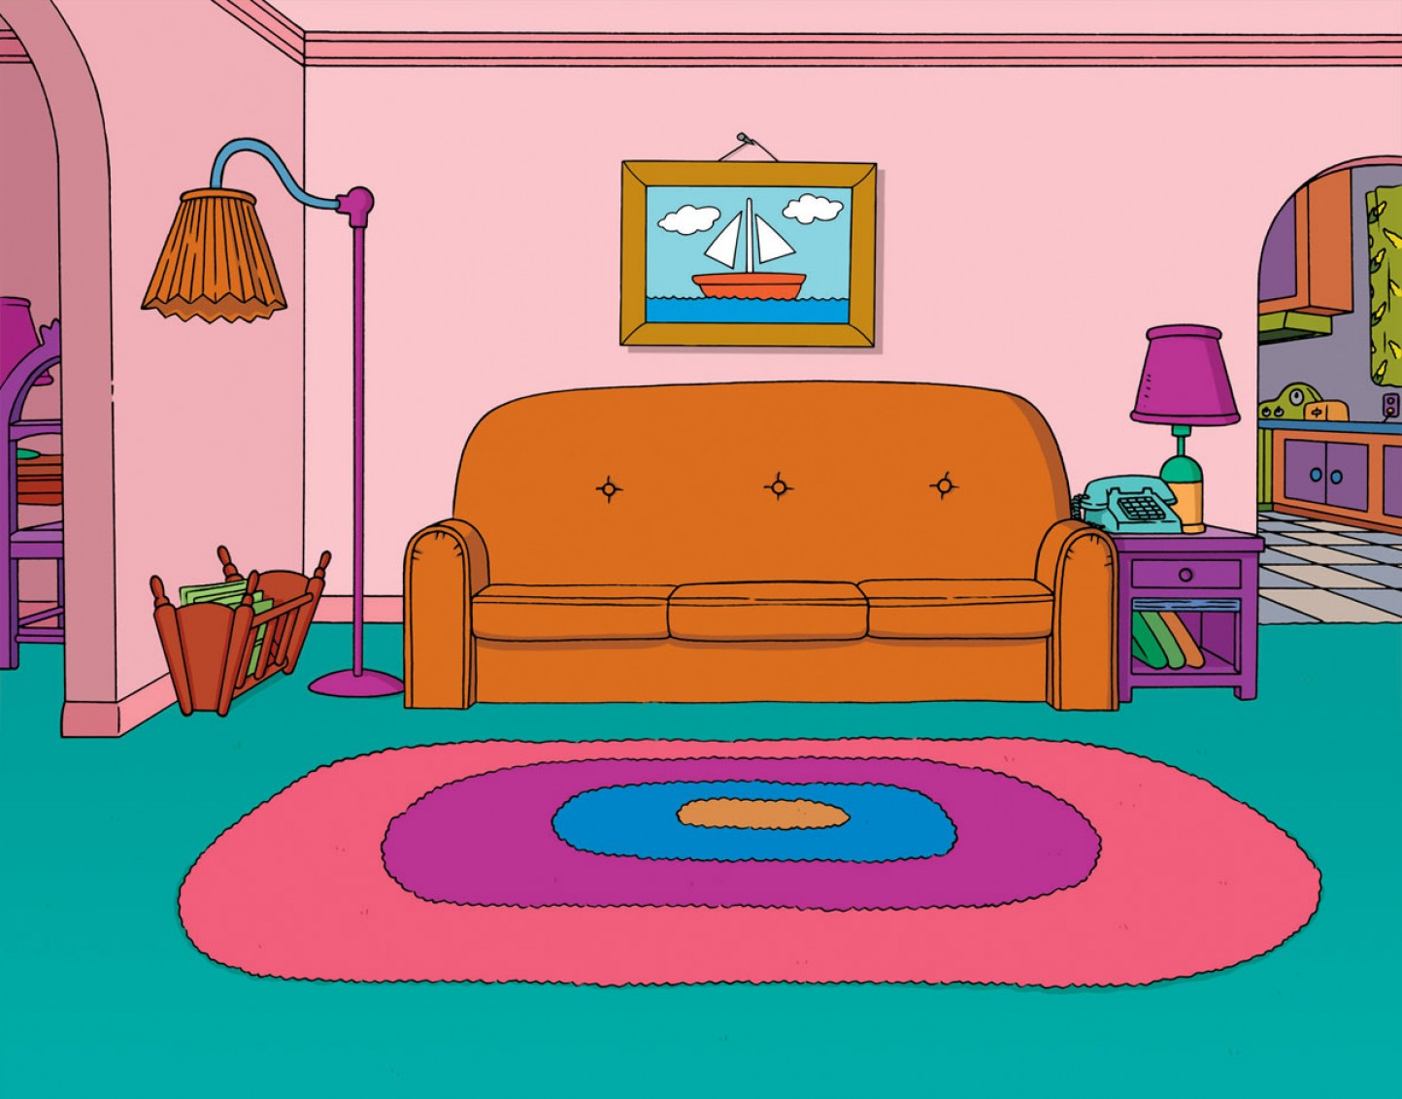
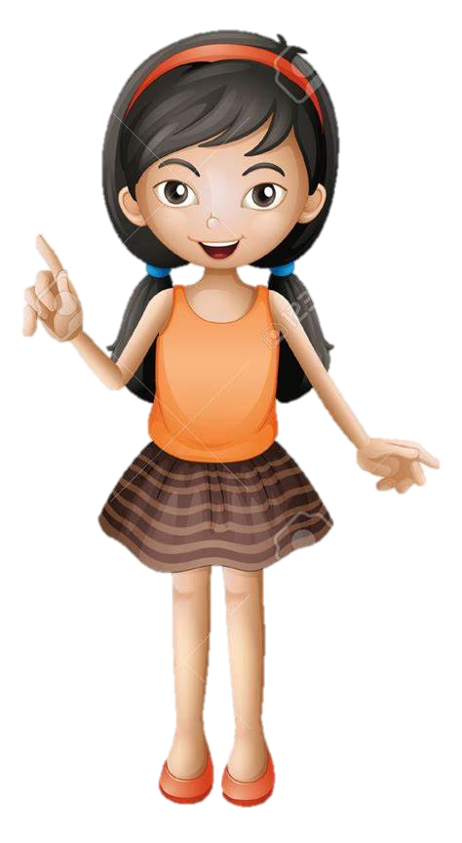
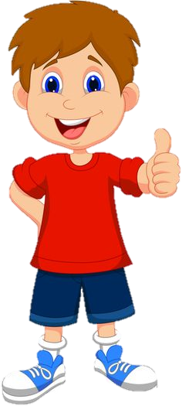
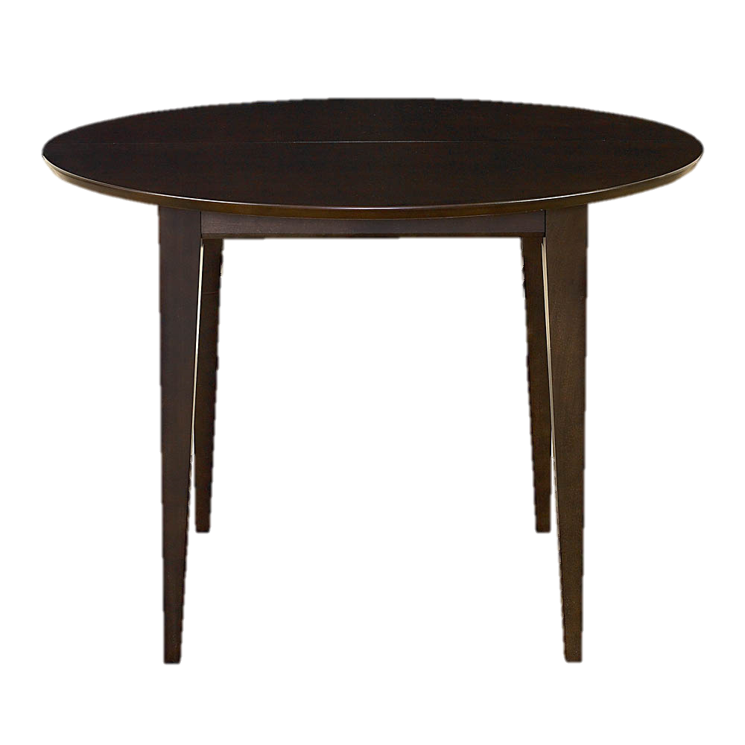
One cold snowy Christmas Eve night, Jasmine, Jessie and John were getting ready to go to bed.

Slide 3
Jessie left out the cookies, milk and carrots. Then they ran upstairs and jumped into their beds.

Slide 4
Half way through the night they went downstairs to see if their presents were there yet, but what they saw wasn’t quite what they expected…

Slide 5
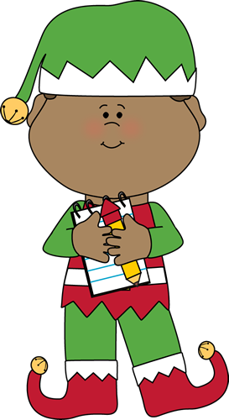
They saw an elf with a star and the star from their tree was gone! They thought that he took it, so they tried to get it back.

Slide 6
They didn’t realise it wasn’t their star but the elves magic star!
This is my Magic Star!

Slide 7
The children took the star, ran upstairs and locked their bedroom door but the elf was chasing them.

Slide 8
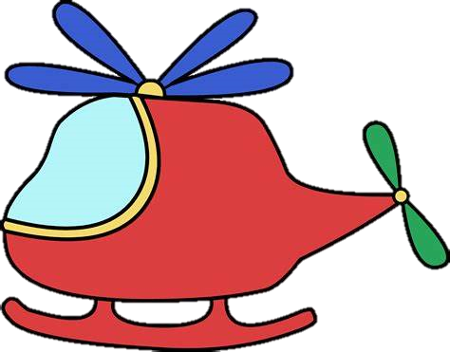
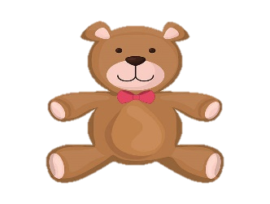
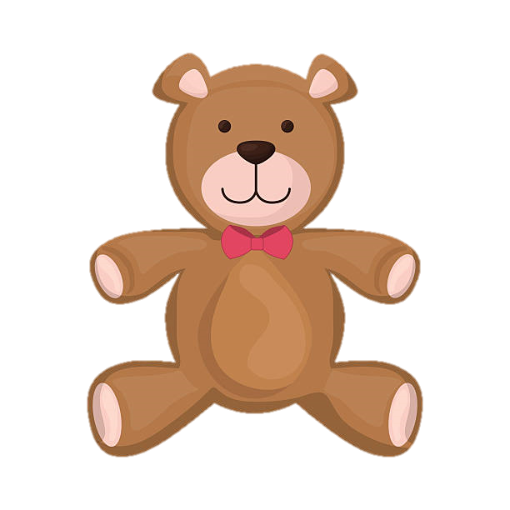
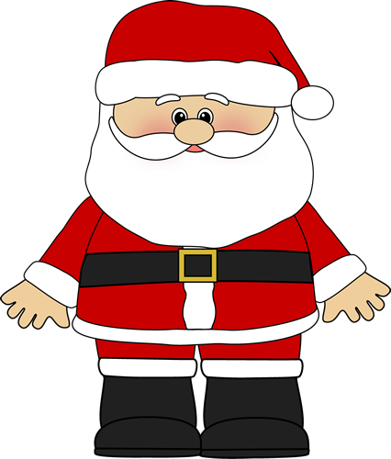
In a panic, they touched the top of the star and got teleported to Santa's Workshop.

Slide 9
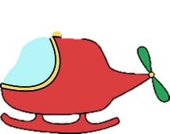
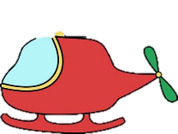
They didn’t know where they were until they saw Santa staring at them. He was surprised to see humans in his workshop.

Slide 10
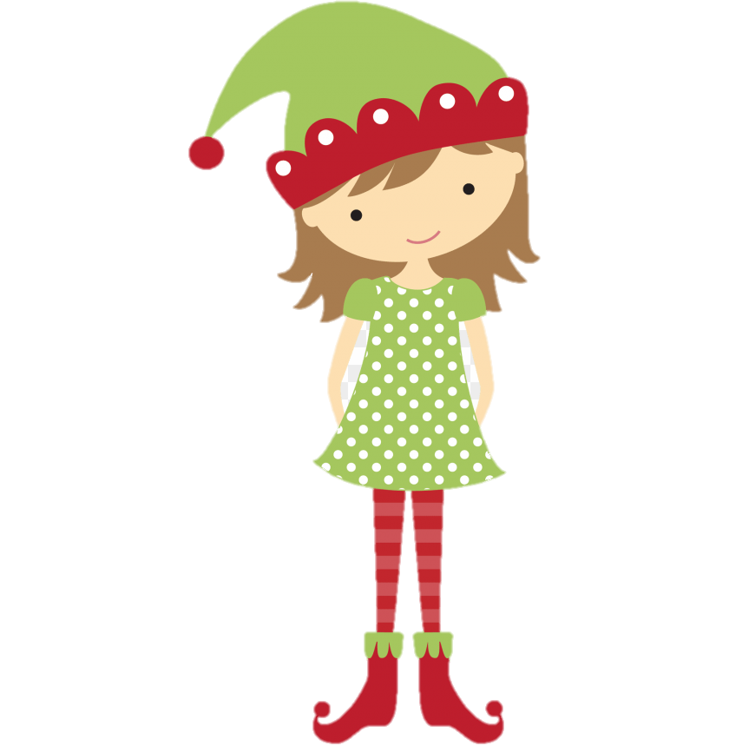
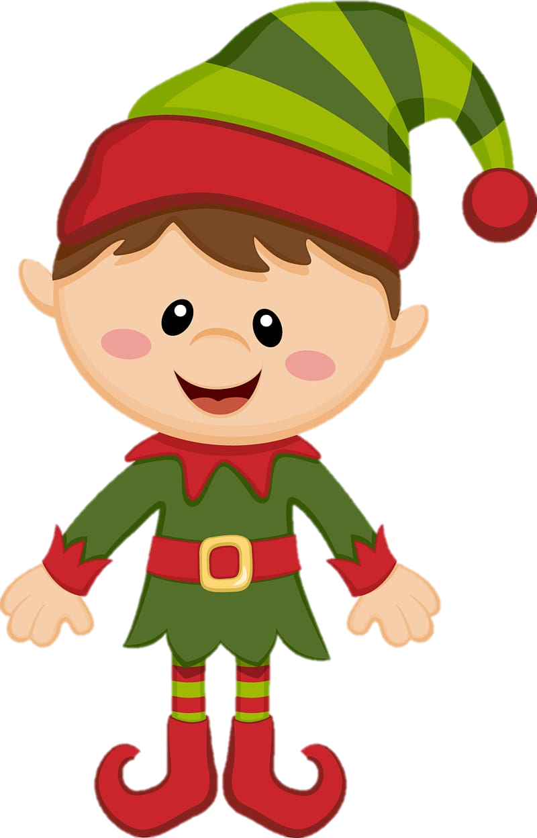
Santa got all the elves together to make sure the children didn’t bring any harm to them or the toys.

Slide 11
Santa asked the children how they got there and they all said they didn’t know.
How did you get here?
We don’t know!

Slide 12
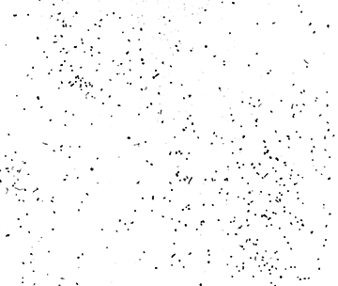
Santa had an idea, he sprinkled magical dust over the children and they got teleported back home.

Slide 13
On Christmas morning they woke up, ran downstairs, saw loads of presents and a letter from Santa saying, “Merry Christmas.”

