Slide 1
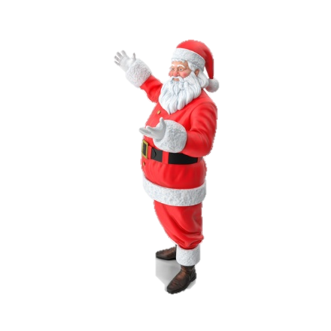
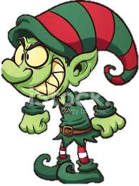
The Evil Elf That Tried To Ruin Christmas

Slide 2
One cold Christmas Eve, an Evil Elf called Grumpy decided that he didn’t want all the children to get their presents because he never got any.
No one’s going to get their presents this year,
HAAAAAA!!!

Slide 3
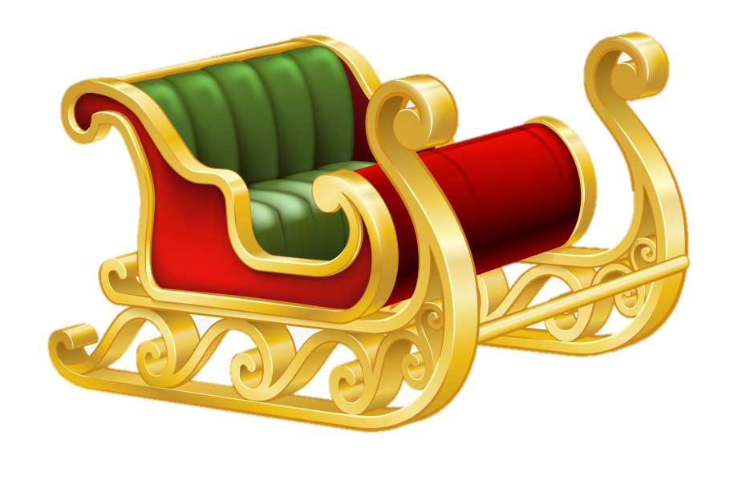
Grumpy went to Santa and said, “ You won’t be able to deliver the presents to the children because your sleigh is not working.” Santa did not believe him and went to check for himself.
It is working!!

Slide 4
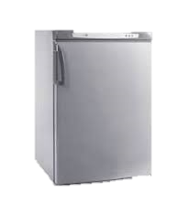
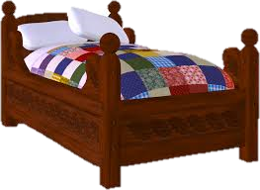
Santa couldn’t believe that the elf would lie to him so he went to his bedroom to get changed into his red suit. When he got there it was gone.

Slide 5
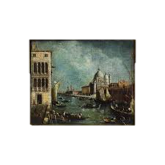
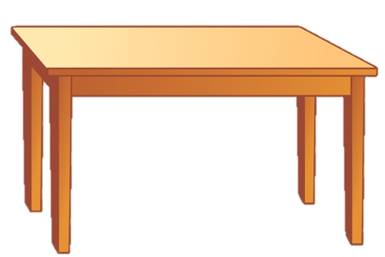
Santa marched down to Grumpy the Elf’s lair to see if he had taken the suit. When Grumpy let Santa in, he saw the red suit on the sofa in the living room.

Slide 6
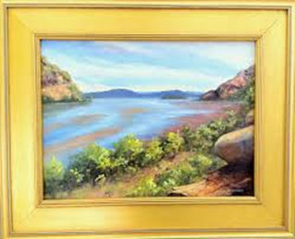
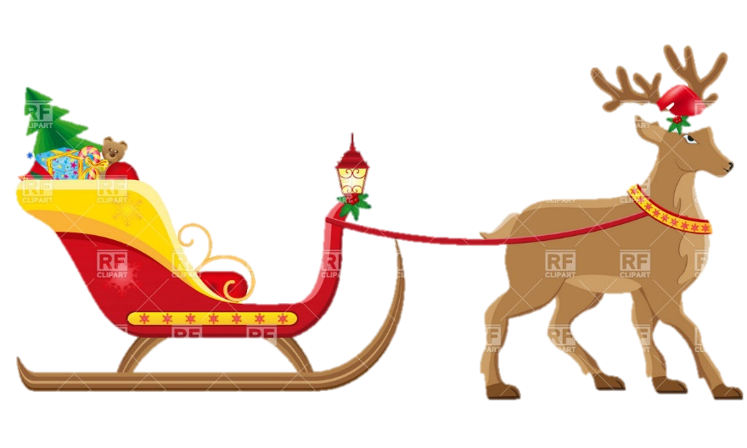
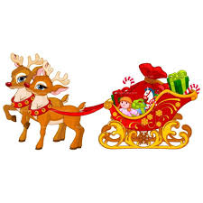
Santa quickly put on his suit and ran to his sleigh. He put the presents in and got the reindeers ready.

Slide 7
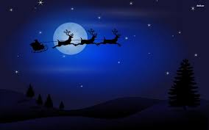
Santa jumped into the sleigh and rode off into the night sky to deliver the lovely presents to all the nice children.

Slide 8
When Santa finished delivering the presents he came back to his workshop. Santa got out of the sleigh and Grumpy the Evil Elf jumped in and took off into the sky.

Slide 9
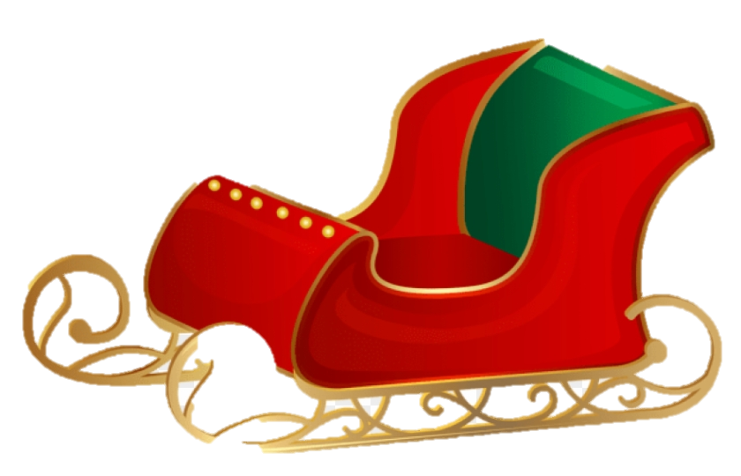
Now that Grumpy was heading towards the houses, Santa had to go to his backup sleigh that could fly without reindeers.

Slide 10
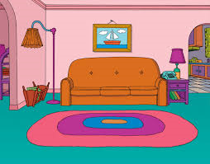
Grumpy arrived at a little girl’s house called Sophia, ready to steal her presents. Santa wasn’t going to let that happen.

Slide 11
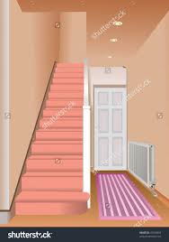
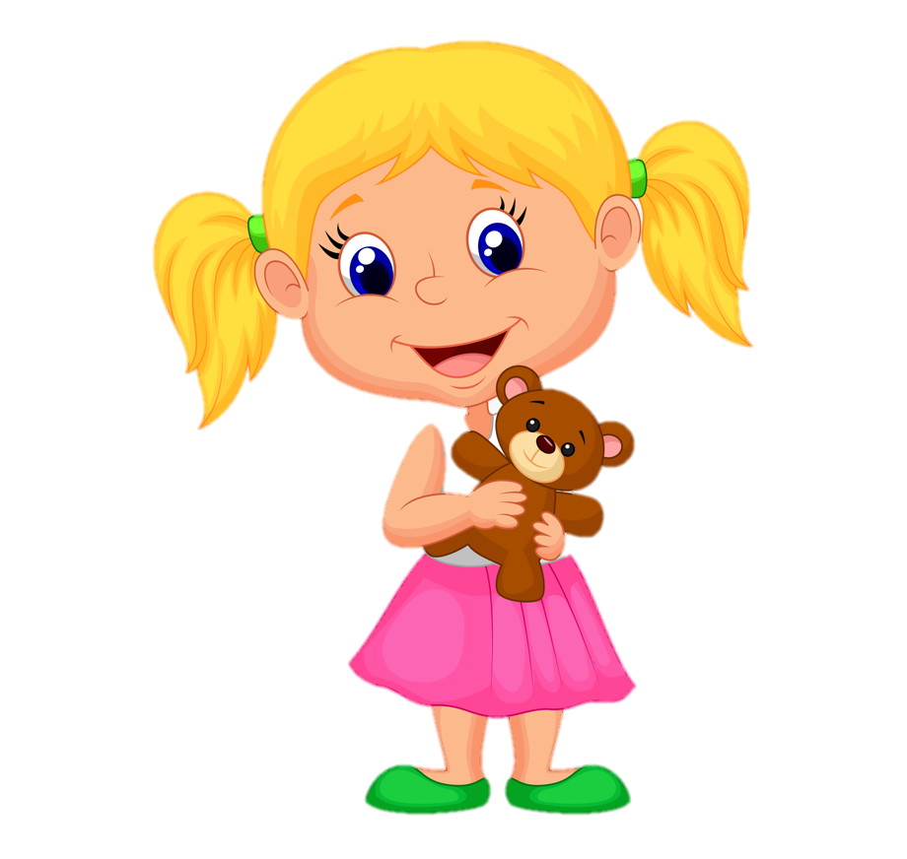
When Grumpy came down the chimney, he made a loud noise which woke up Sophia. Sophia came down stairs and saw the Evil Elf lying at the bottom of the chimney.

Slide 12
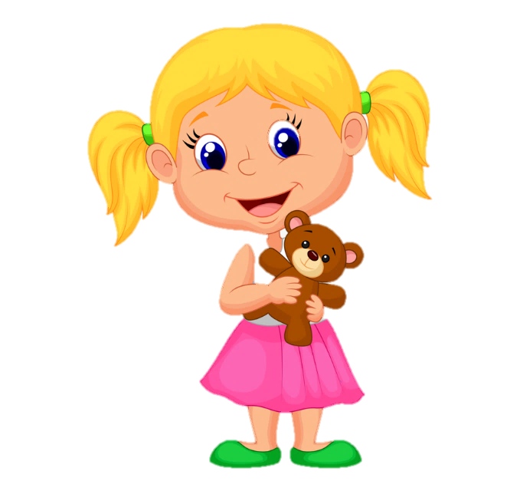
Next Grumpy said to the little girl, “I’m going to steal all your presents.” Sophia explained, “No, I’ve been a good girl.”
No I've been a good girl.
I'm going to steal all your presents.

Slide 13
All of a sudden, Santa came down the chimney and said “Grumpy get back to my workshop, you’re in big trouble.”
Get back to my workshop, you're in big trouble.

Slide 14
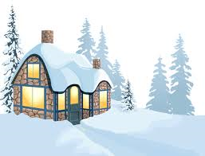
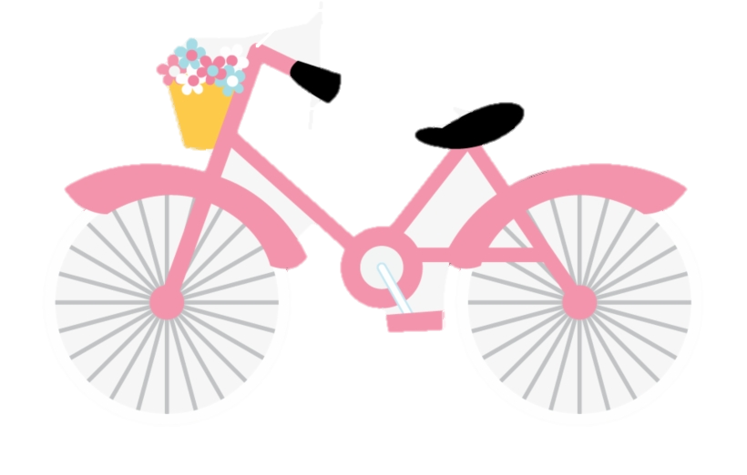
Then Sophia said, “Thank you Santa.” Santa then gave her a special present which was a bike . Then Santa left and went back to his workshop.
Thank you Santa!

Slide 15
THE END Byby

