Slide 1
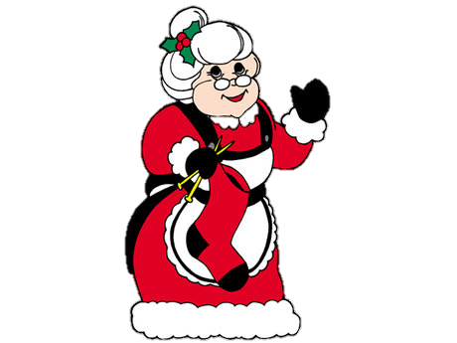
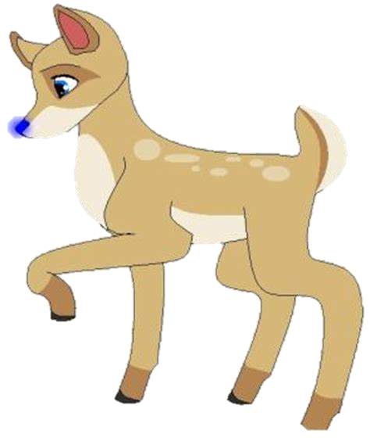
The Worrying Christmas Eve
By Harry Kimberly and Chloe
Enjoy

Slide 2
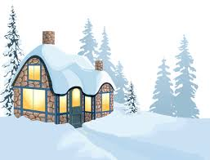
One Christmas Eve, Jessica and Joel were playing in their garden.

Slide 3
Suddenly there was a loud noise. They looked in the sky and saw Santa in his sleigh.

Slide 4
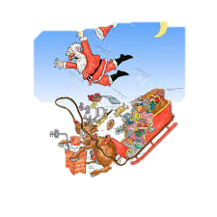
Then they heard Santa shouting, “Help! Help!” After hearing this they rushed to help Santa.

Slide 5
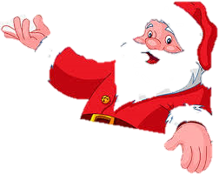
Joel and Jessica wondered what to do, then Santa said, “Rudolph has a brother called Buddy, the blue nosed reindeer.”
Rudolph has a brother called Buddy , the blue nosed reindeer

Slide 6
When they got up to the top of the roof, Santa said that Rudolph had hurt his leg.
Rudolph has hurt his leg!

Slide 7
So Santa told Jessica and Joel to get into the sleigh to go and get Buddy in Iceland.
Get into the sleigh and go get Buddy in Iceland.

Slide 8
When Jessica and Joel arrived in Iceland. Joel told Buddy that Rudolph had hurt his leg. Buddy was sad to hear this awful news.
Rudolph has hurt his leg.

Slide 9
When they reached the kitchen Mrs Claus made some cookies and hot chocolate for the children.

Slide 10
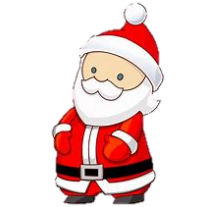
When they drank all the hot chocolate and ate all the cookies, Santa came in and told them that they had to go home.
Time to go home.

Slide 11
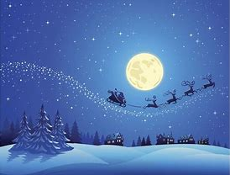
The children jumped in the sleigh and flew home with Santa, Buddy and all the other reindeer.

Slide 12
When Jessica and Joel woke up the next morning, they went downstairs and realised they had got extra presents, with a letter saying, ‘Thank you Jessica and Joel.’

