Slide 1

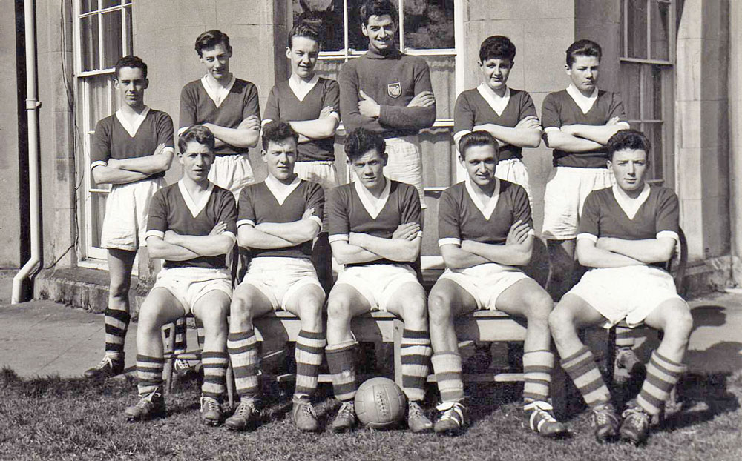
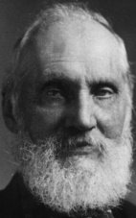
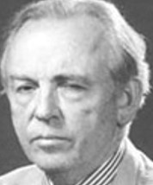
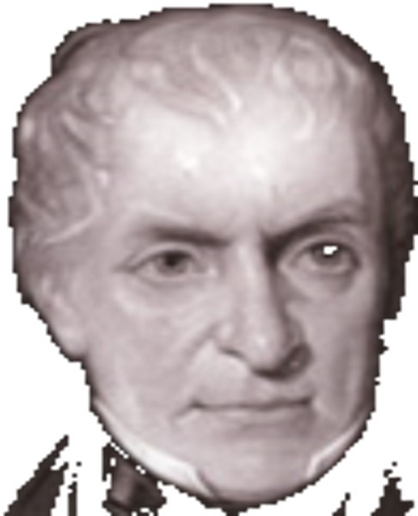
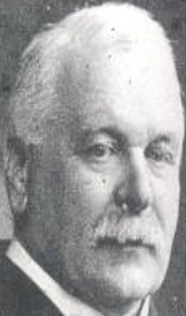
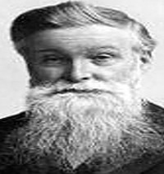
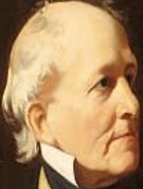
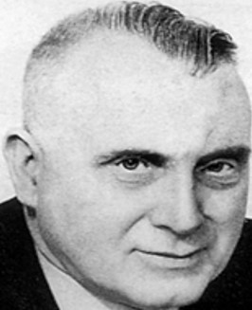
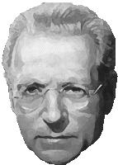
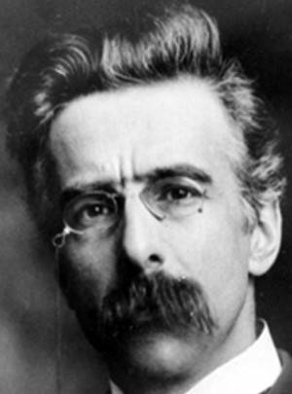
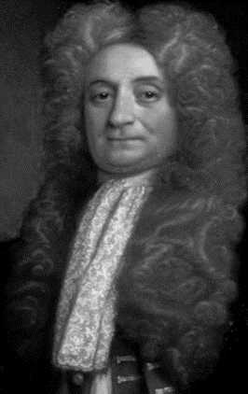

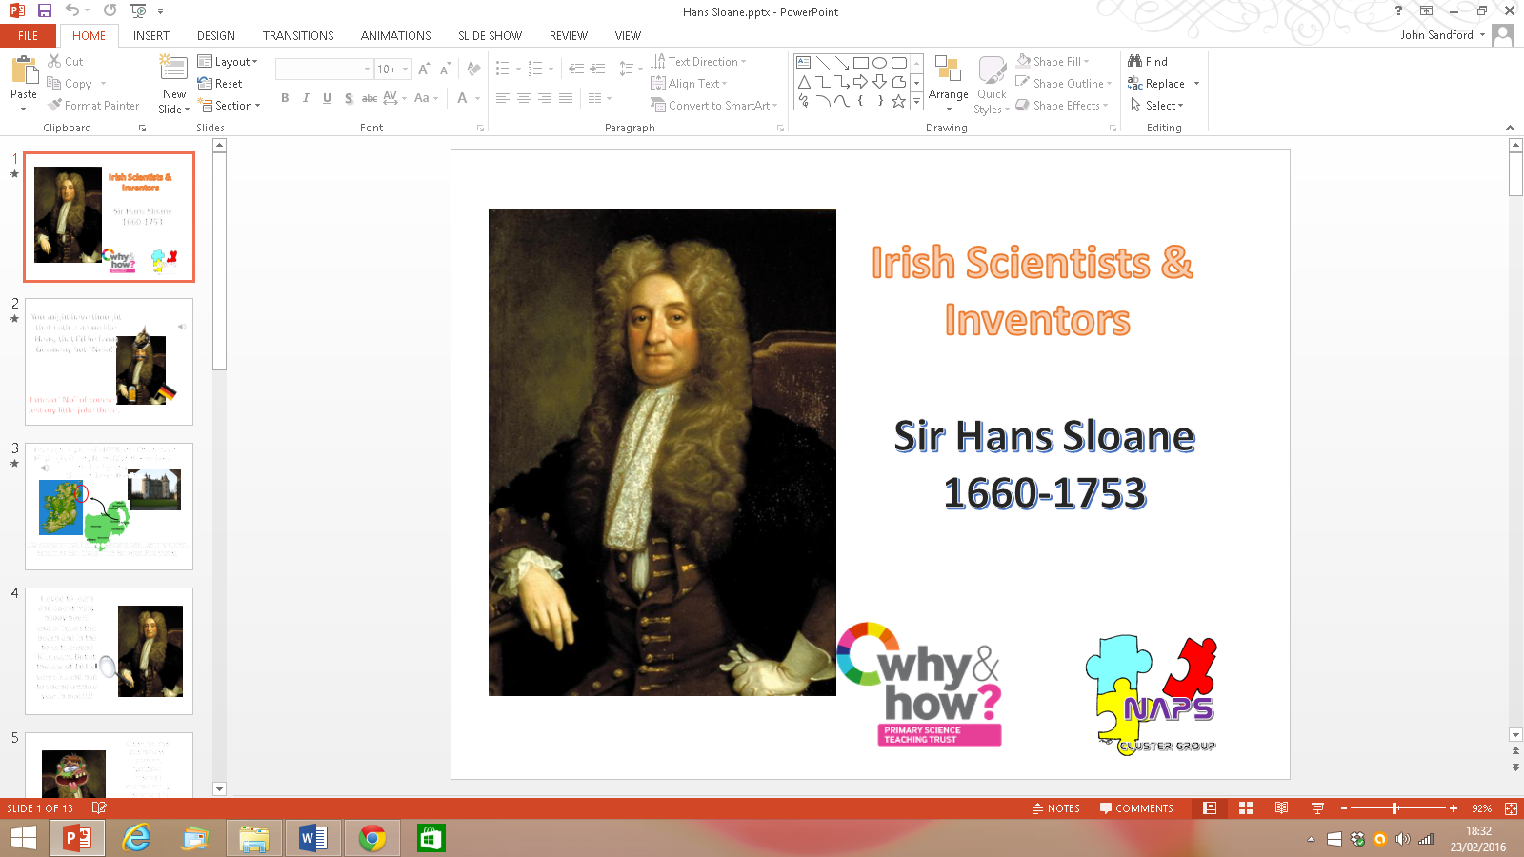
Irish Scientists - The First XI
A Project of The Newtownards Area Primary Science Cluster

Slide 2
John Joly and his Amazing…
‘Joly Colour Process’

Slide 3
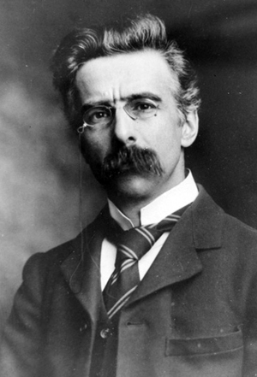
Hello there, my name is John Joly. This is a picture of me and as you can probably tell I lived a long time ago. That’s why I don’t look too ‘jolly’ in the picture. For you see, people in the olden days didn’t tend to smile for photographs!

Slide 4
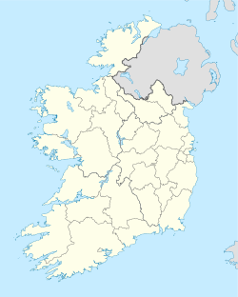
A little bit about me…
I was born on 1st November 1875 in Bracknagh, Co Offally (It was called King’s County in my day).
I studied hard at school and went to university at Trinity College in Dublin. I loved it so much that I became a Professor and worked there until I died in December 1933. During my life…

Slide 5

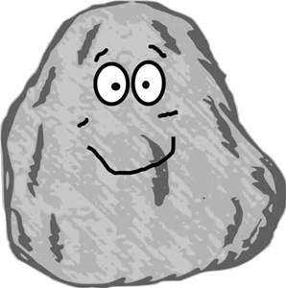
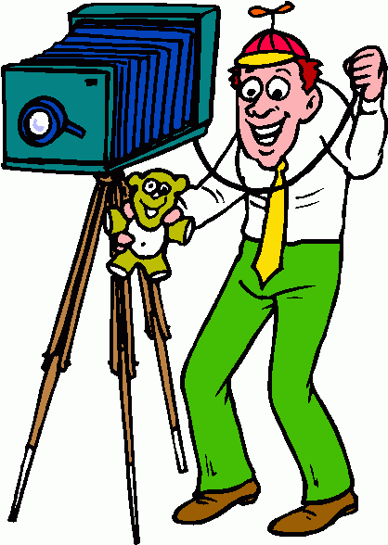
…I had lots to smile about because
I was a physicist and helped to develop medicines for horrible diseases.
I was a geologist and developed ways of telling how old rocks were and even the age of the earth.
I was an inventor and invented the first practical method of colour photography! Cool or what*?!?!
*unlike
this
picture!

Slide 6
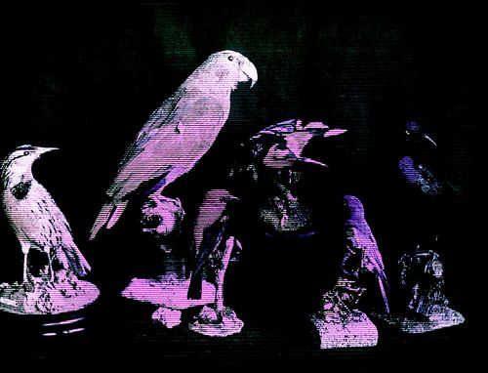
My Joly Colour Process
I won’t bore you with the details, but to put colour into photographs back in the olden days, you had to use a special filter of different colours over the camera lens.
Here is an example of a colour photograph using my colour process.
‘OH!’ I hear you say…‘it’s not great, is it?’

Slide 7


Back in the day…
NO it wasn’t great quality and
YES it was only available for a few years and
YES it was quite expensive to buy the materials
BUT ‘back in the day’ it was quite a marvellous sight to behold!

Slide 8
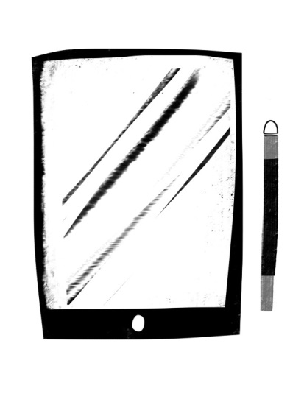



So remember when you are using your fancy iPads and digital cameras and all your millions of megapixels, my Joly Colour Process helped to develop photography as we know it today…and that makes me very ‘jolly’ indeed!

Slide 9
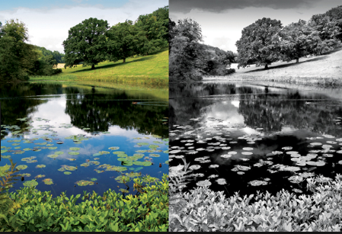
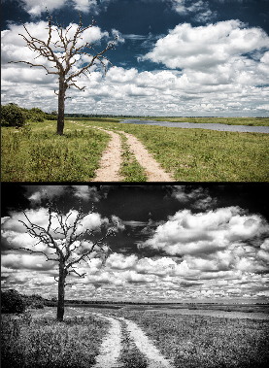
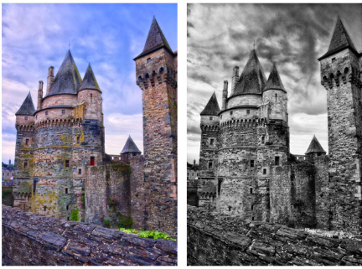
Look and Compare
Are the colour images more effective than black and white? What do you think and why
Get a camera at home and try to take 2 pictures of the same thing. One in full colour and one in another setting. See how different the same picture can look.

Slide 10
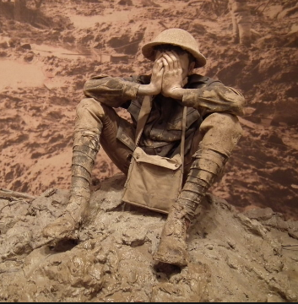
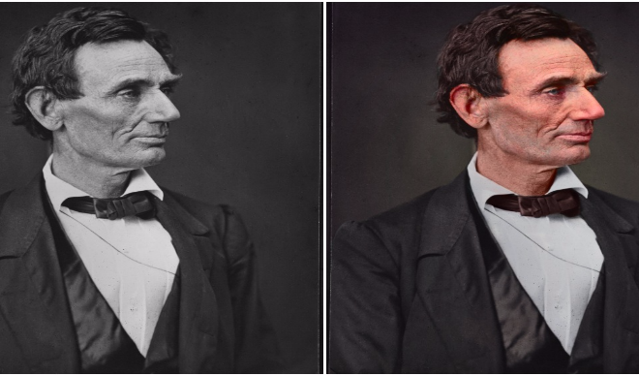
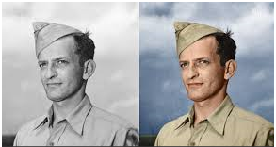
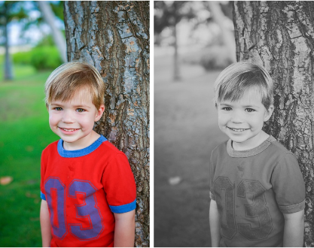

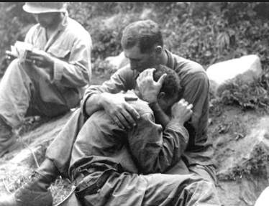
Look and Compare
Does how you look at someone change depending on the colour of the image?
What do you think and why
Which war photograph stands out more and shows pain and sadness?

Slide 11
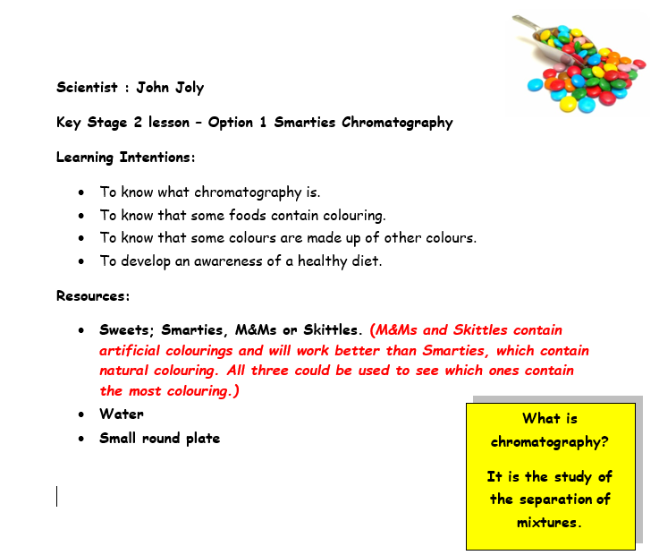

Slide 12
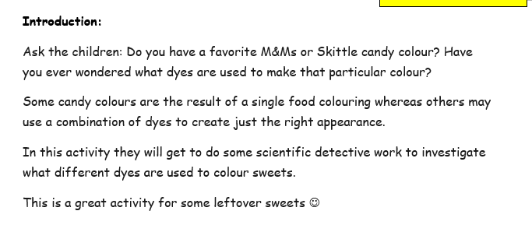
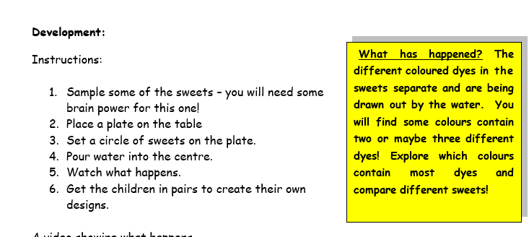
A video showing what happens https://www.youtube.com/watch?v=-BIPZm6az4I

Slide 13
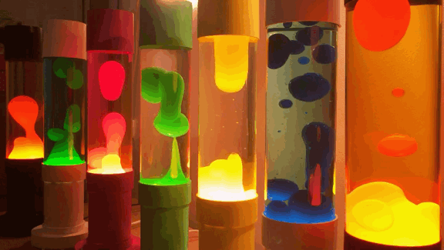
Activity 2- Make a lava lamp at home
How to make a lava lamp [DIY] – YouTube with baking soda
Make a Salt Lava Lamp - Mad Science - YouTube

Slide 14
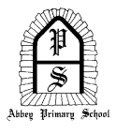









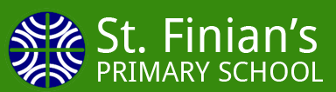
Contributors:
Heather Beattie; Bronagh Reid; Keith Pinkerton; Helen Martin; Daniel Watson; Heather Kinnier; Jeff Colville; Julie Balmer; Lorraine Hutton; Matthew Skimin; John Sandford

