Slide 1
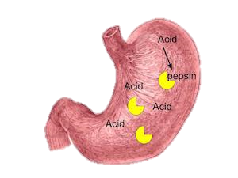
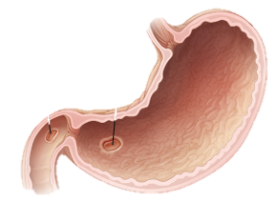
Stomach
Alex and Alfie

Slide 2
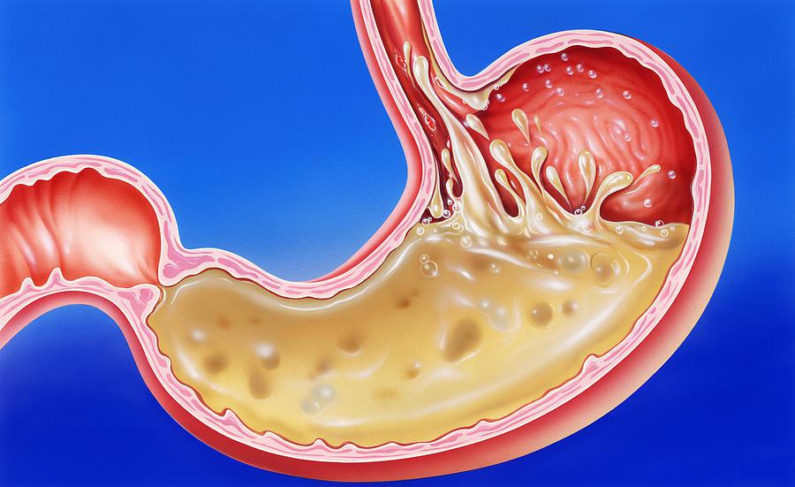
What does the organ do?
The stomach is like mixer churning and mashing together all the small balls of food.

Slide 3
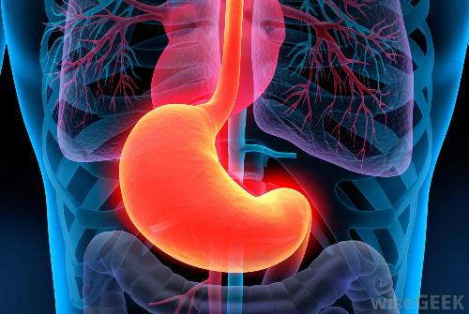
Where would you find the organ?
Your stomach is located in the upper part of your abdomen.

Slide 4
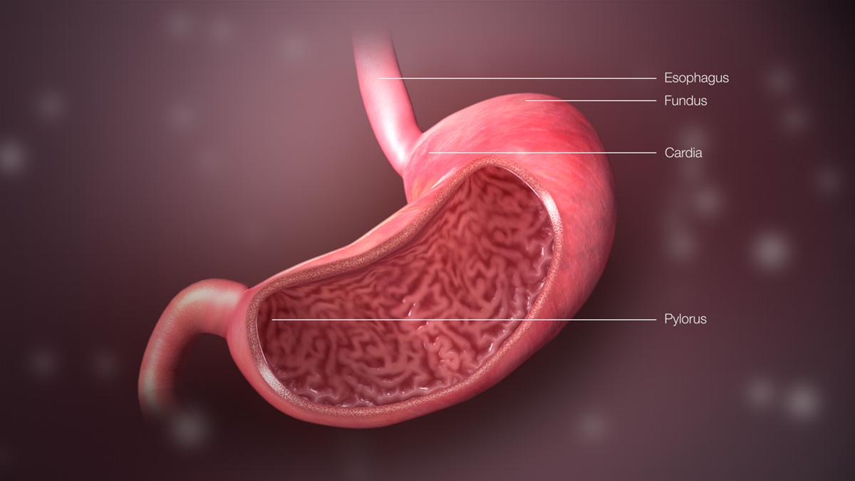
What does the organ look like?
Your stomach looks likes a hollow organ.

Slide 5
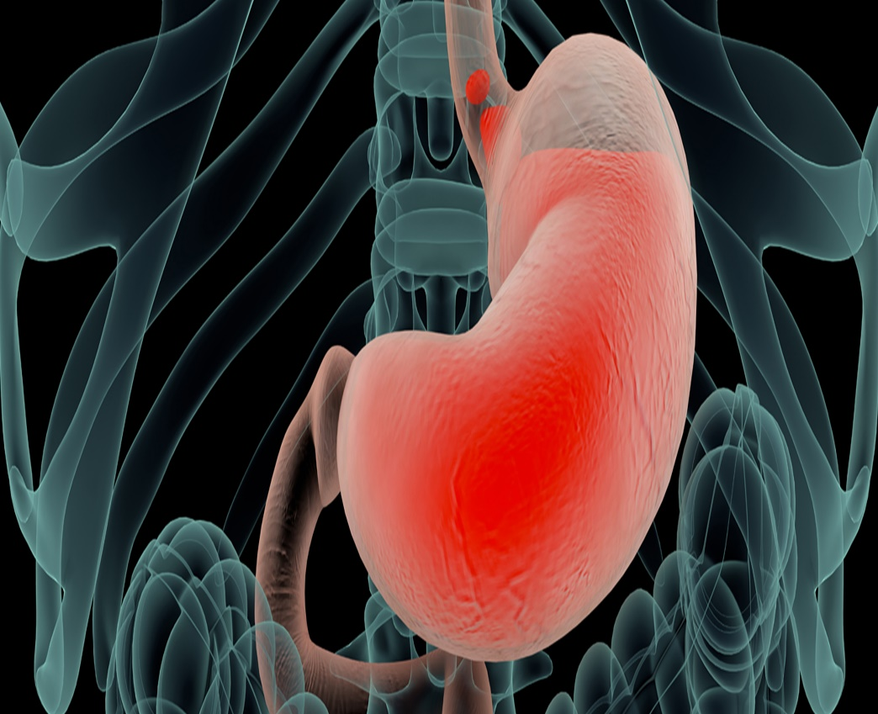
Are there any specific parts of the organ?
Your stomach is a stretchy sack shaped like the letter J.

Slide 6
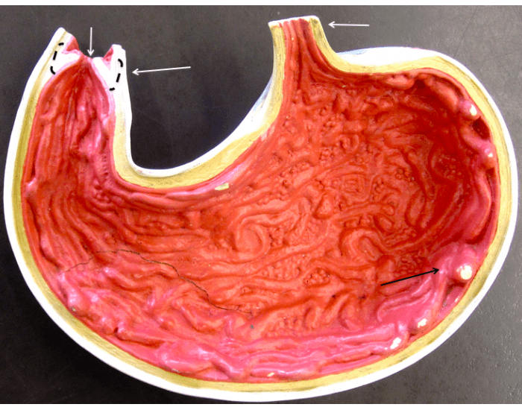
What system does the organ belong to?
It is connected to the oesophagus at one end and the small intestine in Digestive System.

Slide 7
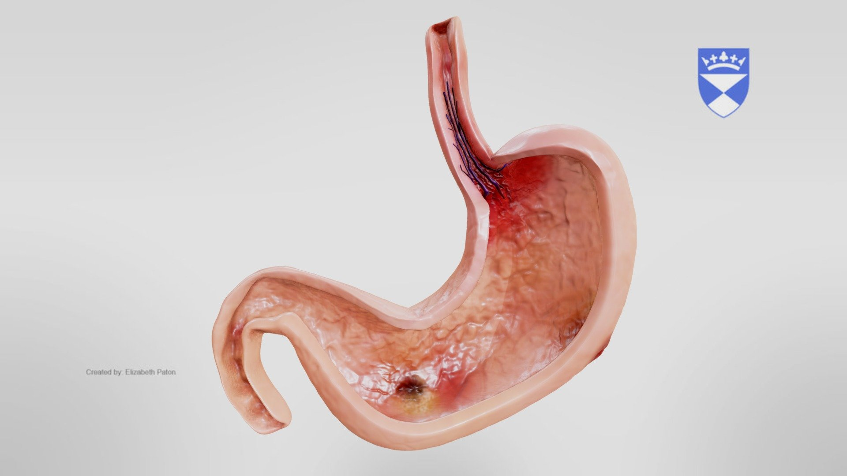
Interesting facts on your organ
It has some serious storage capacity.
PH balance and mucus prevent acid from corrode your stomach.
It allows you to absorb the crucial vitamin b12 out of your food.
Your stomach is one of immune system first lines of defence.

