Slide 1
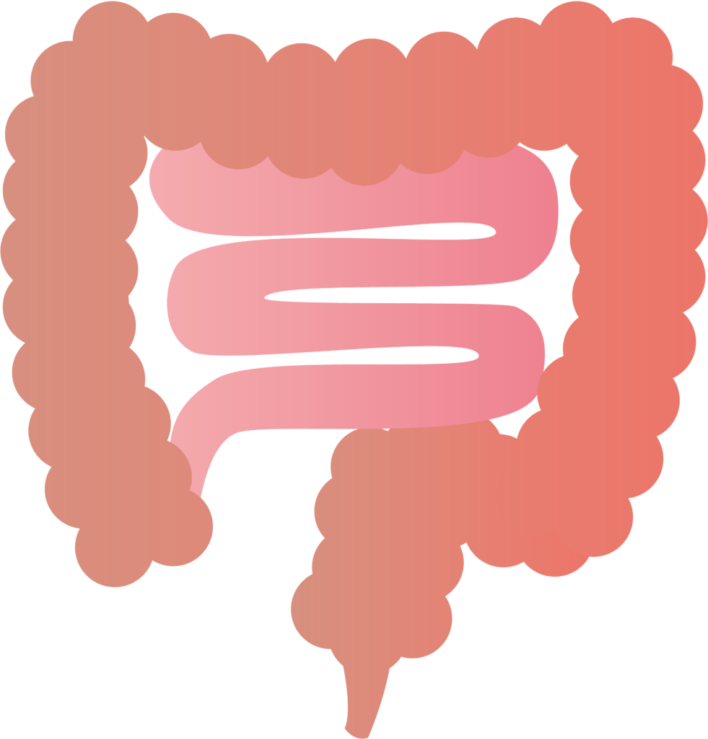
The Small Intestine
By Elizabeth and Orquidia

Slide 2
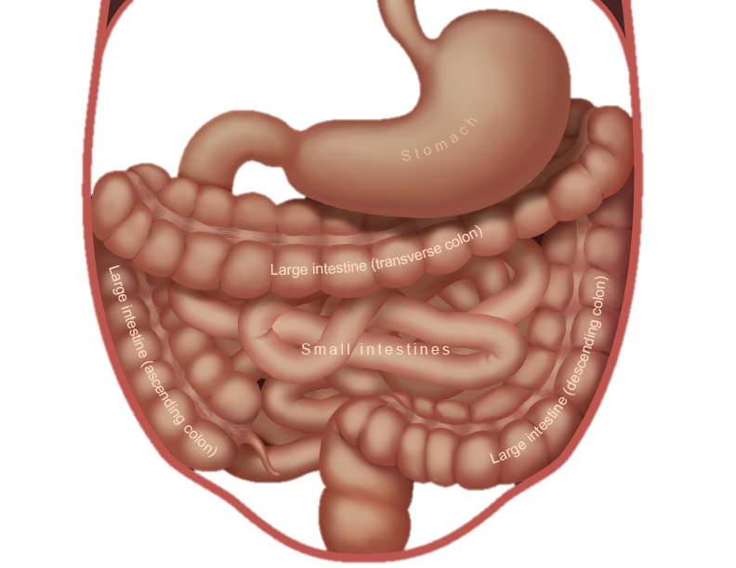
What does the organ do?
The small intestine absorbs nutrients and water from your food
These nutrients are taken to the blood.

Slide 3
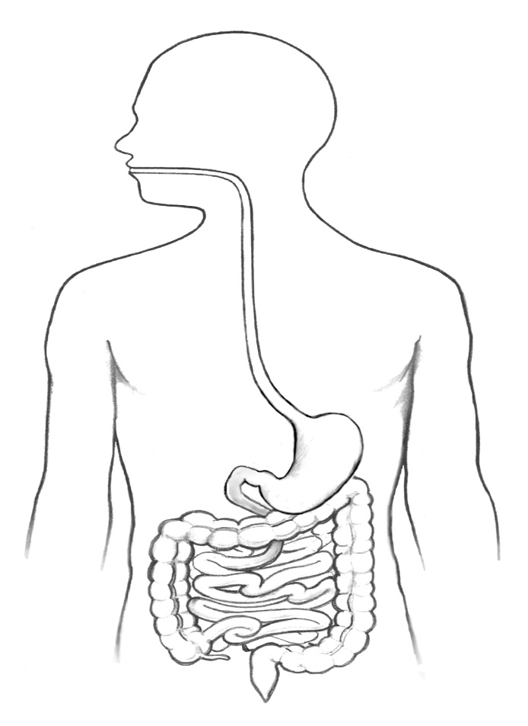
Where would you find the small Intestine?
The small intestine runs from your stomach to your large intestine and it coiled up inside abdomen.
Small intestine

Slide 4
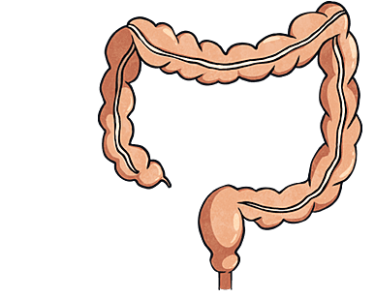
What does the small intestine look like?
The small intestine looks like a long pink or red tube with many folds.

Slide 5
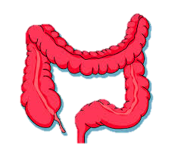
Are there any specific parts of the small intestine?
There are three parts of the small intestine: -
The duodenum receives bile and juice from the pancreas. It is where most digestion takes place. Secretions neutralise the stomach acidity, and enzymes digest the food.
The jejenum: the products of digestion are absorbed into the bloodstream here.
The ileum: absorbs vitamin B12 and bile salts and any products of digestion which were not absorbed by the jejunum.

Slide 6
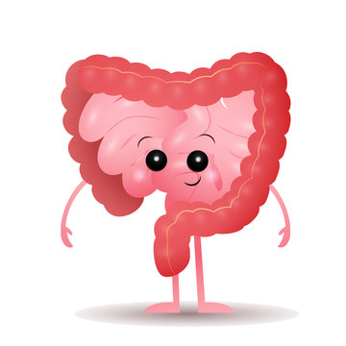
What system does the small intestine belong to?
The small intestine belongs to the digestive system.

Slide 7
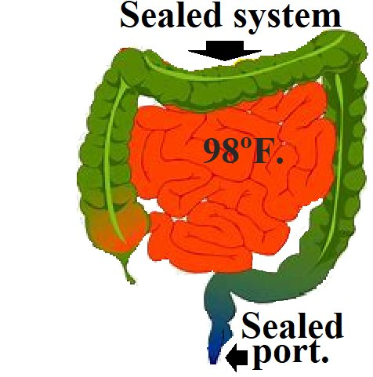
Facts about the small intestine
The small intestine absorbs 90 per cent of your body nutrients.
The small intestine is about three times the length of your body.
The wall of the small intestine are lined with muscles that contract to push food along.

