Slide 2
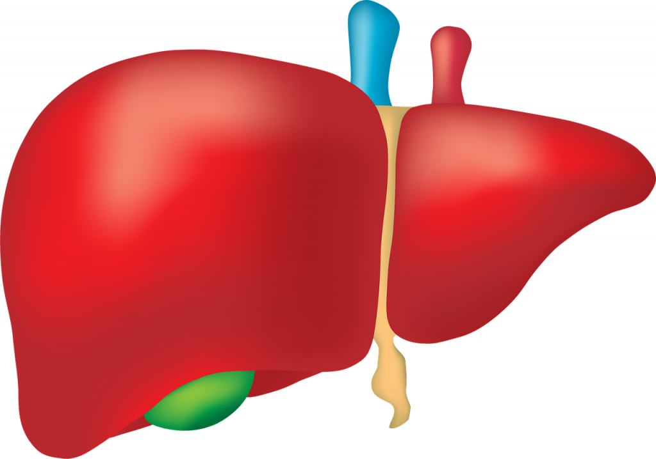
What does the organ do?
The Liver cleans your blood.
It produces an important digestive liquid called bile.
It stores energy in the form of a sugar called glycogen.

Slide 3
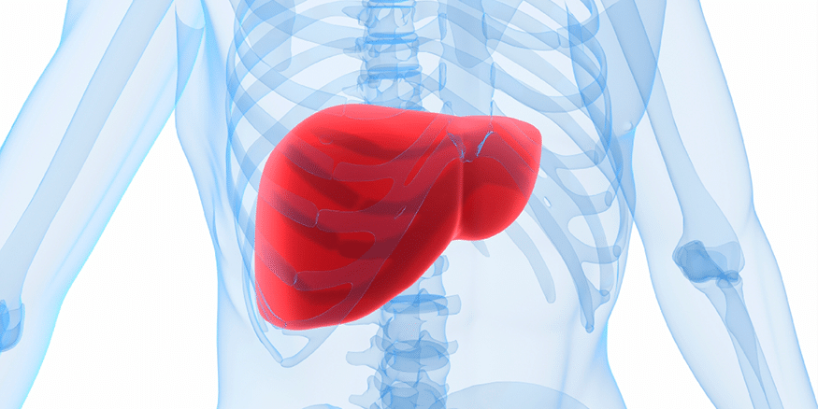
Where would you locate the liver?
The liver is located in the upper abdomen.
The entire organ is located below the lungs.

Slide 4
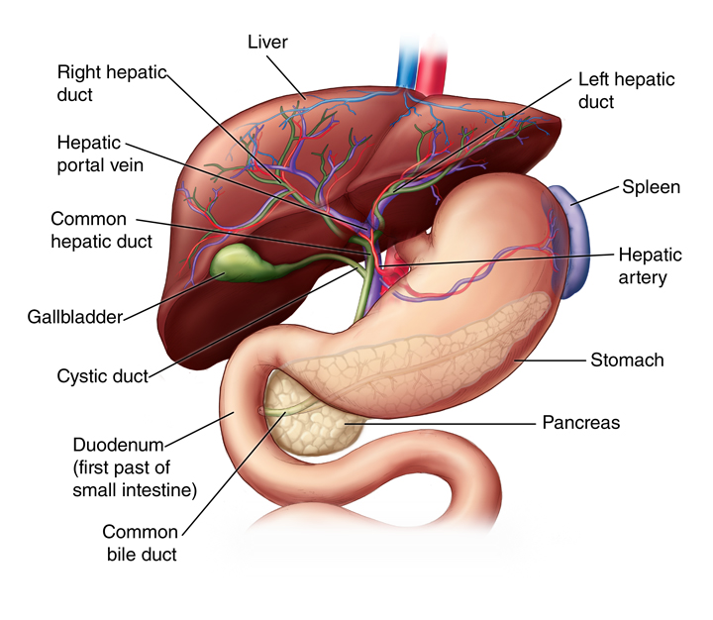
What does the liver look like?
The liver is shaped like a cone.
The liver is a dark reddish-brown organ that weighs about 3 pounds.

Slide 5
Are there any specific parts of the liver?
The liver has two main parts called lobes.
The liver consists of four lobes the larger right lobe and left lobe.
The smaller caudate lobe and quadrate lobe.

Slide 6
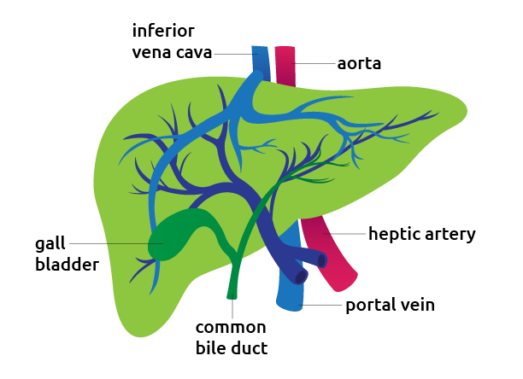
What system does the organ belong to?
The liver belongs to the Digestive System.
The liver also belongs to the Gastrointestinal System.

Slide 7
Interesting facts about the liver.
10% of our liver is made up of fat.
The liver is the second largest organ.
There are up to 500 functions that the liver is believed to be responsible for in the human body.
The liver works with the kidneys to filter out toxins and waste from the blood.

