Slide 1
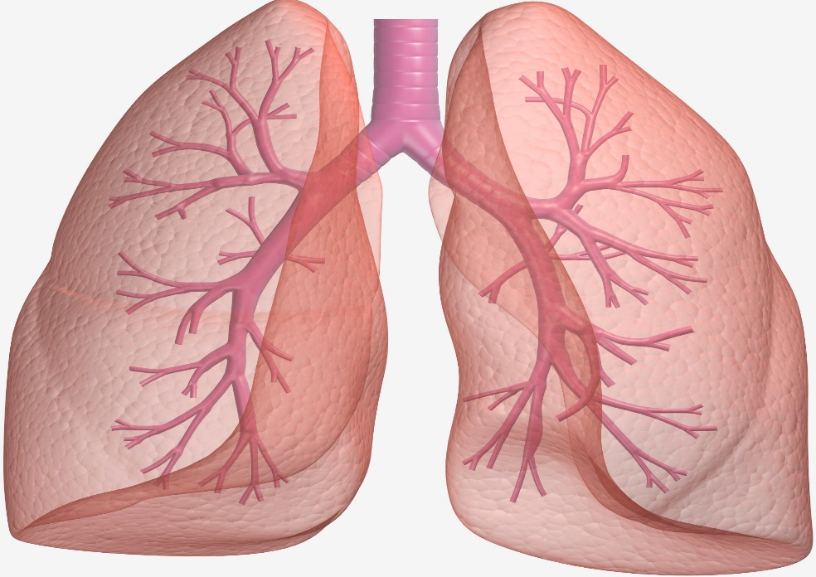
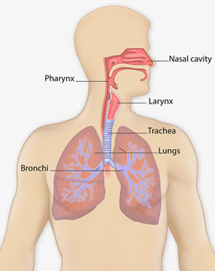
The Lungs
By Daisy-Lee and Courtney

Slide 2
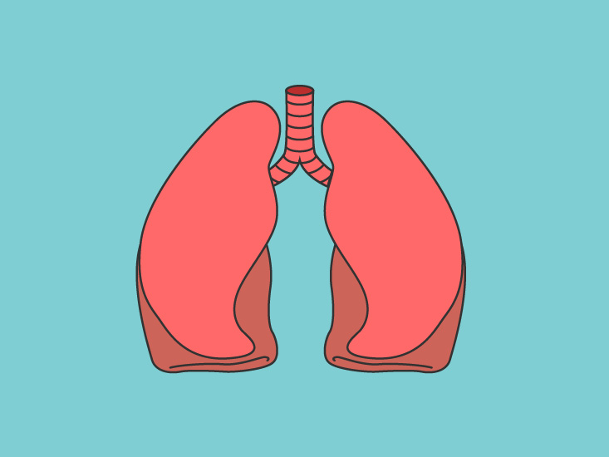
What do the lungs do?
Your lungs move fresh air into your body while removing the waste gases.
Your lungs protect your airways from harmful substances and irritants.

Slide 3
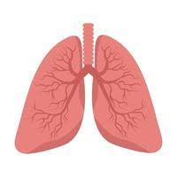
Where can you find your Lungs ?
Your lungs are located in your chest.
The left Lung is smaller than the right lung to make room for the heart.

Slide 4
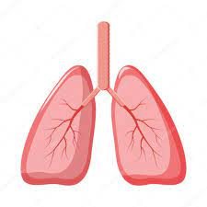
What do your Lungs look like?
Your Lungs are pink, squishy and flexible.
Your lungs feel like soft and squishy sponges.

Slide 5
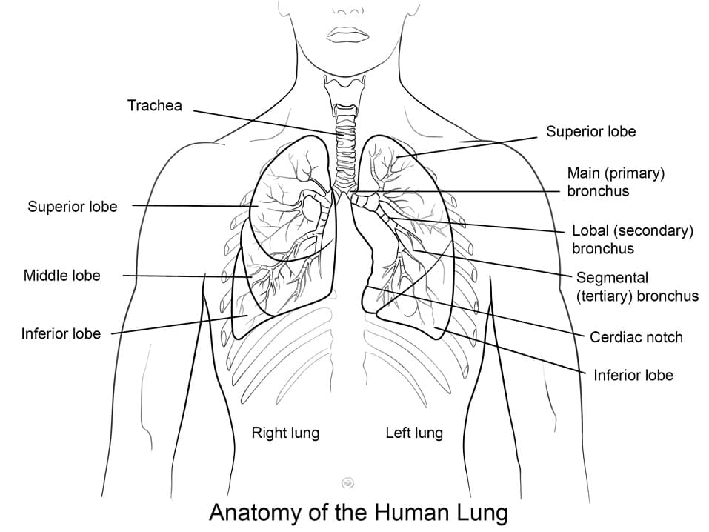
Are there any specific parts of the Lungs ?
Your voice box , your Bronchial tubes , your Air sacs and your wind pipe are in your Lungs.

Slide 6
What system does your lungs belong to ?
Your lungs belong to the Respiratory system.

Slide 7
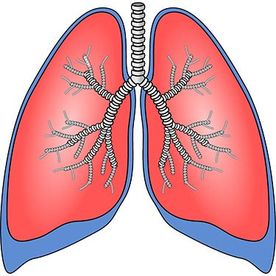
Interesting facts about your Lungs.
You breathe an average of 13 pints per minute through your Lungs.
With healthy lungs you will breathe about 2,900 gallons of air every 24 hours.
Your Lungs are about the size of a big bucket.
Without mucus your lungs would dry out.

