Slide 2
The Ancient Seven Wonders of the World
What are the ancient Seven Wonders of the World?
The ancient Seven Wonders of the World is a list of remarkable, humanly-constructed landmarks from ancient, classical civilisations. The original list dates from the second century BC. The landmarks consist of a pyramid, a mausoleum, a temple, two statues, a lighthouse and a garden.
The ancient Seven Wonders of the World are:
The Lighthouse of Alexandria
The Colossus of Rhodes
The Statue of Zeus at Olympia
The Temple of Artemis at Ephesus
The Hanging Gardens of Babylon
The Great Pyramid of Giza
The Mausoleum at Halicarnassus

Slide 3
The Ancient Seven Wonders of the World
Why was the list created?
When early Greek travellers began to travel and explore other ancient civilisations, such as the Egyptians, Persians and Babylonians, they were impressed with some of the marvellous and imaginative architecture they saw. They began to put together lists of some ‘must-see’ recommendations for future visitors.
They called these inspiring landmarks ‘theamata’ - meaning ‘sights’. Over time, this developed into the more magnificent name ‘thaumato’ - meaning ‘wonders’.
Therefore, the ancient Seven Wonders of the World was an early tourist guidebook!

Slide 4
The Ancient Seven Wonders of the World
Why are there only seven?
Even though there are a multitude of hugely impressive ancient sights, there have only ever been seven ancient Wonders of the World.
The ancient Greeks believed the number seven represented perfection so it was a particularly significant number for them.
The original list of the ancient Seven Wonders of the World has inspired a host of similar lists throughout history.
In 2000, a modern list of the new Seven Wonders of the World was created, consisting of landmarks that are still in existence today.

Slide 5
The Ancient Seven Wonders of the World
Click on the map to find out more about the ancient Seven Wonders of the World.
The Statue of Zeus at Olympia
The Temple of Artemis at Ephesus
The Mausoleum at Halicarnassus
The Colossus of Rhodes
The Hanging Gardens of Babylon
Talk About it
The Lighthouse of Alexandria
The Great Pyramid of Giza

Slide 6
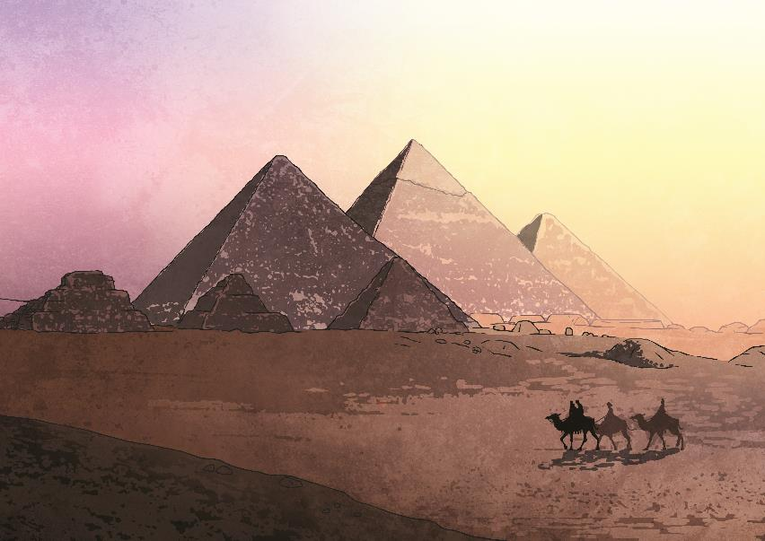
The Great Pyramid of Giza
Back
Did You Know...?
The Great Pyramid of Giza is the only one of the ancient Seven Wonders of the World that is still standing!
The Great Pyramid of Giza was built in about 2600 BC by the Egyptians. It took 20 years to complete.
It is the largest of the three Giza pyramids and was constructed as a tomb for the Egyptian pharaoh named Khufu.
The pyramid’s perfect symmetry and unparalleled height (146.5 metres) impressed the ancient tourists. It remained the tallest human-made structure on earth for almost 4000 years.

Slide 7
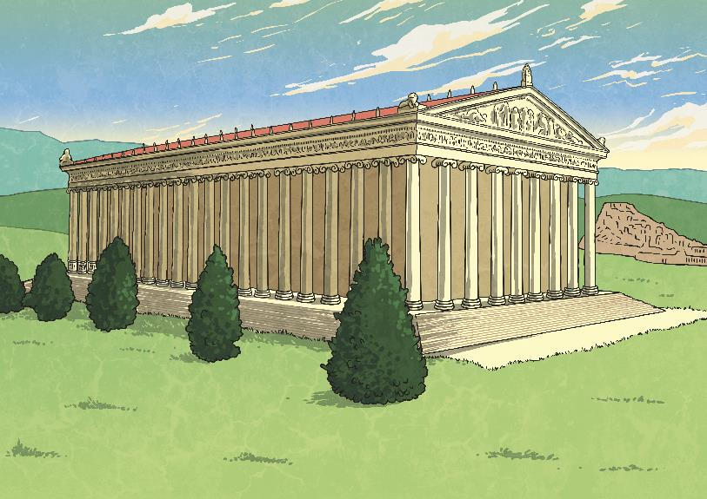
The Temple of Artemis at Ephesus
Back
Did You Know...?
The temple took over 120 years to build and only one night to destroy!
The Temple of Artemis was built in the Greek colony of Ephesus (now part of Turkey) in 550 BC. It was created to honour Artemis, the goddess of hunting. Earlier temples had been repeatedly devastated by flooding.
No expense was spared in the building of the temple and ancient visitors were in awe of the sheer beauty of this amazing structure.
On July 21st, 356 BC it was set ablaze by a man called Herostratus, who hoped that he would become famous by destroying such a beautiful creation.

Slide 8
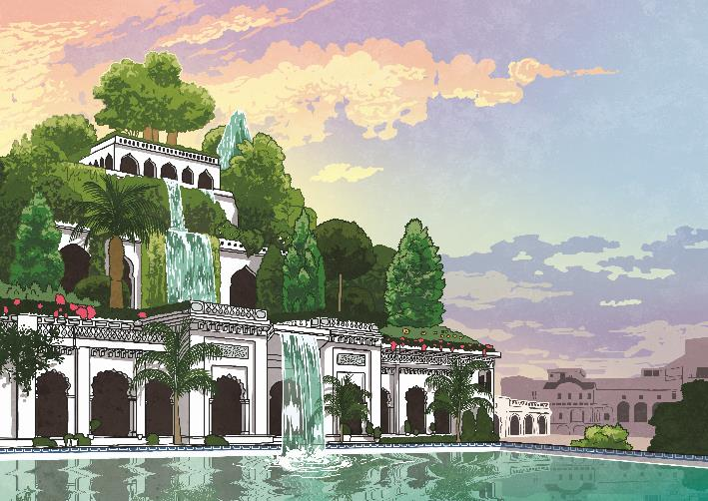
The Hanging Gardens of Babylon
Back
Did You Know...?
It is possible these mysterious gardens were purely mythical and never actually existed. No archeological evidence of them has ever been discovered.
The Hanging Gardens of Babylon are said to have been created in about 600 BC in the ancient city of Babylon (now part of Iraq). King Nebuchadnezzar II built them as a gift for his wife, who missed the mountains and flowers of her homeland.
Ancient travellers described the mud brick structure as a remarkable feat of engineering. The gardens resembled a lush green mountain full of trees, shrubs and vines - quite an achievement in the desert!
The Hanging Gardens of Babylon were destroyed by an earthquake in the first century AD.

Slide 9
The Statue of Zeus at Olympia
Back
The Statue of Zeus was created around 435 BC by the Greek sculptor Phidias to honour the chief of the Greek gods. It was placed in the Temple of Zeus in Olympia (the site of the first Olympic Games).
The enormous statue, over 12 metres high, was intended to inspire awe in worshippers. Zeus was shown seated on a resplendent throne, with ivory skin and golden robes.
After the rise of Christianity, the statue (considered to be pagan) was removed. It was later destroyed (possibly by an earthquake) sometime during the fifth century AD.
Did You Know...?
The ancient traveller Strabo reported, “It seems that if Zeus moved to stand up, he would unroof the temple.”
resplendent - Something that has an expensive appearance and is impressive-looking.

Slide 10
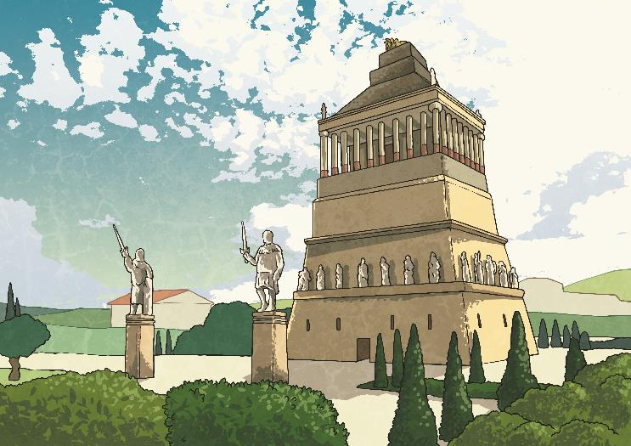
The Mausoleum at Halicarnassus
Back
Did You Know...?
The word ‘mausoleum’ (meaning an impressive building housing a tomb) comes from the tomb of Mausolus.
The Mausoleum at Halicarnassus was built between 353 and 350 BC as a tomb for the Persian satrap (governor) Mausolus. His wife, Artemisia II, was so distraught at his death that she ordered the creation of an extravagant tomb, worthy of a king.
The impressive 41 metre high structure combined Greek, Lycian and Egyptian architecture. No expense was spared; the mausoleum was filled with beautiful marble statues, temples, sculptures and friezes.
After the Great Pyramid of Giza, this was the longest surviving ancient wonder when it was destroyed by earthquakes between the 12th and 15th century AD. The Mausoleum is located near Bodrum in Turkey.

Slide 11
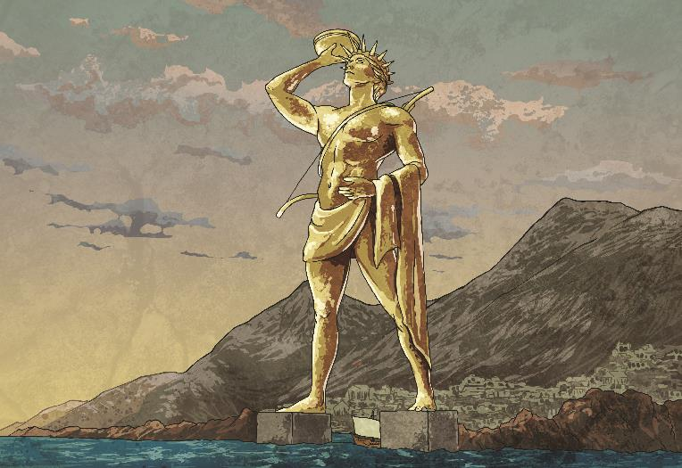
The Colossus of Rhodes
Back
Did You Know...?
At 33 metres, the Colossus was the tallest statue in the ancient world - approximately the height of the modern Statue of Liberty.
The Colossus was built by Chares of Lindos, a Greek sculptor, between 292 and 280 BC. It overlooked the harbour on the Greek island of Rhodes.
The statue was built to honour Helios, the Greek sun god, in celebration of the successful defence of the island after a year-long siege. Legend says that the people of Rhodes melted down abandoned bronze and iron weapons to help with its creation.
The Colossus only stood for 54 years before an earthquake caused it to fall in 226 BC. It lay in pieces for over 800 years.

Slide 12
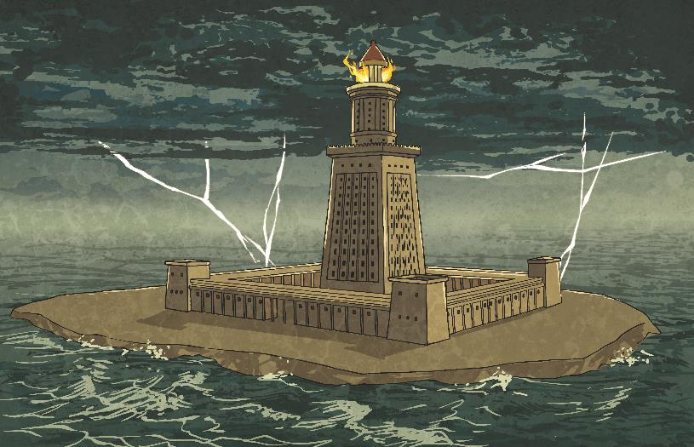
The Lighthouse at Alexandria
Back
Did You Know...?
In 1994, archaeologists discovered some remains of the lighthouse on the seabed. In 2016, Egypt had plans to turn the submerged ruins into an ancient museum.
The Lighthouse at Alexandria was constructed in 280 BC on the Island of Pharos, in Egypt, to guide ships through the shallow, rocky waters of Alexandria’s harbour.
The pioneering lighthouse, estimated to be between 115 and 145 metres tall, used a mirror to reflect the sun's rays during the day and a fire at night. The light was reportedly visible over 30 miles away.
The lighthouse was damaged and eventually abandoned after several major earthquakes. The ruins completely collapsed during the 15th century.

Slide 13
Talk About It
Which ancient Wonder of the World would you most like to have visited?
Do you know anyone who has visited these ancient sites?
What would you put on your own list of wonders?
Why do you think all of the ancient Wonders of the World are located around the Mediterranean?
What do the ancient Wonders of the World look like now?
Click to find out.

Slide 14
What Do the Ancient Wonders of the World Look like Now?
Back
“Bronze doe and stag where the Colossus of Rhodes might have once stood” by Jorge Lascar is licensed under CC BY 2.0
"490_pamukkale_templo_artemisa" by queulat00is licensed under CC BY 2.0
"Fort Qaitbey" by D-Stanley is licensed under CC BY 2.0
"Mausoleum at Halicarnassus" by Shadowgate is licensed under CC BY 2.0
The bronze doe and stag mark the possible site of the Colossus of Rhodes.
The ruins of the Temple of Artemis, Ephesus.
Fort Qaitbey is built on the same site as the Lighthouse at Alexandria.
The ruins of the Mausoleum at Halicarnassus
"Collapsed Temple of Zeus in Olympia" by nox-AM-ruit is licensed under CC BY 2.0
"Great Pyramid of Giza" by girolame is licensed under CC BY 2.0
"Hanging Gardens of Babylon" by D-Stanley is licensed under CC BY 2.0
The ruins of the Temple of Zeus, home of the Statue of Zeus at Olympia.
The Great Pyramid of Giza
The ruins of Babylon, where the hanging gardens are said to have been built.

