Slide 2
The New Seven Wonders of the World
The ancient world had seven significant places, known as ‘The Seven Wonders of the World’. In 2000, a campaign began to choose seven wonders of the modern world.
Over 100 million votes were cast. The final seven places chosen were:
Chichén Itzán, Mexico;
Machu Picchu, Peru;
Christ the Redeemer, Brazil;
The Colosseum, Italy;
Petra, Jordan;
Taj Mahal, India;
The Great Wall, China.
Today, we are going to find out about Machu Picchu.

Slide 3
Where Is Machu Picchu?
Machu Picchu sits on top of the Andes mountain range in Peru, South America.
It is almost 8000 feet above sea level.
Pacific Ocean

Slide 4
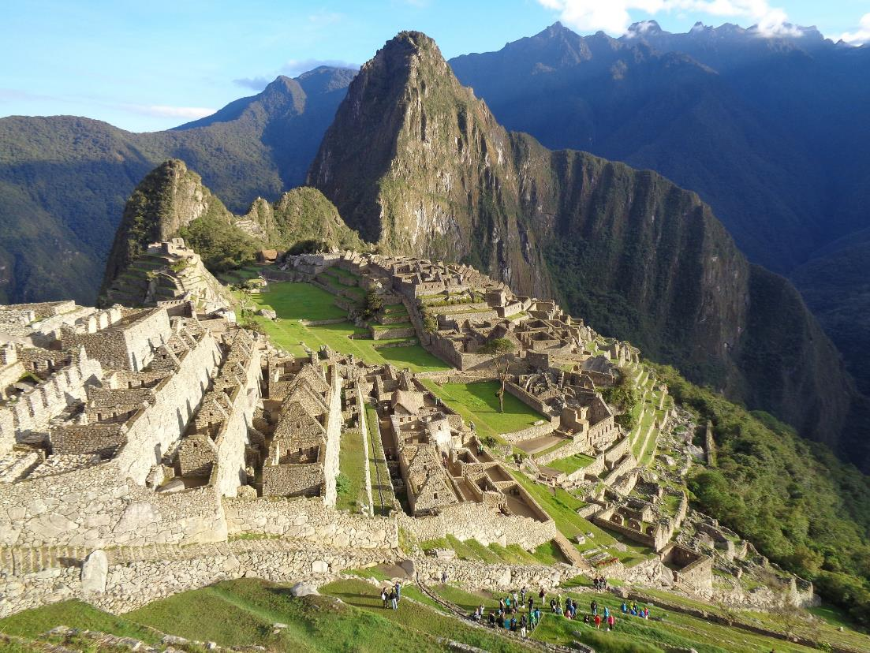
What do you think Machu Picchu once was?

Slide 5
What Is Machu Picchu?
Machu Picchu is a ruined, historical settlement. It is believed to have been built by the Inca civilisation at around 1450 as an estate for Emperor Pachacuti.
There are many theories as to why it was built. Some people believe it was a sacred, religious site while others thought it was built as a holiday retreat.
For many years, only native locals knew about Machu Picchu. However, when a historian rediscovered it 1911, it became famous around the world.

Slide 6
Who Were the Incas?
The Incas were a great civilization, existing from AD 1400 - AD 1533. They built the largest empire of the native South American people.
They built roads, performed brain surgery, started a postal service, developed their own calendar and spoke their own language, Quechua.

Slide 7
The Incas
Life was very different depending on who you were in the Inca empire.
Most people were peasants and farmers. They were forced to work very hard and didn’t own their farm. They had to pay taxes and give food and items to the Inca empire.

Slide 8
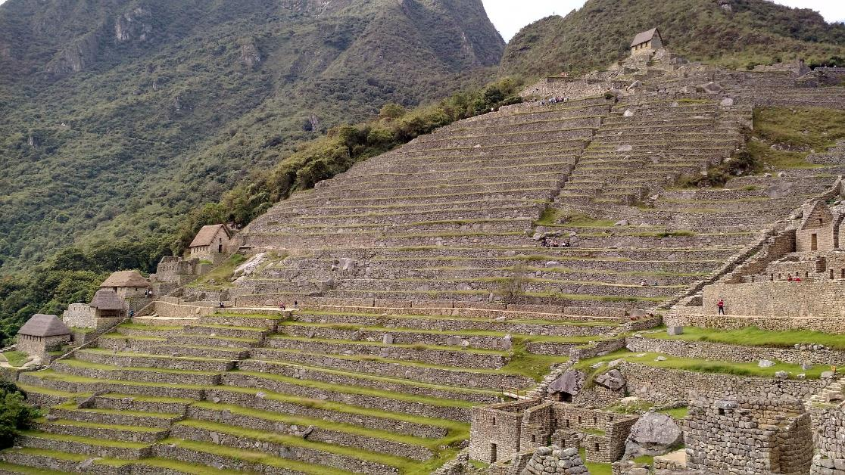
The Incas
The Incas lived in the mountains so it was difficult to find flat land to grow food. To solve this issue, they created terrace farming, building steps on the sides of the mountain.

Slide 9
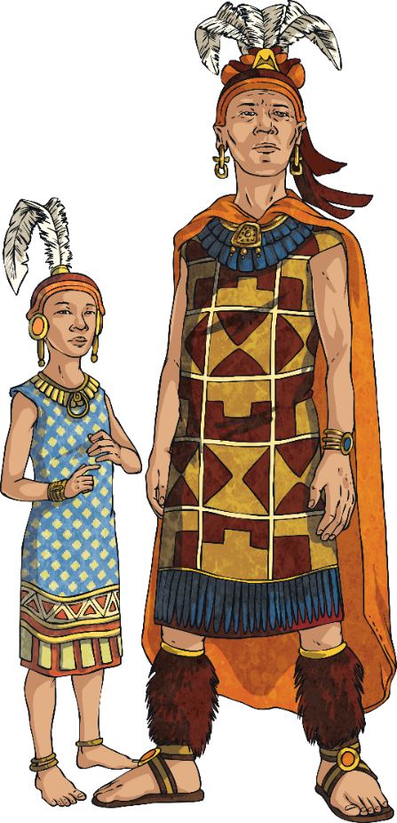
The Incas
A smaller number of people were royals. Royals lived a luxurious lifestyle. They wore special hairstyles and jewellery to make themselves stand apart from the peasants.

Slide 10
The Incas
The most important person was the emperor, more commonly known as the Sapa Inca. He was also believed to be a god.
Sapa Inca means ‘son of the sun.’ Everything about him was thought to be sacred. He owned everything in the empire and made all the laws.

Slide 11
Machu Picchu - A Sacred, Religious Site?
The Incas worshipped many gods and goddesses. They prayed to these gods every day and held festivals and celebrations in their honour.
The Incas’ most important festival was held every June in honour of the sun god, Inti. The emperor was believed to be the son of Inti.
This festival lasted for nine days. During the festival, the people of the empire danced and prayed to the sun, offering up food in its honour.
Some historians believe that on the fourth day of the festival, everyone in the empire would stretch out their arms to the sun and make a kissing sound to show how grateful they were for its warmth and energy.

Slide 12
What Happened to Machu Picchu?
In 1528, the Inca empire was divided by civil war which lasted for five years. The Inca people fought over who was the next rightful Sapa Inca. Many people lost their lives.
Meanwhile, the Spanish explorer Francisco Pizarro arrived in Cusco – the once capital of the Inca empire. Over the next 50 years, the Spanish explorers captured all the Incan cities. They brought disease with them, such as smallpox, which caused many people in the Inca empire to die.
In 1572, the Spanish defeated the last Inca emperor and Machu Picchu was abandoned.

Slide 13
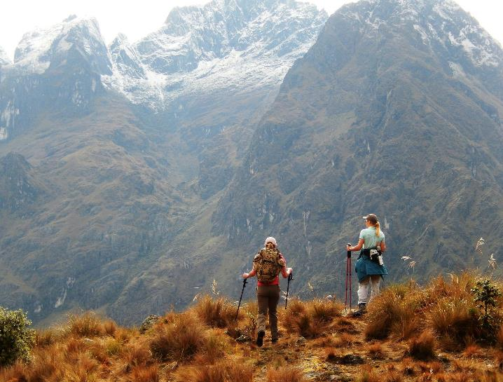
Machu Picchu Today
Since its rediscovery, some of the site has been reconstructed to show what it would have once looked like.
Trekking up to Machu Picchu can take between two to five days along the Inca Trail.
Machu Picchu was voted one of the new Seven Wonders of the World.

Slide 14
Machu Picchu Today

Slide 15
Quiz
Machu Picchu can be found in which South American country?
Bolivia
Peru
Chile
Ecuador
Answer
b

Slide 16
Quiz
Machu Picchu was built around...
1250
1350
1450
1550
Answer
c

Slide 17
Quiz
What was the name of the Inca emperor of the time?
Pachacuti
Answer

Slide 18
Quiz
What do some people believe was its purpose? Pick two.
a holiday destination for Emperor Pachacuti
a place to send people who had committed crimes
a farming community
a sacred, religious site
Answer
a and d

Slide 19
Quiz
True or False?
The most important person was the emperor, more commonly known as the Sapa Inca. He was also believed to be a god. Sapa Inca means ‘son of the moon.’
Answer
False
It means ‘son of the sun’.

Slide 20
Quiz
When was Machu Picchu abandoned?
1472
1572
1672
1772
Answer
b

