Slide 2
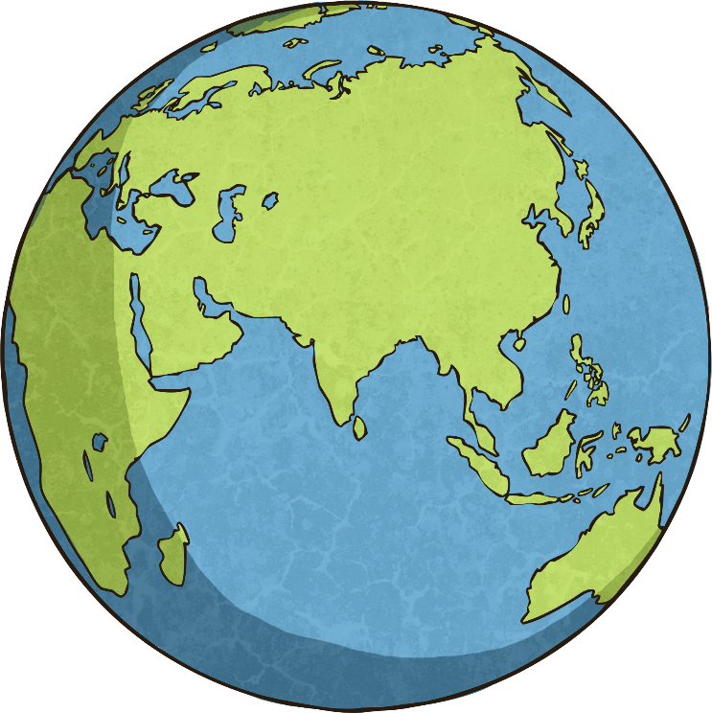
The New Seven Wonders of the World
The ancient world had seven significant places, known as ‘The Seven Wonders of the World’. In 2000, a campaign was started to choose seven wonders of the modern world.
The final seven places chosen were:
Chichén Itzá, Mexico;
Machu Picchu, Peru;
Christ the Redeemer, Brazil;
The Colosseum, Italy;
Petra, Jordan;
Taj Mahal, India;
The Great Wall, China.
Today, we are going to find out about Petra in Jordan.

Slide 3
Where Is Jordan?
Jordan is in the continent of Asia.

Slide 4
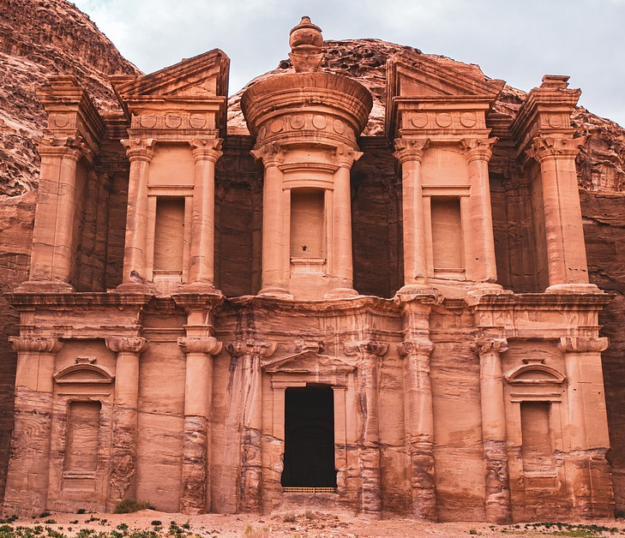
Petra
Petra is an ancient city in Jordan. When it was built, it was known as ‘Raqmu’. It is about 240 kilometres south of Amman, the capital city of Jordan.
It is sometimes known as the ‘Rose City’ because of the colour of the rocks.
Petra is entered by way of a 1.2 kilometre-long canyon long gorge called the Siq. At places, the Siq is only 3 metres wide.

Slide 5
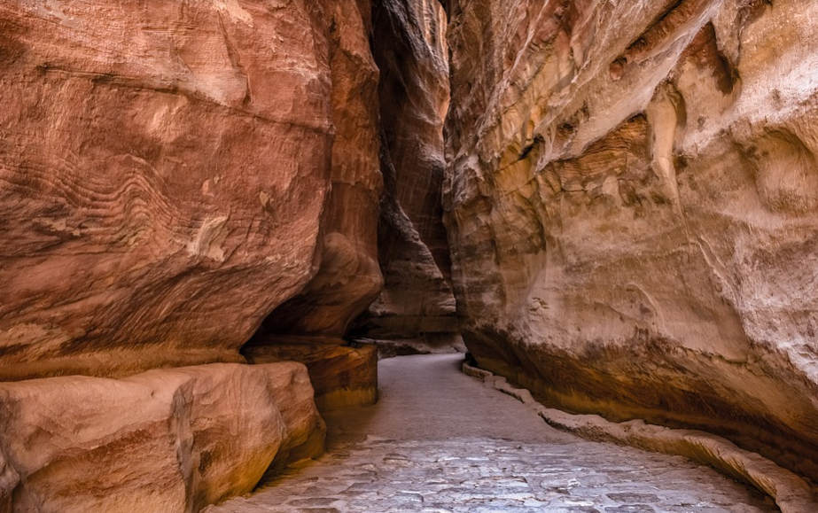
When Was Petra Built?
The city of Petra was first established as a trading post by a group of people called the Nabataean.
The Nabataean were originally a nomadic tribe. This means that they moved from place to place instead of living in one area. During the 4th century BC, the Nabataean began to settle in one place.
Petra became an important trading city because of its central location. The city was surrounded by huge walls of red sandstone, which made it easier to defend.
Red Sandstone at Petra

Slide 6
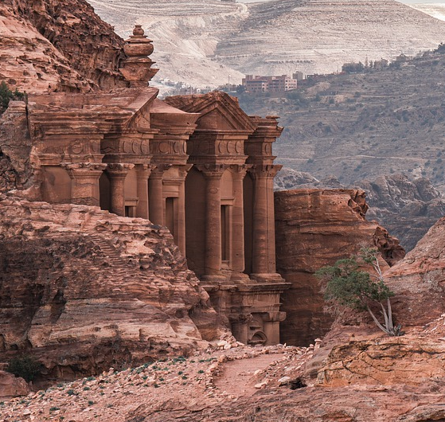
What Was Petra Like?
No surviving documents explain what Petra was like when it was first built. Everything we know is from the excavations that archaeologist have done. The Nabataeans created buildings, temples and tombs by carving them out of the rock.
They created a system of dams, pipes and underground cisterns (containers) to store and then distribute water. This meant that during dry months, the Nabataeans were able to water crops and have drinking water. Petra was an important trading place and traders of frankincense, myrrh and spices visited the city.

Slide 7
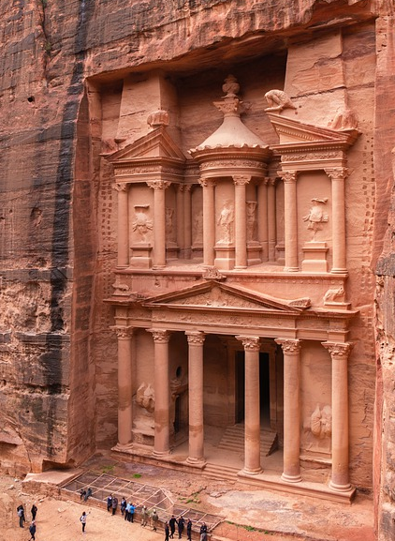
Al Khazna
One of Petra’s most famous sights is Al Khazna - sometimes known as the Treasury. It is believed by some that Al Khazna was a tomb built for a Nabataean king or queen in the 1st century AD. At the top of Al Khazna, is an urn (pot). It was rumoured to contain treasure (hence the name the Treasury) but in reality, it is just a stone carving.
Did You Know...?
Al Khazna was in the film ‘Indiana Jones and the Last Crusade’. However, unlike in the film, there is only a very small hall behind the beautiful front of the building.

Slide 8
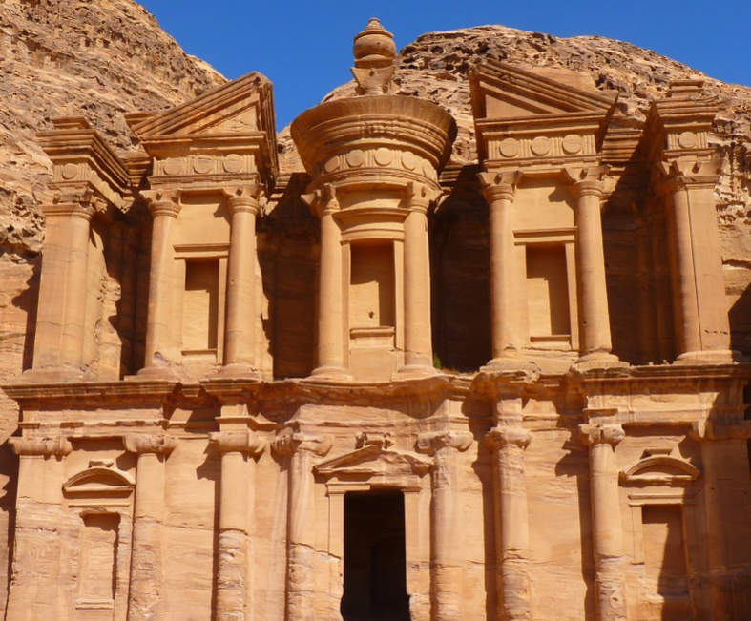
Al-Dayr (The Monastery)
It is thought that Al-Dayr was built in the middle of the 1st century AD and was probably used as a religious temple.
Al-Dayr is 48 metres high and 47 metres wide. Behind the entrance (shown in the picture), there is a large hall carved into the rock.
It is thought that later inhabitants of the area may have used Al-Dayr as a church as there are three crosses carved into one of the walls.

Slide 9
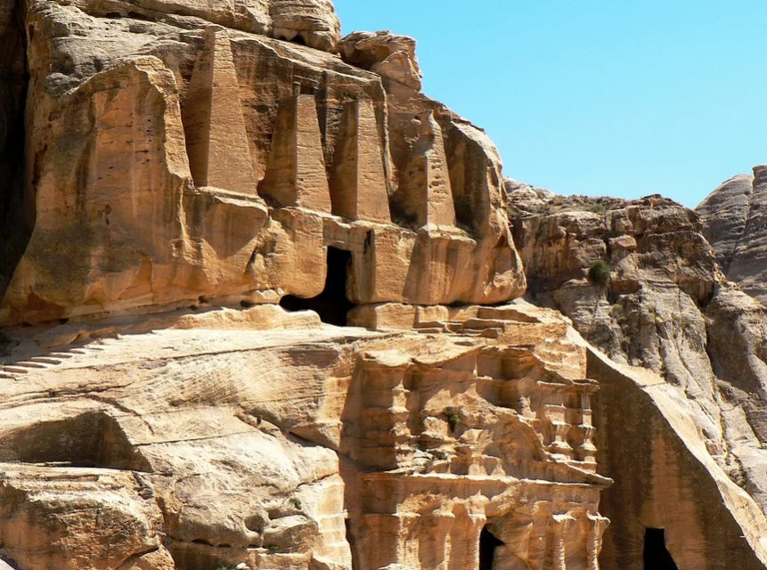
Petra in History
The Nabataeans were able to defend themselves against attacks from the Greek empire. However, Petra eventually came under the control of the Roman Empire in AD 106. Under Roman rule, Petra was less of an important trade route. In AD 363, much of the city was destroyed in an earthquake. Over time, the city was largely abandoned and forgotten.
Tombs at Petra

Slide 10
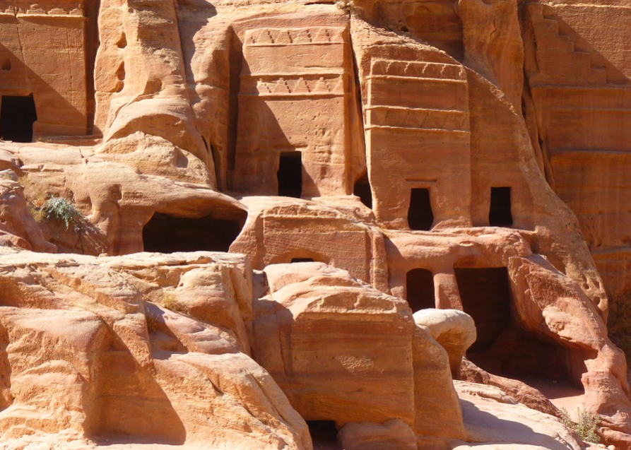
Petra Today
Despite over a century of archaeology at Petra, it is thought that only 15% of the ancient city has so far been uncovered.
Today, Petra is an important tourist destination, with hundreds and thousands of people visiting each year.
In 1985, Petra was made a UNESCO (United Nations Educational, Scientific and Cultural Organisation) World Heritage Site. World Heritage Sites are those deemed to be culturally or historically important. They are protected from being developed or changed in any way.

Slide 11
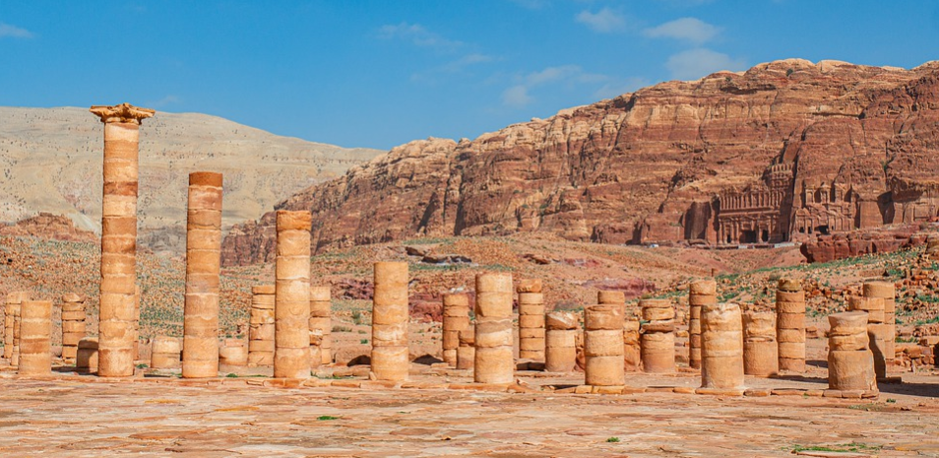
Petra Today

Slide 12
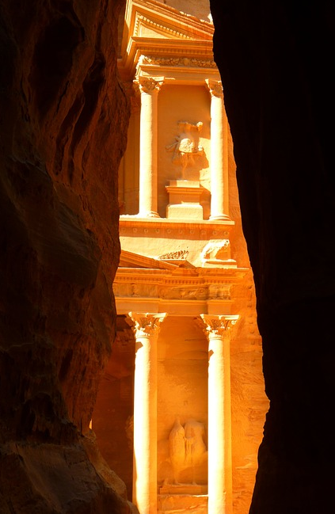
Petra Today

