Slide 2
The Ancient Seven Wonders of the World
The ancient Seven Wonders of the World is a list of remarkable, humanly constructed landmarks from ancient, classical civilisations. The original list dates from the second century BC. The landmarks consist of a pyramid, a mausoleum, a temple, two statues, a lighthouse and a garden.
The ancient Seven Wonders of the World are:
•The Lighthouse of Alexandria
•The Colossus of Rhodes
•The Statue of Zeus at Olympia
•The Temple of Artemis at Ephesus
•The Hanging Gardens of Babylon
•The Great Pyramid of Giza
•The Mausoleum at Halicarnassus

Slide 3
The Ancient Seven Wonders of the World
Why was the list created?
When early Greek travellers began to travel and explore other ancient civilisations, such as the Egyptians, Persians and Babylonians, they were impressed with some of the marvellous and imaginative architecture they saw. They began to put together lists of some ‘must-see’ recommendations for future visitors.
They called these inspiring landmarks ‘theamata’ - meaning ‘sights’. Over time, this developed into the more magnificent name ‘thaumato’
- meaning ‘wonders’.
Therefore, the ancient Seven
Wonders of the World was an
early tourist guidebook!

Slide 4
The Ancient Seven Wonders of the World
Even though there are a multitude of hugely impressive ancient sights, there have only ever been seven ancient Wonders of the World.
The ancient Greeks believed the number seven represented perfection so it was a particularly significant number for them.
Why are there only seven?
The original list of the ancient Seven Wonders of the World has inspired a host of similar lists throughout history.
In 2000, a modern list of the new Seven Wonders of the World was created, consisting of landmarks that are still in existence today.

Slide 5
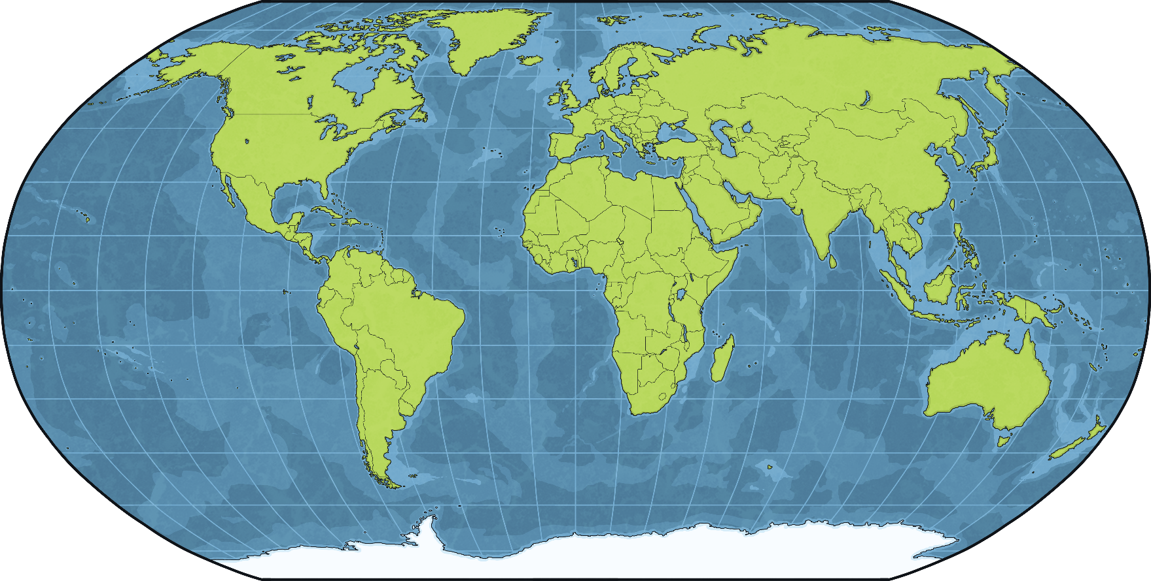
The Mausoleum at Halicarnassus
The Mausoleum of Halicarnassus was one of the seven wonders of the ancient world. It was in Halicarnassus, which is the modern-day city of Bodrum in Turkey.
Turkey

Slide 6
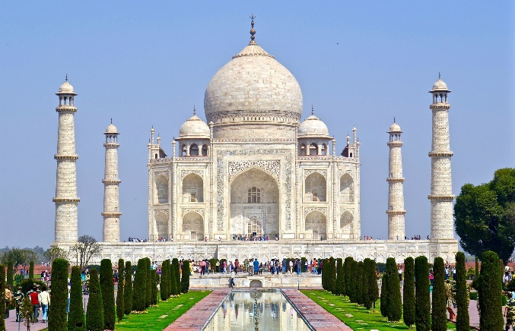
What is a Mausoleum?
A mausoleum is a tomb. Unlike most graves, where people are laid to rest buried in the earth, a mausoleum is a free-standing building (usually made of stone) that is above ground.
Mausoleums can be any size and are designed to hold the remains of deceased people. Some mausoleums are built for one or two people, whereas other, much larger structures may be built to house many.
The Taj Mahal in India is a mausoleum that was commissioned by the emperor Shah Jahan in 1632 for his wife Mumtaz.
In some places, mausoleums are common because of the type of soil in an area. Sometimes soil is too hard to dig, or is sometimes so crumbly that gravestones would eventually collapse. New Orleans in the USA is an example of a place where mausoleums are common due to soil type.

Slide 7
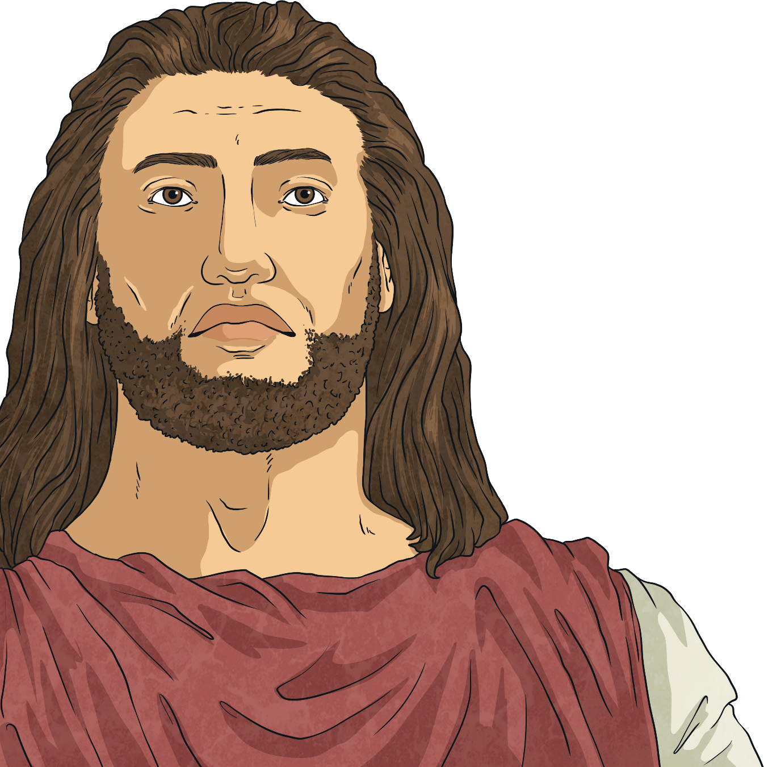
Who Was Mausolus?
The word ‘mausoleum’ comes from Mausolus, who was the ruler of a place called Caria in the 4th century BC.
Caria was part of the Persian Empire. Mausolus had the title of ‘satrap’ which meant that although his region came under Persian rule, he was generally free to run the area in his own way. The word ‘satrap’ meant ‘protector of the kingdom’ or ‘keeper of the region’.
Mausolus ruled from 377 BC to 353 BC. He is thought to have chosen Halicarnassus to be his capital city around 370 BC.

Slide 8
Halicarnassus
At the time, Halicarnassus was already a thriving city but Mausolus made it even grander.
He added many new and exquisite buildings to the city including a palace, temples and a new harbour.
Earth was dug away from the bottom of the harbour to make it deeper. This meant bigger ships could arrive in Halicarnassus, bringing more goods to trade and making the city richer. Trade was also improved by a better road network, which made it easier to travel around the Persian Empire and further improved the area’s wealth.
Mausolus had a grand palace built by the harbour. An amphitheatre was built as well as a temple dedicated to Ares, the Greek god of war.
Did You Know…?
Halicarnassus was the birthplace of Herodotus, the most important Greek historian of the time.

Slide 9
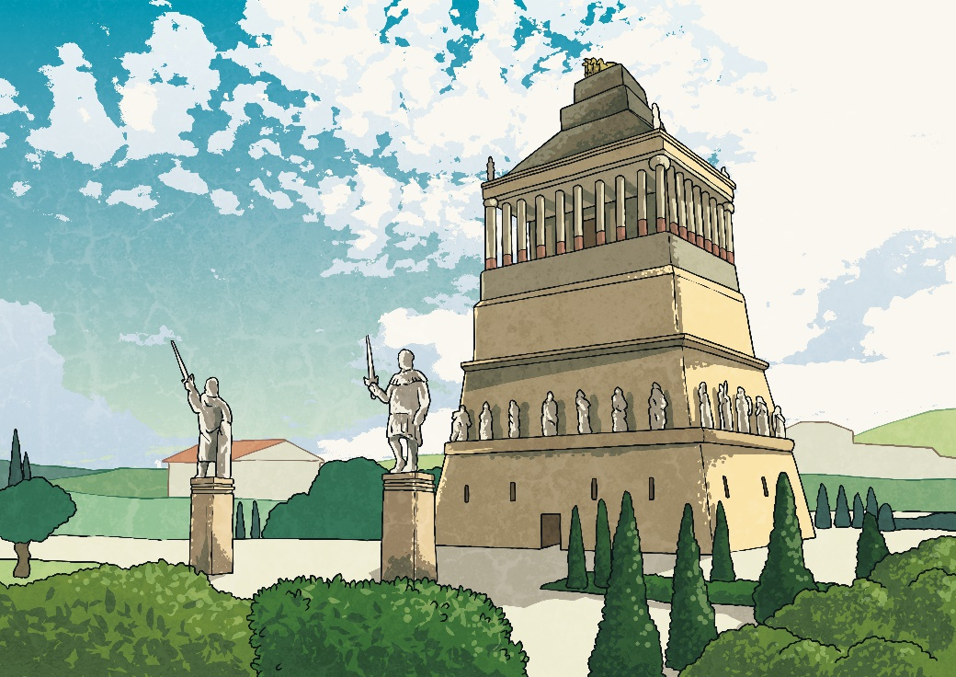
The Mausoleum
In 353 BC, Mausolus died. After his death, his widow Artemisia took over as ruler. During this time, work started on the monument to honour her husband.
No expense was spared on the building. Artemisia ensured the best sculptors and architects from Greece were chosen. Satyrus and Pytheos, the architects who designed the building, later wrote a book about the monument.
Did You Know…?
Mausolus actually put plans in place for his own tomb before his death!

Slide 10
The Mausoleum
At the top was a quadriga, which is a statue of four horses, pulling a carriage on which statues of Mausolus and Artemisia stood.
It was built on a hill overlooking the city.
Each side was decorated with carvings showing battles and other action scenes.
Statues of gods and goddesses.
Stone soldiers guarding the tomb.
The tomb was around 40 metres high.

Slide 11
The Mausoleum
Work on the Mausoleum took several years, and it is thought that Artemisia died before its completion. For many years, the Mausoleum remained one of the grandest buildings in the world.
It is not known exactly when the Mausoleum was destroyed. It was referred to as ‘a wonder’ by a bishop and historian in the 12th century. However, in 1402, a group of soldiers arrived in the city and recorded that it was in ruins. Historians think the Mausoleum must have been destroyed by an earthquake at some point.
Did You Know…?
The Mausoleum was the second to last wonder of the ancient world to survive, behind the Great Pyramid of Giza. Today, only the Great Pyramid survives.

Slide 12
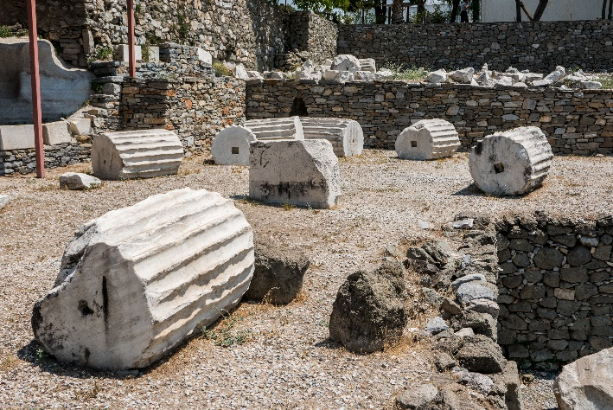
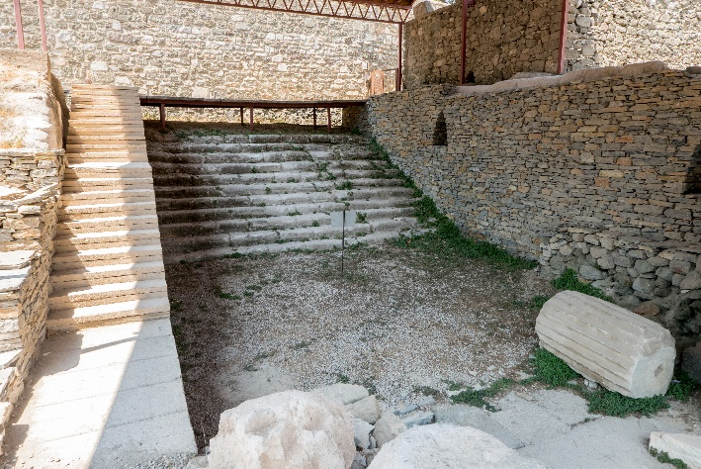
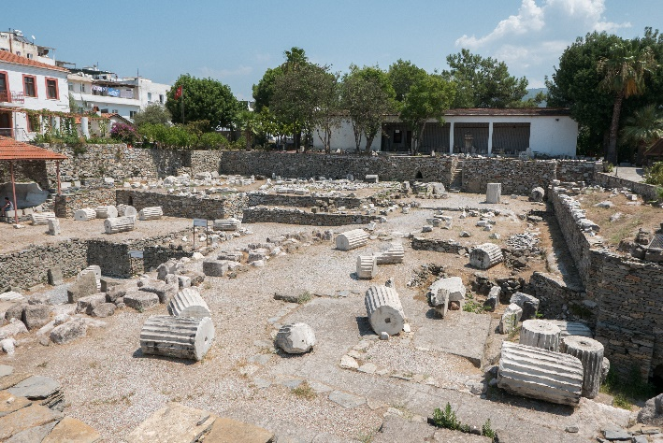
The Ruins of the Mausoleum
Today, only ruins of the Mausoleum remain. It is thought that many of the stones were used in other buildings over time. The site is a popular tourist attraction in Bodrum.
“Mausoleum at Halicarnassus” by [shadowgate] is licensed under CC BY 2.0
“Mausoleum at Halicarnassus” by [shadowgate] is licensed under CC BY 2.0
“Mausoleum at Halicarnassus” by [shadowgate] is licensed under CC BY 2.0

Slide 13
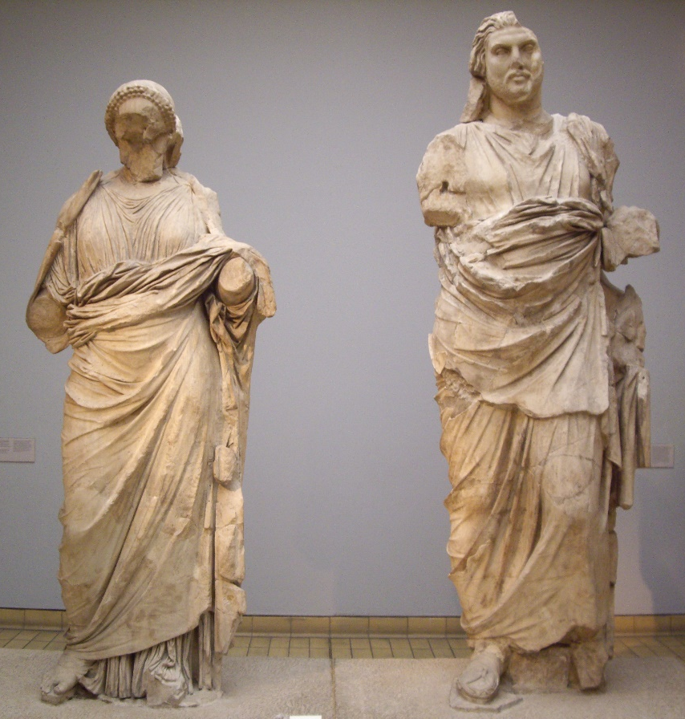
The Ruins of the Mausoleum
In the 19th century, British explorers removed many of the statues and sections of marble carvings from the site. Many of these items are now on display at the British Museum in London.
This statue, in the British Museum, is thought to possibly be Mausolus and Artemisia.
“Woman and man statues” by [virtusincertus] is licensed under CC BY 2.0
Did You Know…?
Why do you think explorers took the items? Do you think it was right to do so, or do you think they should have remained in Turkey?

