Slide 2
The Ancient Seven Wonders of the World
The ancient Seven Wonders of the World is a list of remarkable, humanly-constructed landmarks from ancient, classical civilisations. The original list dates from the second century BC. The landmarks consist of a pyramid, a mausoleum, a temple, two statues, a lighthouse and a garden.
The ancient Seven Wonders of the World are:
•The Lighthouse of Alexandria
•The Colossus of Rhodes
•The Statue of Zeus at Olympia
•The Temple of Artemis at Ephesus
•The Hanging Gardens of Babylon
•The Great Pyramid of Giza
•The Mausoleum at Halicarnassus

Slide 3
The Ancient Seven Wonders of the World
Why was the list created?
When early Greek travellers began to travel and explore other ancient civilisations, such as the Egyptians, Persians and Babylonians, they were impressed with some of the marvellous and imaginative architecture they saw. They began to put together lists of some ‘must-see’ recommendations for future visitors.
They called these inspiring landmarks ‘theamata’ - meaning ‘sights’. Over time, this developed into the more magnificent name ‘thaumato’ - meaning ‘wonders’.
Therefore, the ancient Seven Wonders of the World was an early tourist guidebook!

Slide 4
The Ancient Seven Wonders of the World
Even though there are a multitude of hugely impressive ancient sights, there have only ever been seven ancient Wonders of the World.
The ancient Greeks believed the number seven represented perfection so it was a particularly significant number for them.
Why are there only seven?
The original list of the ancient Seven Wonders of the World has inspired a host of similar lists throughout history.
In 2000, a modern list of the new Seven Wonders of the World was created, consisting of landmarks that are still in existence today.

Slide 5
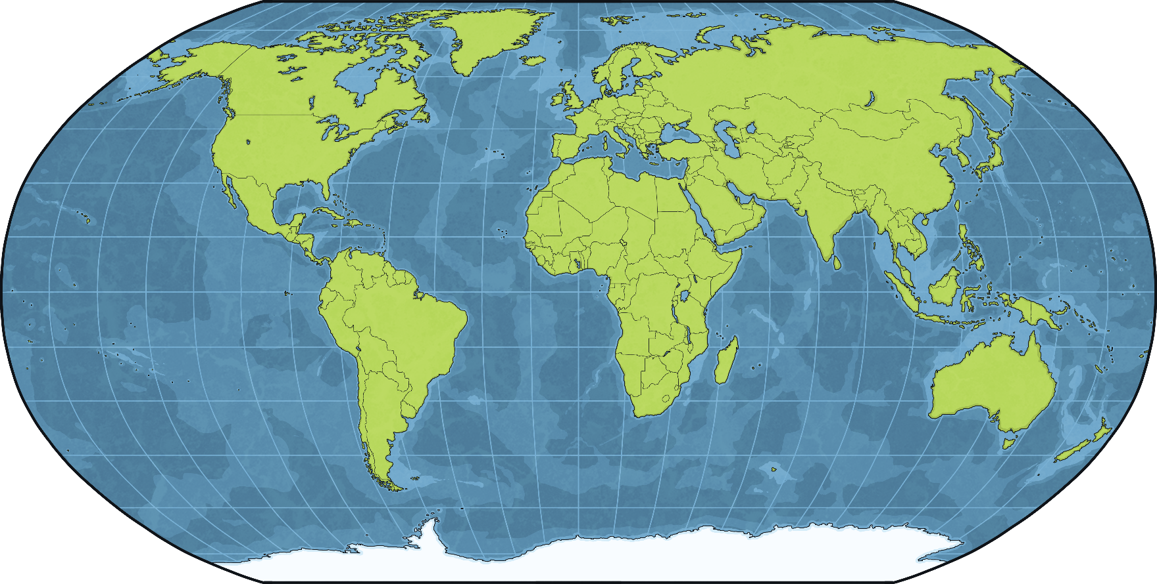
The Statue of Zeus at Olympia
The Statue of Zeus at Olympia was one of the ancient Seven Wonders of the World. It was in Olympia in Greece.
Greece

Slide 6
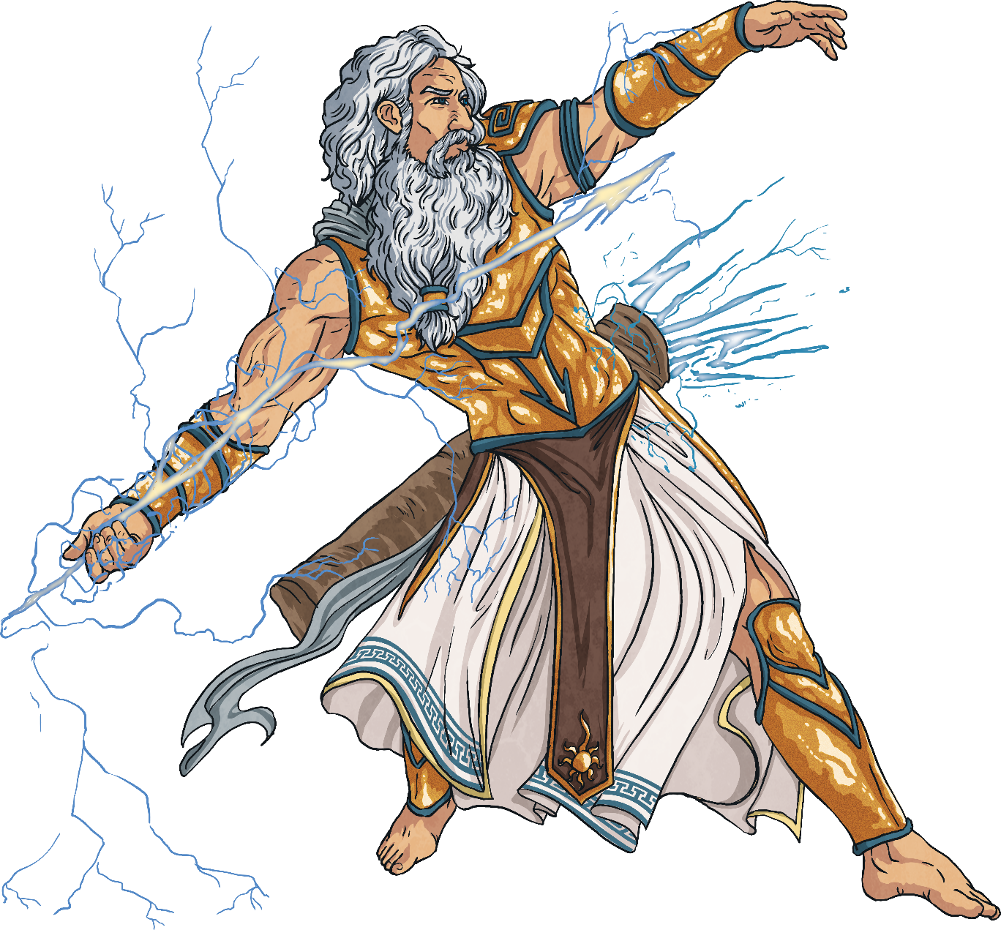
Zeus
The ancient Greeks believed in a system of gods and goddesses, each of whom were responsible for different parts of life. These gods and goddesses were thought to live on Mount Olympus.
Zeus was the king of gods, as well as being god of the sky and thunder. He was also connected with wisdom, authority and destiny.
Zeus was married to the goddess Hera and had many children.

Slide 7
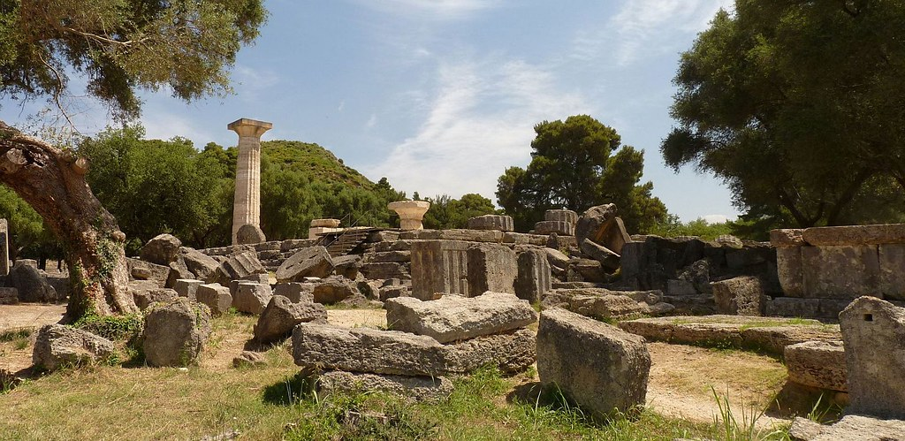
Olympia
The town of Olympia was important in the ancient Greek world. As you can probably tell from its name, Olympia was the home of the Greek Olympics. The first games were thought to have been held in 776 BC. Olympia had a stadium, a hippodrome for chariot racing, a gymnasium and temples dedicated to different gods.
Although only ruins of these structures remain, Olympia is a popular tourist destination and an important place for archaeologists to discover more about the ancient Greeks.
Did You Know…?
“Olympia Temple of Zeus” by [Ronny Siegel] is licensed under CC BY 2.0
The flame that burns at modern-day Olympics is lit at Olympia before starting its journey across the globe, arriving at the stadium for the start of the games.

Slide 8
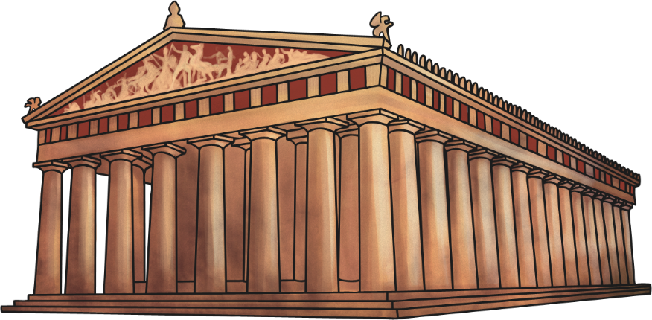
The Temple of Zeus
The worshipping of Zeus was important in Olympia and the temple of Zeus was one of the most important buildings in the town. The temple was built to celebrate a victory over the people of Pisa.
It is believed to have been constructed around 460 BC. The temple was made of limestone and then covered in stucco, a type of plaster that could be made to look like marble.
The temple was over 20 metres high, 28 metres wide and 64 metres long.
Did You Know…?
Despite their similar sounding names, Olympia is over 500km away from Mount Olympus.

Slide 9
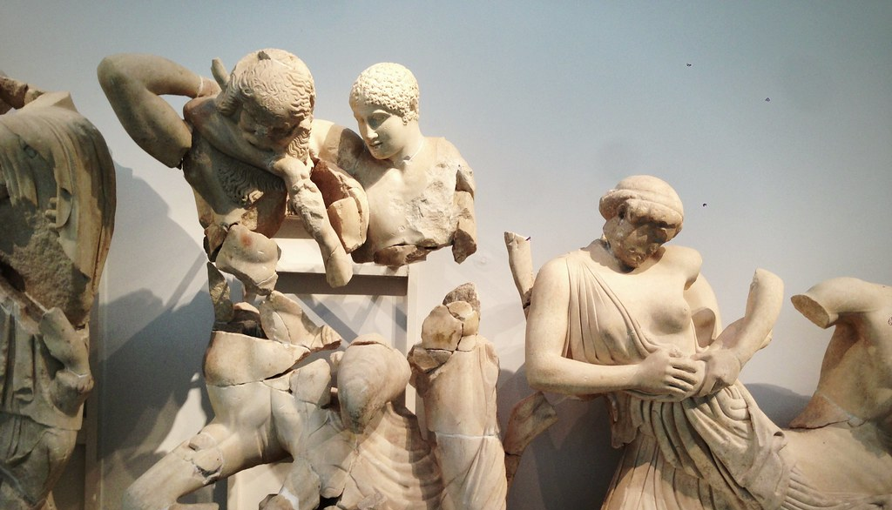
The Temple of Zeus
Greek temples had triangular sections on the front and back which were called pediments. The pediments on the temple of Zeus showed scenes from Greek mythology, including chariot races and battles. Lion-head statues acted as water spouts to take water away from the roof of the temple. The remains of these lion heads can still be seen at the site of the temple.
Above the front and rear porches were sculptures showing the ‘Labours of Heracles’, a Greek myth about the adventures of the son of Zeus. Parts of many of these statues survive in a museum in Olympia.
Did You Know…?
“Olympia” by [Karl Baron] is licensed under CC BY 2.0
The ancient Greeks believed that a god would visit or live in a temple dedicated to them. This was why the statue of a god was the most important part of a temple.

Slide 10
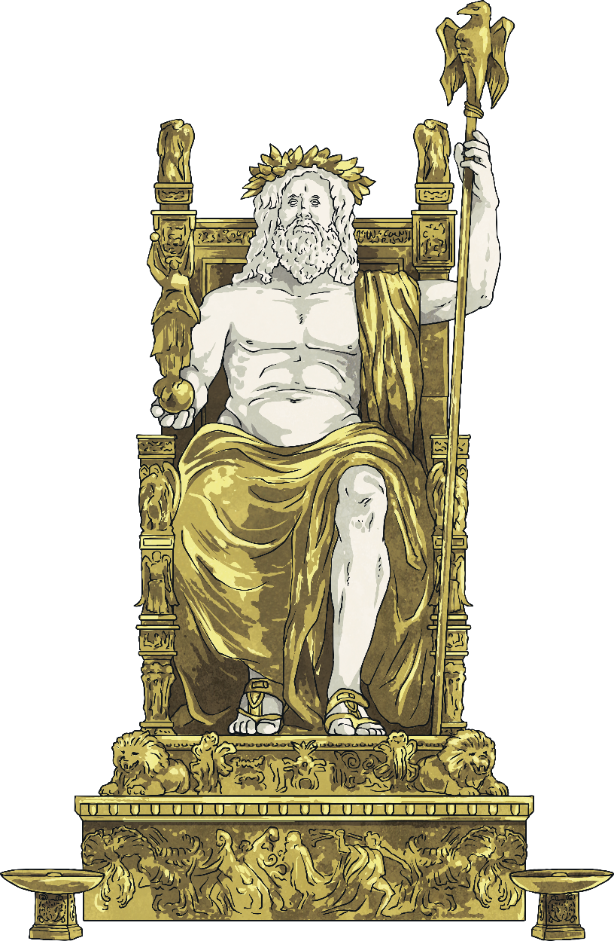
The Statue of Zeus
The sculptor Phidias created the statue. Phidias also made the statue of Athena in the Parthenon in Athens.
The statue was almost 12 metres high.
The statue wore an olive wreath on his head. This symbolises victory, like the ones given to athletes who won events at the Olympics.
The frame of the statue was wooden. It was then covered with ivory and gold.
In the statue’s hand was a smaller statue of the goddess Nike (the Greek goddess of victory).

Slide 11
The Statue of Zeus
The statue held a sceptre (a long stick carried by rulers), on which perched an eagle – a symbol of Zeus.
Zeus’ throne was decorated with glass and precious jewels.
One Greek writer said the statue was kept covered in olive oil to protect it. This made the statue glisten.
In front of the statue, there were tiles that reflected its image, making its appearance more impressive.
We only know what the statue looked like from a coin and a few accounts from ancient Greek writers.
The footstool was decorated with a battle scene.

Slide 12
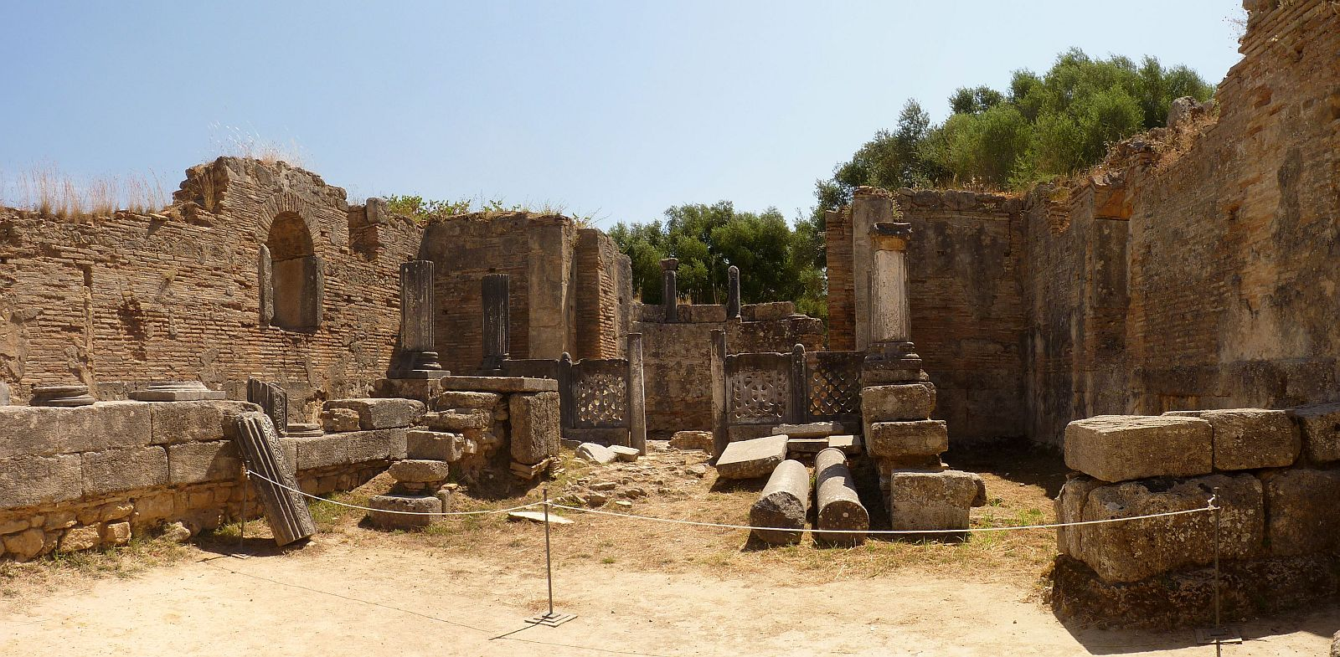
Phidias’ Workshop
These are the ruins of Phidias’ workshop in Olympia, where he would have designed and created the statue of Zeus. On the bottom of the statue, Phidias carved these words: ‘Phidias, son of Charmides, an Athenian, made me’.
“Olympia Phidias' workshop and paleochristian basilica” by [Ronny Siegel] is licensed under CC BY 2.0

Slide 13
The Destruction of the Statue
Stories are told that the Roman Emperor Caligula tried to remove the statue of Zeus. The legend says that the statue began to laugh and the scaffolding being used to remove the statue collapsed.
With the growth of Christianity among the Roman Empire, worship of Greek gods and events, such as the Olympics, were banned. The final Olympics were held in AD 393 and the temple fell into disrepair. It is thought the temple was completely destroyed by an earthquake in the 6th century.
What became of the statue is unclear. Some historians think the statue was eventually removed and taken to the city of Constantinople in AD 395, where it was later destroyed by fire in AD 475. Other accounts say the statue remained in the temple but was later destroyed by a great fire in AD 425.

Slide 14
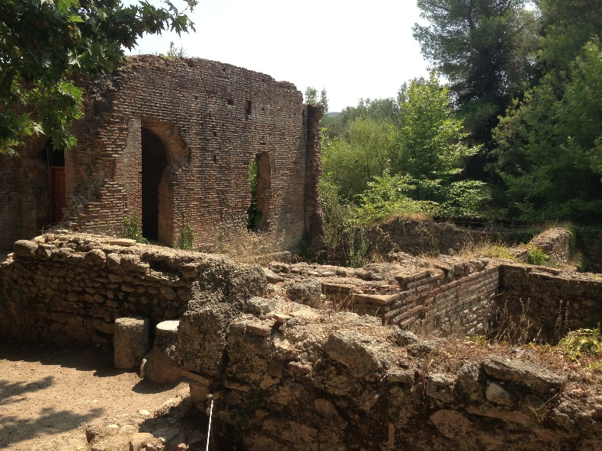
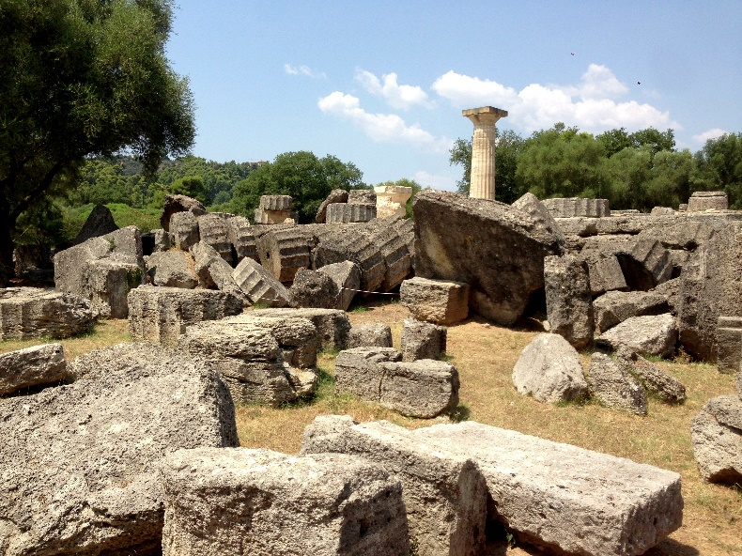
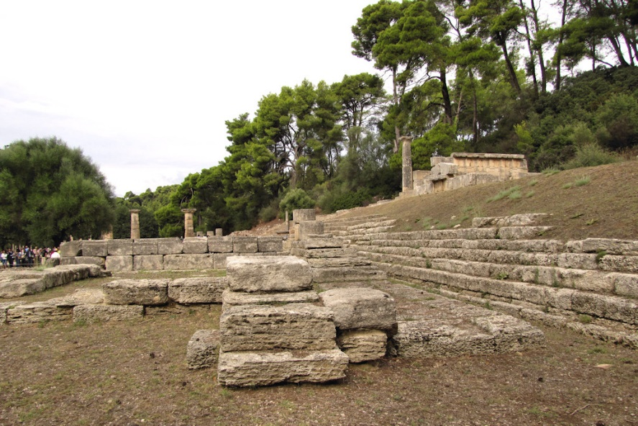
The Remains of Olympia
The ruins of ancient Olympia can still be viewed today.
“Olympia” by [Karl Baron] is licensed under CC BY 2.0
“Olympia” by [Karl Baron] is licensed under CC BY 2.0
“Olympia” by [Karl Baron] is licensed under CC BY 2.0
“Ruins of Olympia, Greece #5” by [wiredtourist.com] is licensed under CC BY 2.0

Slide 15
Design It!
Imagine you are in Phidias’ workshop and you are going to design your own statue.
Who will it be of and why?
What would your statue be made of?
Where would your statue be placed?
How big would your statue be?

