Slide 2
The Ancient Seven Wonders of the World
The ancient Seven Wonders of the World is a list of remarkable, humanly-constructed landmarks from ancient, classical civilisations. The original list dates from the second century BC. The landmarks consist of a pyramid, a mausoleum, a temple, two statues, a lighthouse and a garden.
The ancient Seven Wonders of the World are:
•The Lighthouse of Alexandria
•The Colossus of Rhodes
•The Statue of Zeus at Olympia
•The Temple of Artemis at Ephesus
•The Hanging Gardens of Babylon
•The Great Pyramid of Giza
•The Mausoleum at Halicarnassus

Slide 3
The Ancient Seven Wonders of the World
Why was the list created?
When early Greek travellers began to travel and explore other ancient civilisations, such as the Egyptians, Persians and Babylonians, they were impressed with some of the marvellous and imaginative architecture they saw. They began to put together lists of some ‘must-see’ recommendations for future visitors.
They called these inspiring landmarks ‘theamata’ - meaning ‘sights’. Over time, this developed into the more magnificent name ‘thaumato’
- meaning ‘wonders’.
Therefore, the ancient Seven
Wonders of the World was an
early tourist guidebook!

Slide 4
The Ancient Seven Wonders of the World
Even though there are a multitude of hugely impressive ancient sights, there have only ever been seven ancient Wonders of the World.
The ancient Greeks believed the number seven represented perfection so it was a particularly significant number for them.
Why are there only seven?
The original list of the ancient Seven Wonders of the World has inspired a host of similar lists throughout history.
In 2000, a modern list of the new Seven Wonders of the World was created, consisting of landmarks that are still in existence today.

Slide 5
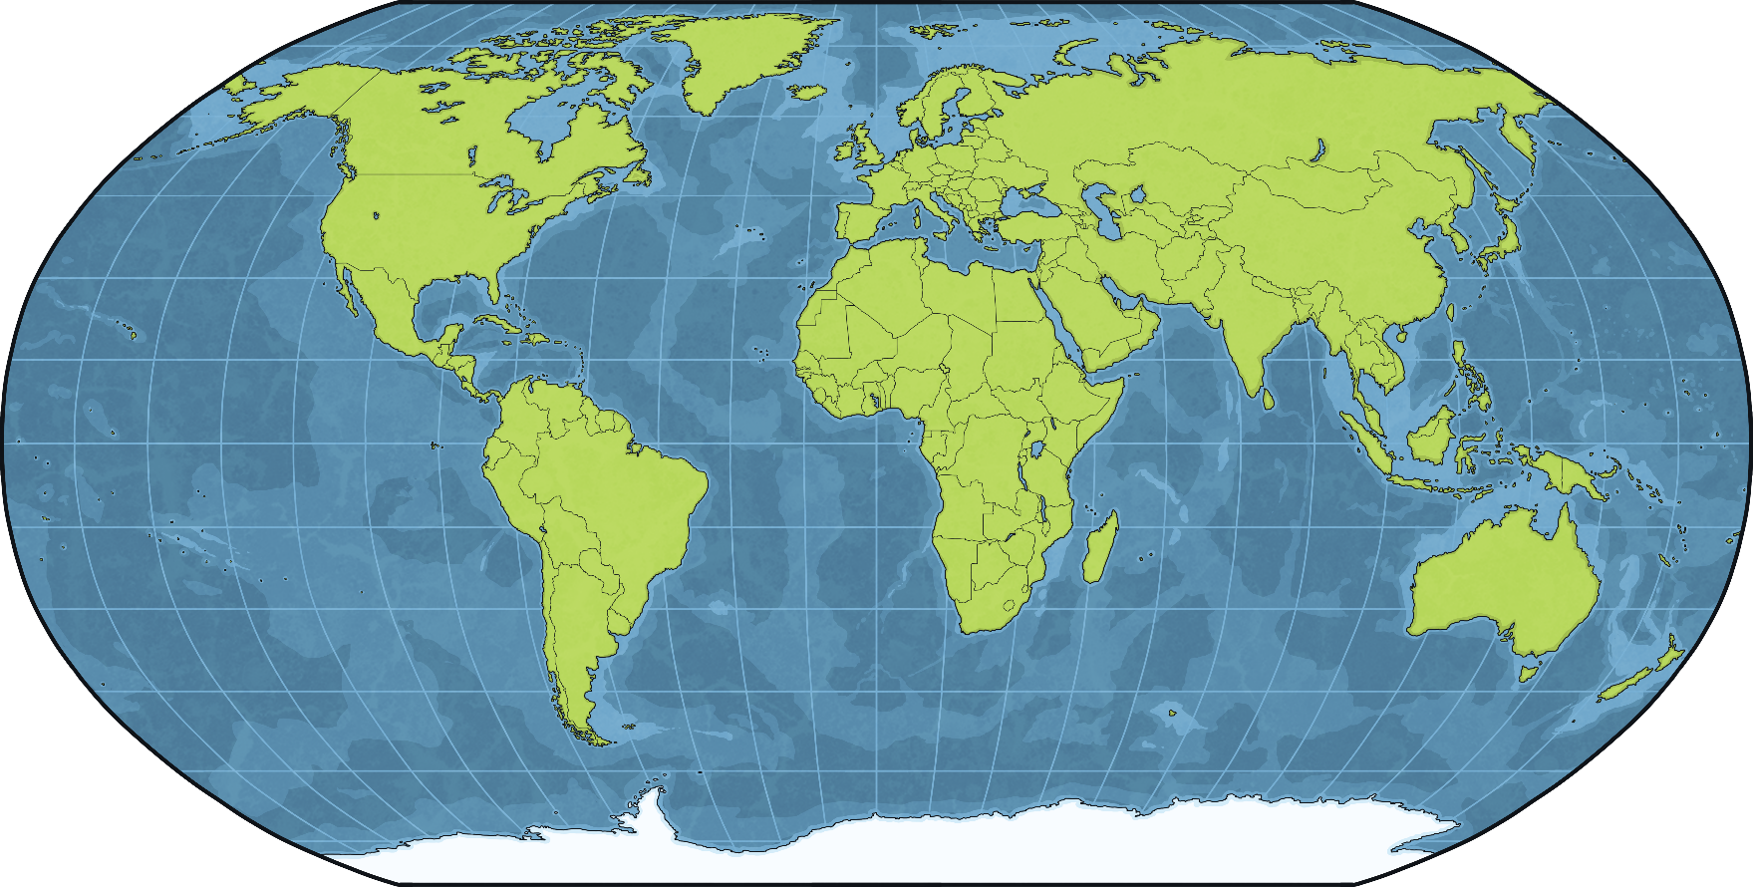
The Hanging Gardens of Babylon
The Hanging Gardens of Babylon were in the city of Babylon in present-day Iraq.
Iraq

Slide 6
The Babylonians
Babylonia was a state in ancient Mesopotamia. Its people were the Babylonians. Its capital was the city of Babylon.
Can you find Babylon on the map?
Mesopotamia means ‘land between rivers’. The ancient civilisation of Mesopotamia developed between the Tigris and Euphrates rivers. It was one of the main civilisations of the ancient world.
Babylon
Israel
That’s right! Babylon was located about 50 miles south of modern-day Baghdad, the capital of Iraq.
civilisations - Organised societies with their own cultures and ways of life, existing in a particular area over a particular period of time

Slide 7
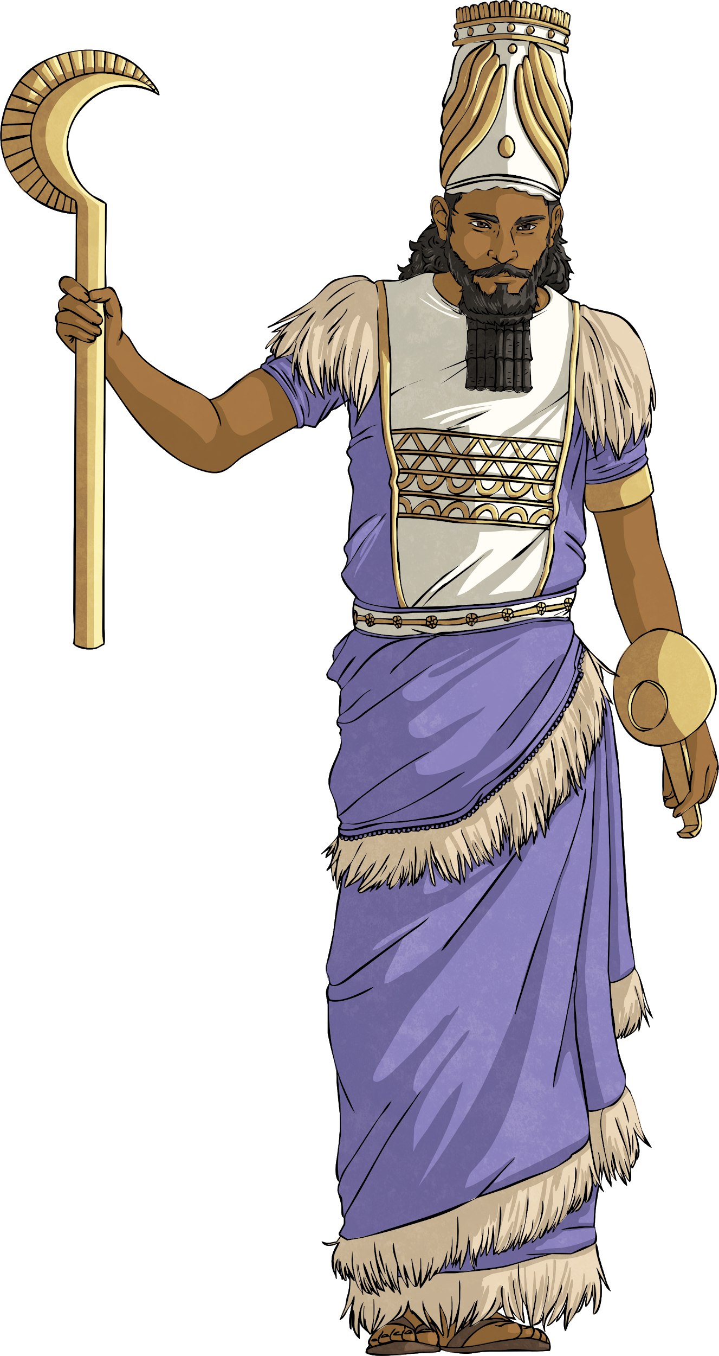
Two Kings
Two kings were the main contributors to the development of Babylon as one of the key cities in ancient Mesopotamia – King Hammurabi and King Nebuchadnezzar II.

Slide 8
King Hammurabi
King Hammurabi is famous for creating the Code of Hammurabi, which was once considered the oldest set of laws in human history. He is represented on the slab in which the code was inscribed – which of the two figures do you think represents him?
He is the figure on the left. Were you right? You might have thought he was the figure on the right, who seems to be sitting on a throne. However, that’s the Sun God, Shamash, who was supposed to have handed over the laws to Hammurabi.

Slide 9
King Hammurabi
The Code of Hammurabi contains 282 laws written in cuneiform script, the wedge-shaped writing that you can see on the picture.
Cuneiform script was discovered in the late 19th century and transformed our understanding of history. Until then, the Bible was considered the oldest book of the world.
A translator called George Smith published his translation of a tablet that contained ‘The Epic of Gilgamesh’, which in turn allowed other cuneiform tablets to be translated. Cuneiform script was first developed by the Sumerians, another group of peoples of ancient Mesopotamia.

Slide 10
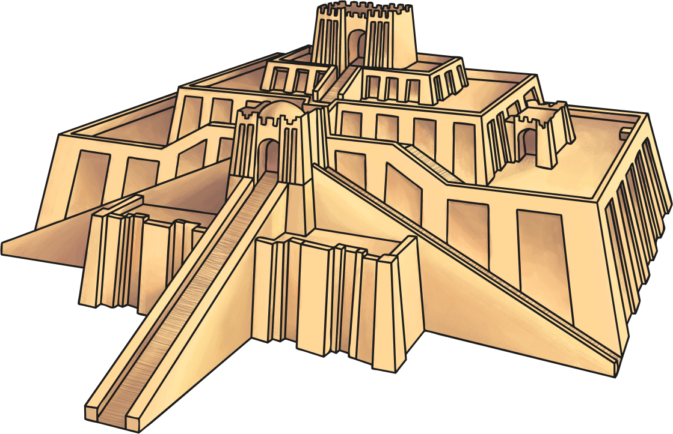
Making Babylon Important
King Hammurabi was responsible for transforming Babylon from a small town to a capital city. He improved the defences of the city, strengthening the city walls. He also improved the city’s watering system and built new temples.
These changes were implemented during his reign, which lasted from 1792 to 1759 BC.

Slide 11
King Nebucchadnezzar II
By the 6th century BC, Babylon had fallen into disrepair. The city had been damaged in fights between different peoples who wanted to control Mesopotamia and a lot of the improvements carried out by King Hammurabi were not visible any more.
King Nebuchadnezzar II rebuilt Babylon and for this reason, his period of reign was known as the Neo-Babylonian Empire. He ruled from 605 to 561 BC. Some of his achievements included:
rebuilding the massive walls of the city so it would be more difficult to attack;
building new temples and restoring old ones that had been damaged;
constructing the beautiful Ishtar Gate that we can still see today, reconstructed at the Pergamon Museum in Berlin;
building an enormous palace that included the Hanging Gardens of Babylon.

Slide 12
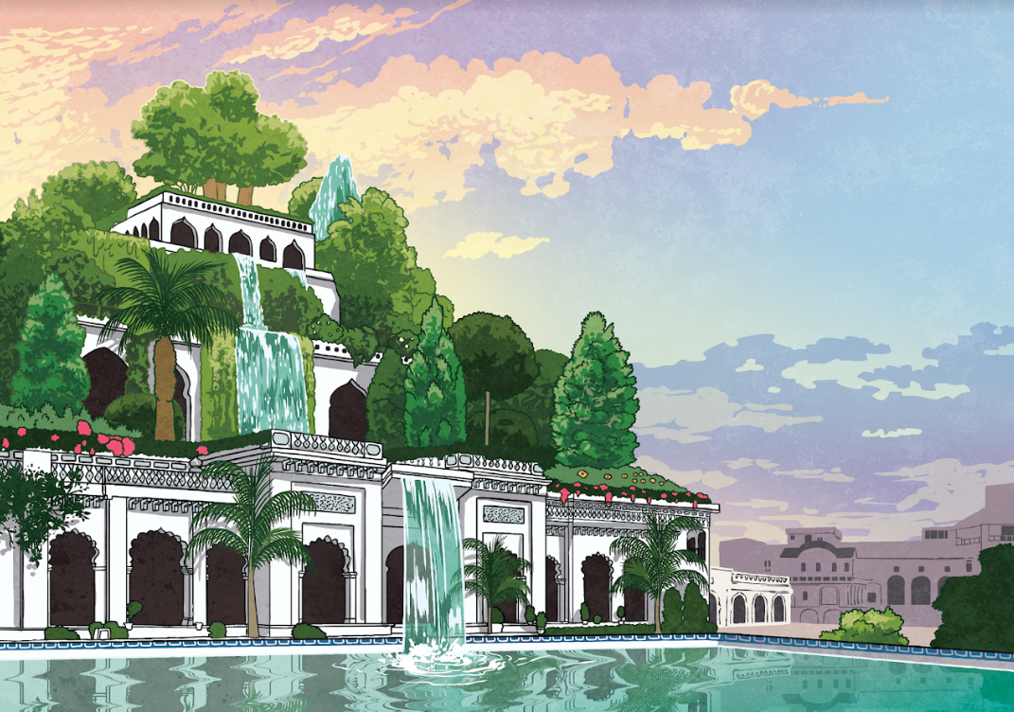
The Hanging Gardens of Babylon
It is said that King Nebucchadnezzar II commanded the construction of the Hanging Gardens of Babylon because his wife, Queen Amytis, missed the mountains and flowers of her lush homeland.
One Greek author who mentioned the Gardens, spoke of a structure made of mud bricks, measuring 400 feet wide and 75 feet high, resting on heavy foundations of natural stone.
There were waterfalls falling from floor to floor and lots of different kinds of trees, shrubs and flowers.
The Gardens were considered a feat of engineering, especially taking into account how dry the area around Babylon was.

Slide 13
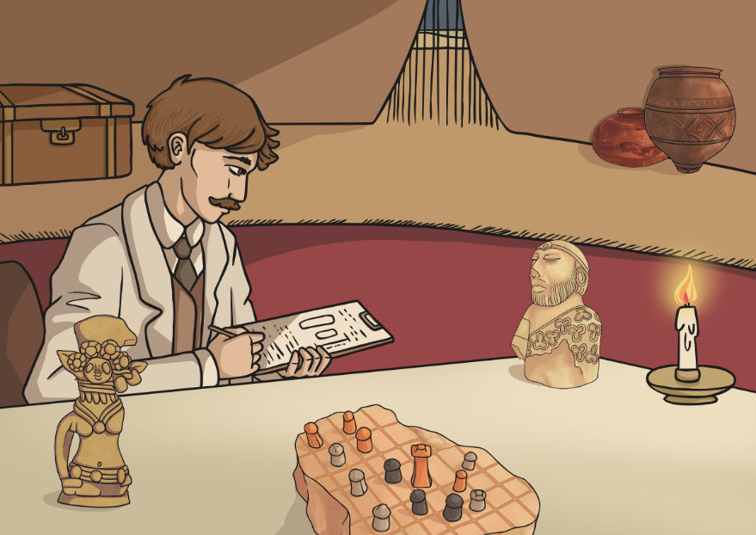
The Controversy
However, there is no actual evidence that the Hanging Gardens of Babylon ever existed. No Babylonian texts mention them and no archaeological remains have been found.
Some researchers think that the gardens may actually have been in Nineveh, which was another important city in Mesopotamia, while others claim that the Greek authors, who compiled the list of the ancient Seven Wonders of the World, may have been fantasising about the royal palace in Babylon.
fantasising - imagining something that is desired

Slide 14
Did the Gardens Really Exist?
Using the information on this PowerPoint, as well as using the Internet and some reference books, prepare a debate on whether the Hanging Gardens of Babylon really existed.
One team will defend the fact that they did exist. They will need to find out:
the names of the Greek authors that mention the gardens;
archaeologists who have found any remains that could be interpreted as the gardens.
The other team will defend the fact that they did not exist. They will need to find out:
the names of archaeologists who think they might have been located in other places;
online newspapers that deny the existence of the gardens, with dates.
Which team has been the most persuasive?

