Slide 1
We hope you find the information on our website and resources useful.
This resource contains links to external video websites.
These websites often have autoplay features meaning that other videos will play after the video you are watching finishes. You should disable this feature before using the video in any classroom or similar setting. Twinkl assumes no responsibility for the contents of linked websites. The inclusion of any link in this resource should not be taken as an endorsement of any kind by Twinkl of the linked website or any association with its operators. We have no control over the availability of the linked pages. If the link is not working, please let us know by contacting TwinklCares and we will try to fix it, although we can assume no responsibility if this is the case.
Please be aware, clicking this button will take you to an external video website:

Slide 3
The New Seven Wonders of the World
The ancient world had seven significant places, known as ‘The Seven Wonders of the World’. In 2000, a campaign was started to choose seven wonders of the modern world.
Over 100 million votes were cast. The final seven places chosen were:
Chichén Itzá, Mexico;
Machu Picchu, Peru;
Christ the Redeemer, Brazil;
The Colosseum, Italy;
Petra, Jordan;
Taj Mahal, India;
The Great Wall, China.
Today, we are going to find out about Chichén Itzá in Mexico.

Slide 4
Where Is Mexico?
Mexico is in North America.

Slide 5
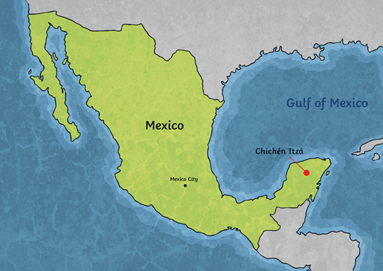
What Is Chichén Itzá?
Chichén Itzá is an ancient city built by the Maya people over 1500 years ago. Around AD 600, it became an important area.
It was built on the Yucatán Peninsula of Mexico. It was once a busy city for the Maya people as it was vital for trade.
‘Chichén Itzá’ means at the mouth of the well of Itzá. Two large sinkholes nearby would have provided much needed water, which is why it is believed to have been built where it was.

Slide 6
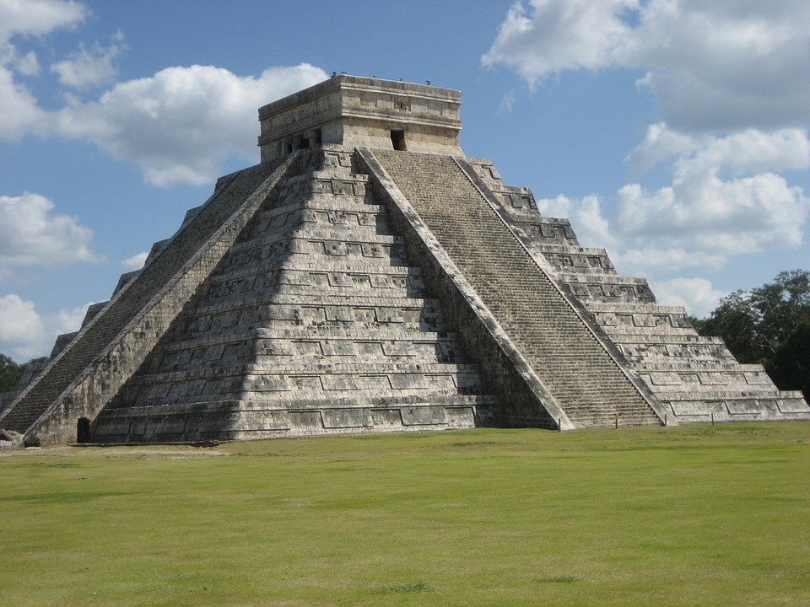
The Kukulkan Pyramid
The Maya people were great architects. Chichén Itzá demonstrates the vision of the world that the Maya people had, shown in the artwork and stone monuments that are still there today.
Within the Great North Platform area of the city, is the most recognised temple in Chichén Itzá - El Castillo (The Castle), also known as the Temple of Kukulkan or the Kukulkan Pyramid. This stands at 24 metres high.

Slide 7
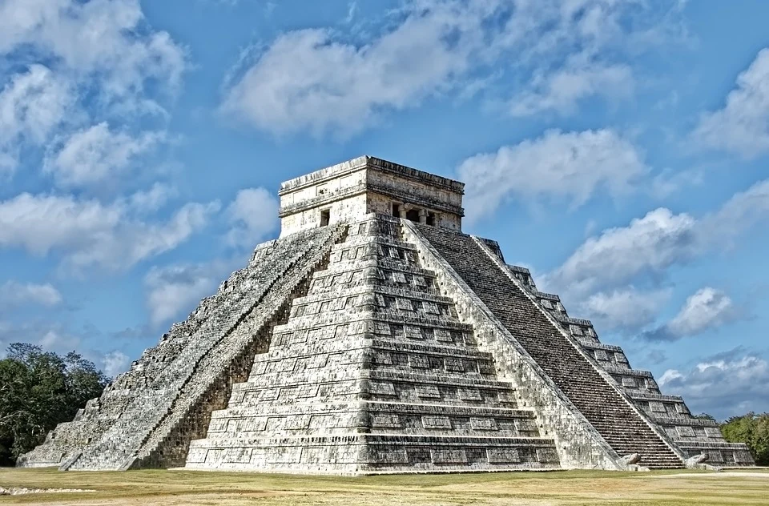
The Kukulkan Pyramid
Kukulkán was the most important of the gods that the Maya people worshipped. The name means ‘feathered serpent’.
During the spring equinox (around 20th March) and the autumn equinox (22nd September), the sun’s rays create a shadow across the Kukulkan Pyramid, which gives the impression of a snake slithering down the staircase.
It has 91 steps on each of its four sides which, when combined with the final step on top, makes 365 steps. This totals one step for each day of the year. This would have been deliberate as the Maya people were skilled astronomers and the Solar System was extremely important to them.

Slide 8
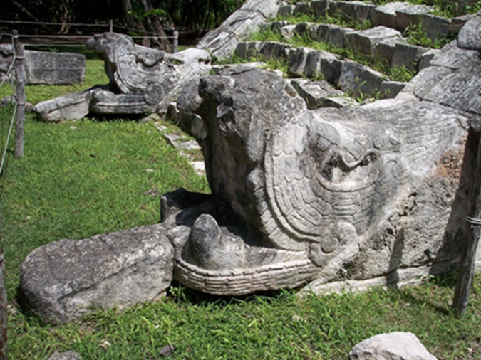
Serpent Statues
The feathered snake god of the Maya people, Kukulkán, is also represented around the pyramid, with carved serpent heads guarding each set of stairs.

Slide 9
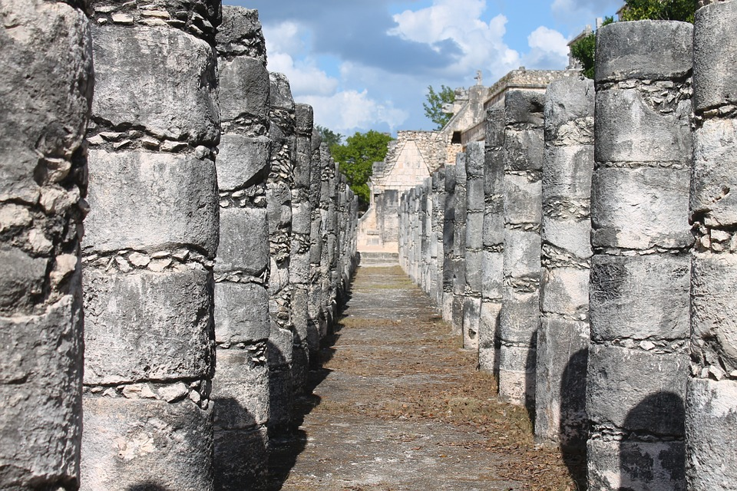
The Temple of Warriors
There are a number of temples at Chichén Itzá. The Temple of Warriors is also known as the Temple of a Thousand Columns due to the number of pillars along the south and west sides (although there are actually only 200). The pillars depict warriors. There would have been a roof on this temple but it has now disintegrated.

Slide 10
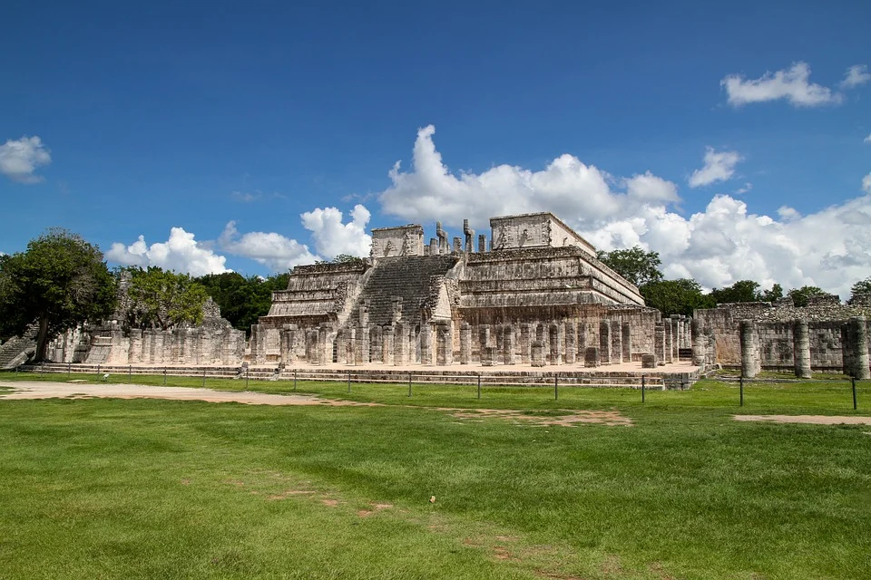
The Temple of Warriors

Slide 11
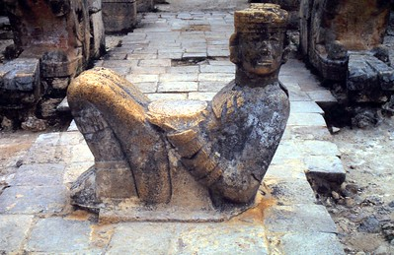
Chac Mool
At the top of the steps to the Temple of Warriors, there is a stone statue known as a Chac Mool. A Chac Mool was a figure leaning back on its elbows while resting a plate on its tummy. It is thought that the heart of an animal sacrifice might be placed on the plate to keep the gods happy.
“Photo” by OliBac is licensed under CC BY 2.0

Slide 12
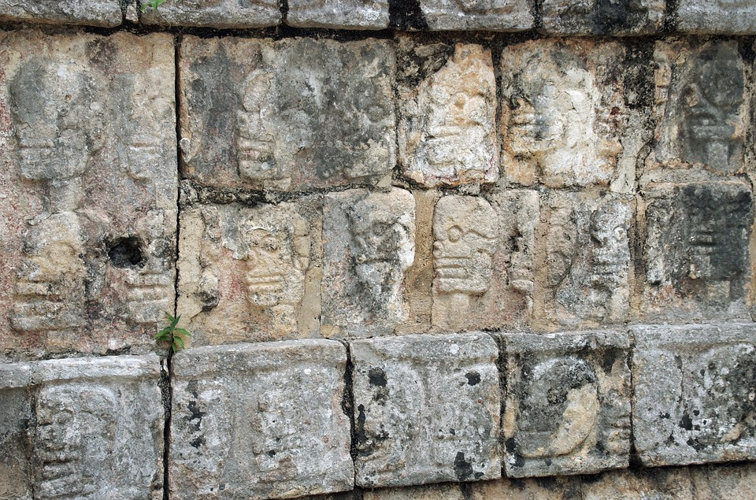
Wall of Skulls
In the Maya culture, those who had died were remembered through stone carvings on the Wall of Skulls, also known as Tzompantli or skull rack. The platform is decorated with eagles, skulls and snakes. It is thought that the Toltecs (a Mexican civilisation well-known for its sculpting) introduced the idea of a skull rack to the Maya people.

Slide 13
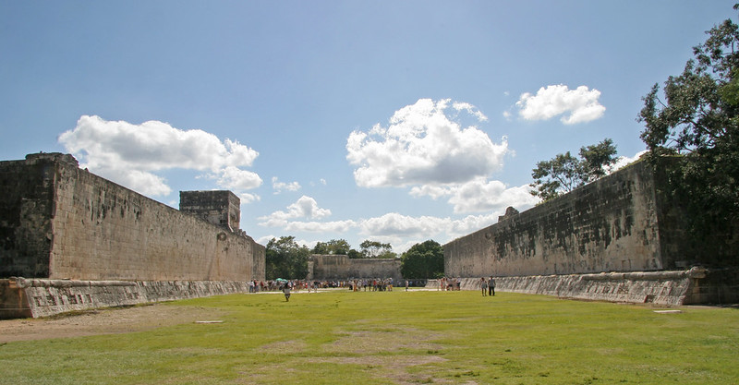
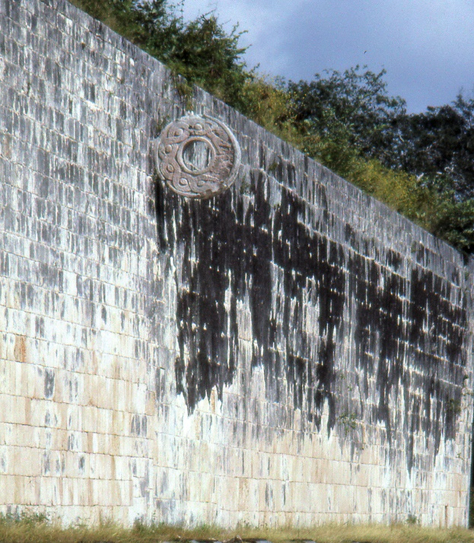
Ball Games
The Maya people were great sportspeople. In Chichén Itzá, there is the Great Ball Court. Games were played to settle political and social disputes, as well as for fun. Some ball games also had religious meanings. The ball game ‘pitz’ was popular. A rubber ball would be bounced without using hands or feet and put through stone hoops attached to the court.
Photo by BrianSnelson is licensed under CC BY 2.0
Did You Know…?
If you stand at the northern wall of the ball court and speak, it can be heard clearly at the southern wall – more than 500 feet away!
Click on this photo to see the metal hoop for the ball game.
Photo by JimG is licensed under CC BY 2.0

Slide 14
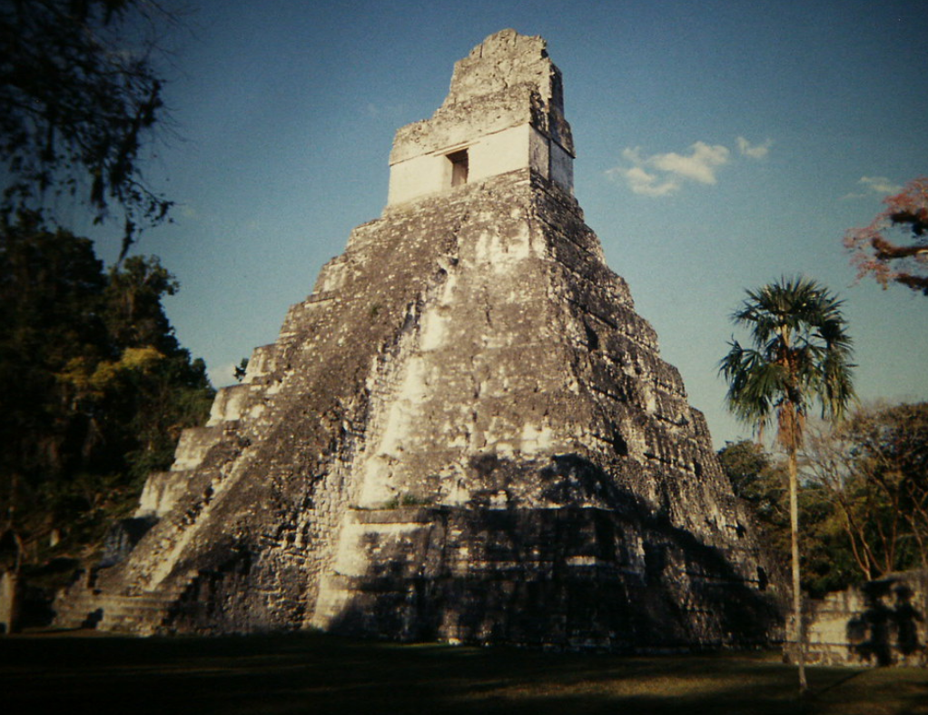
The Temple of the Jaguar
The Temple of the Jaguar, also known as Tikal Temple I, was built around AD 732. It has jaguar statues at the entrance and around the sides. Inside, the top of the temple is decorated with amazing paintings and drawings depicting Maya life (including battles, warriors, scenes from nature and people and how they dressed). The outside is guarded by huge serpent statues.
Click here to see a video of the inside of the temple.

Slide 15
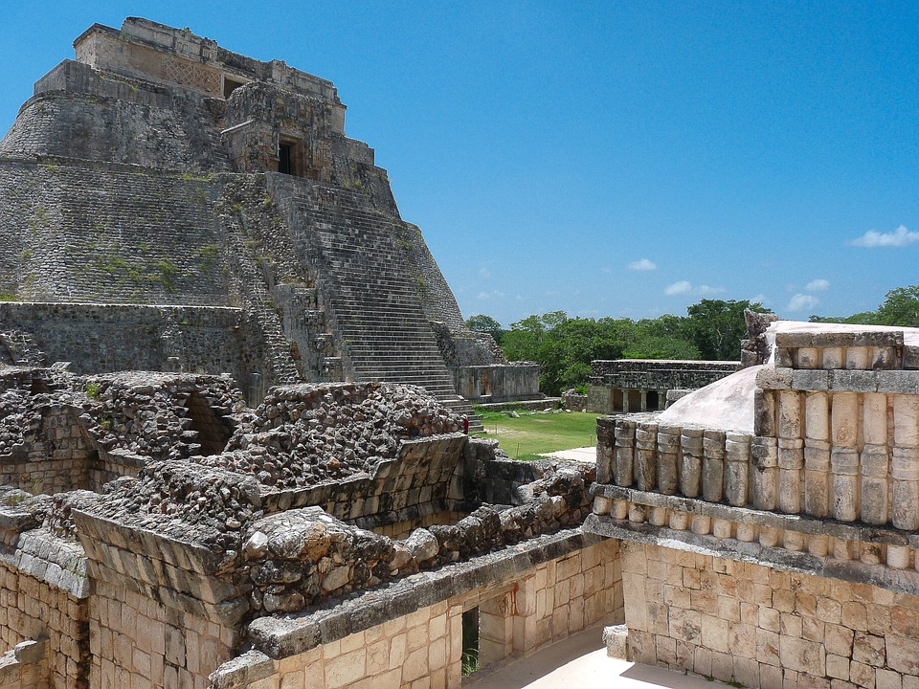
A Wonder of the World
Chichén Itzá is great evidence of how the Maya people lived over 1000 years ago. The remains of the city show there were marketplaces, many temples and a church, as well as places to play games. The life of the Maya people is evident in the stone carvings and paintings that still exist, showing them to be highly skilled craftspeople, as well as being religious, political and deeply aware of their connection to the natural world around them.
Chichén Itzá is a popular tourist destination and can have thousands of visitors each day during the high season. Due to the high volume of visitors, parts of the city have been destroyed so there are some areas where visitors can no longer go, such as to the top of the Kukulkan Pyramid.
Archaeologists continue to explore this fascinating city as they uncover the life of the Maya people.

