Slide 2
The Ancient Seven Wonders of the World
The ancient Seven Wonders of the World is a list of remarkable, humanly-constructed landmarks from ancient, classical civilisations. The original list dates from the second century BC. The landmarks consist of a pyramid, a mausoleum, a temple, two statues, a lighthouse and a garden.
The ancient Seven Wonders of the World are:
•The Lighthouse of Alexandria
•The Colossus of Rhodes
•The Statue of Zeus at Olympia
•The Temple of Artemis at Ephesus
•The Hanging Gardens of Babylon
•The Great Pyramid of Giza
•The Mausoleum at Halicarnassus

Slide 3
The Ancient Seven Wonders of the World
Why was the list created?
When early Greek travellers began to travel and explore other ancient civilisations, such as the Egyptians, Persians and Babylonians, they were impressed with some of the marvellous and imaginative architecture they saw. They began to put together lists of some ‘must-see’ recommendations for future visitors.
They called these inspiring landmarks ‘theamata’ - meaning ‘sights’. Over time, this developed into the more magnificent name ‘thaumato’ - meaning ‘wonders’.
Therefore, the ancient Seven Wonders of the World was an early tourist guidebook.

Slide 4
The Ancient Seven Wonders of the World
Even though there are a multitude of hugely impressive ancient sights, there have only ever been seven ancient Wonders of the World.
The ancient Greeks believed the number seven represented perfection so it was a particularly significant number for them.
Why are there only seven?
The original list of the ancient Seven Wonders of the World has inspired a host of similar lists throughout history.
In 2000, a modern list of the new Seven Wonders of the World was created, consisting of landmarks that are still in existence today.

Slide 5
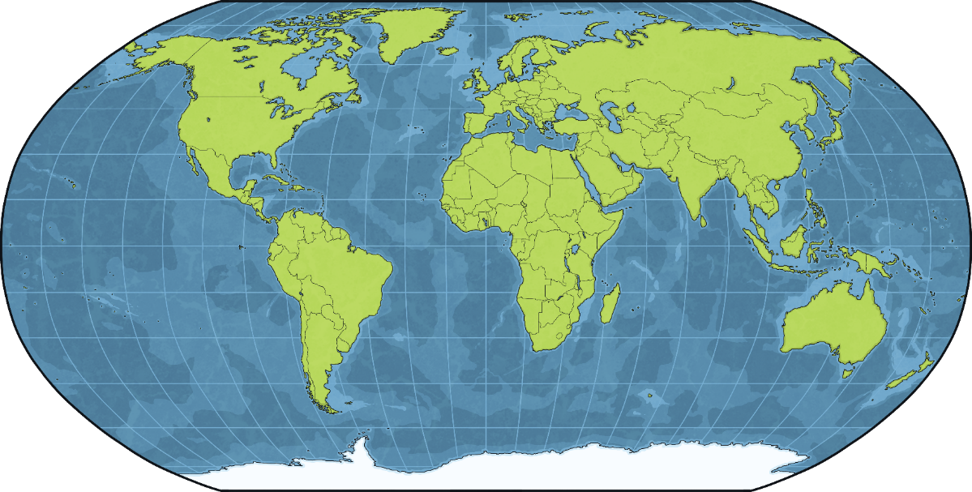
The Great Pyramid of Giza
The Great Pyramid of Giza was one of the ancient Seven Wonders of the World. It is in Egypt.

Slide 6
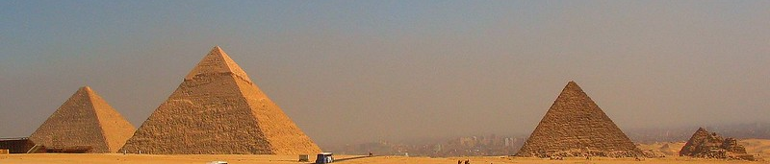
What Are the Pyramids?
The Egyptian pyramids were built at a time when Egypt was one of the most powerful and wealthy civilisations in the world. Kings of Egypt, known as pharaohs, were considered to be almost like gods. It was believed that after they died, they were resurrected in the afterlife and became gods who judged others when they died. Because of this, they continued to be honoured even in death.
Pyramids were built as tombs for the pharaohs and their queens. One of the first pyramids was built in 2630 BC. That’s over 4500 years ago.
Pharaohs were buried in the pyramids with all the belongings they may need in the afterlife.
Did You Know…?
Some people think that the three main pyramids of Giza were built in line with the stars which form the constellation, Orion’s Belt. This is because the Egyptians believed the gods descended from the stars.
“Pyramids” by jay8085 is licensed under CC BY 2.0

Slide 7
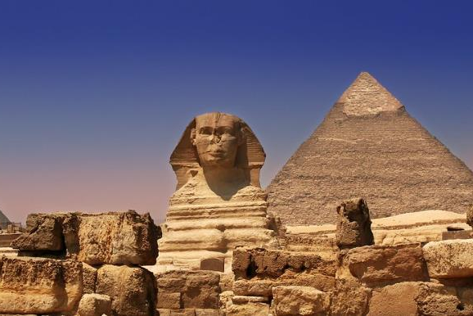
The Pyramids of Giza
The Great Pyramid of Giza is the largest of the pyramids which stand in Giza. They were built on the west bank of the river Nile, near the capital city of Cairo, Egypt.
Around 2550 BC, Pharaoh Khufu, also known as Cheops, instructed the first of the three pyramids to be built. This was the Great Pyramid and stood 147 metres above the ground when first constructed. The building of the second pyramid was instructed by Khufu’s son, Pharaoh Khafre, around 2520 BC. He included the structure known as the Sphinx, which guards the entrance to the pyramid.
“Giza Pyramids & Sphinx - Egypt” by Sam valadi is licensed under CC BY 2.0
The third pyramid at Giza was built by Pharaoh Menkaure around 2490 BC. Although it is a lot smaller than the first two, parts of it are a lot more complex.
Did You Know…?
The Sphinx is made from limestone and has the body of a lion and the head of a human.

Slide 8
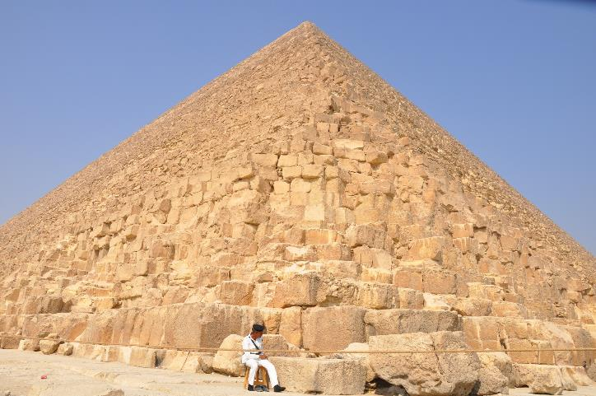
The Great Pyramid
The Great Pyramid was the tallest human-made structure in the world for around 3800 years and is the last remaining structure from the list of the ancient Seven Wonders of the World. It is thought to have taken up to 20 years to build, using 2.5 million limestone blocks (each weighing between 2 and 30 tonnes) which were cut, moved and positioned by hand. The limestone came from quarries nearby but the largest stones came from Aswan, which is 500 miles away from Giza.
Originally, the three pyramids would have had a smooth outer casing of lighter limestone, which would have shone white in the sun. That covering has since come away through earthquakes and has been used to build other structures in Cairo.

Slide 9
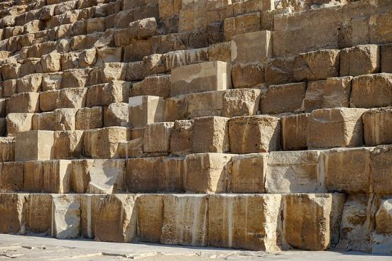
How Was It Built?
Scientists believe they have found out how the huge blocks used to build the pyramid were moved. A ramp, cut into the ground, has been discovered. It is thought that the blocks were hauled up the ramp using a pulley system. Although this cannot be proven, it is one explanation for how such a building was constructed. It is thought that approximately 20,000 workers built the pyramid.
The ground on which the pyramids were built was made from granite, which was ideal for withstanding the millions of tons of brick and mortar. Here are the estimated weights of the materials used:
The limestone blocks weighed 5.5 million tonnes;
The mortar weighed 500,000 tonnes.
“Giza Pyramid Complex” by Nina R is licensed under CC BY 2.0
The base of the Great Pyramid has an area of 55,000 square metres, which is about the same size as eight football pitches.

Slide 10
Inside the Great Pyramid
Inside the Great Pyramid are mortuary temples in which daily offerings would be made in honour of the king. Below the pyramid is a subterranean chamber. It is thought that the pharaoh was meant to be buried there but there is no evidence to suggest he was.
Within the Great Pyramid are the Queen’s Chamber, Grand Gallery and the King’s Chamber. There was one thing in the King’s Chamber - a broken, granite sarcophagus. It is thought that this is where the pharaoh’s body would have been laid. However, his mummified remains and grave goods were stolen by robbers hundreds of years ago so experts are unsure exactly where he was buried. The Queen’s Chamber was more likely used as a shrine to the pharaoh, with a life-sized statue of him on display.
Did You Know…?
A sarcophagus is a stone coffin in which the body of a deceased person would be wrapped and laid inside.
This is an example of an Egyptian sarcophagus.

Slide 11
Inside the Great Pyramid
There are many corridors and passages within the Great Pyramid with numerous doors leading to other chambers and small rooms. This means that, despite its huge size, there is not much space. The passages are slightly less than a metre wide and only 1.2 metres high.
This is a photo taken from inside the Grand Gallery. It is nearly 9 metres high and 47 metres long.
“Looking upwards, along the Grand Gallery, inside the Great Pyramid 1984” by Mike McBey is licensed under CC BY 2.0
Try It!
Use the Internet to find a virtual, 360° tour through the Great Pyramid of Giza.

Slide 12
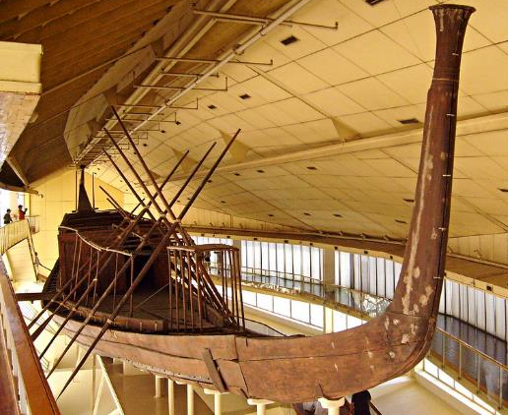
Beside the Great Pyramid
In 1954, a wooden boat was discovered buried beside the Great Pyramid. It was nearly 5000 years old and 44 metres long. The space was airtight so the wood was well preserved and strong.
The boat had been taken apart and buried in pieces. It took two years to remove all the pieces from the pit and ten years to reassemble the boat. It had no sail or mast but it did have oars.
At the time when boats like this were used by the Egyptians, all the pieces of these vessels were tied together with rope. No nails or metal were used. This was so that boats could be dismantled and carried over land. They would then be rebuilt to cross water.
“Solar Ship” by zolakoma is licensed under CC BY 2.0
The actual purpose of the boat remains a mystery but some historians believe it was a funeral boat, which Egyptians believed were needed to carry the dead to the afterlife. It is now on display at a museum in Cairo.

Slide 13
An Amazing Structure
The Great Pyramid of Giza is an amazing structure. It is surrounded by cemeteries where royals and nobles were buried, as well as other pyramids built for other pharaohs that ruled the wealthy and powerful nation of Egypt.
The precision involved in building the three pyramids at Giza suggests that the Egyptians were mathematical and engineering experts. For such an enormous structure to still be standing over 4500 years after it was built, truly makes it a wonder of the ancient world.
“Pyramids of Giza” by Vincent Brown is licensed under CC BY 2.0

